Slide 1

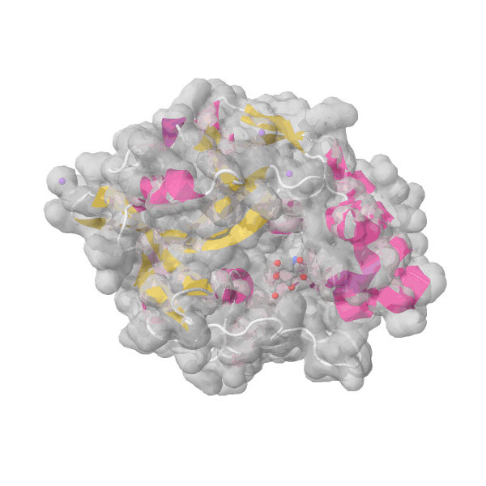

Spatially-aware detection of binding sites with protein language models
David Hoksza
Department of Software Engineering
Faculty of Mathematics and Physics
Charles University

Slide 2
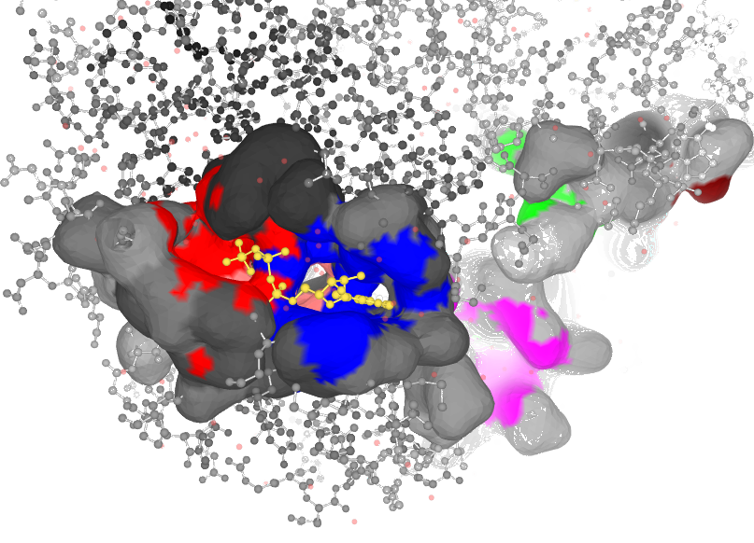
Protein-ligand binding sites

Slide 3
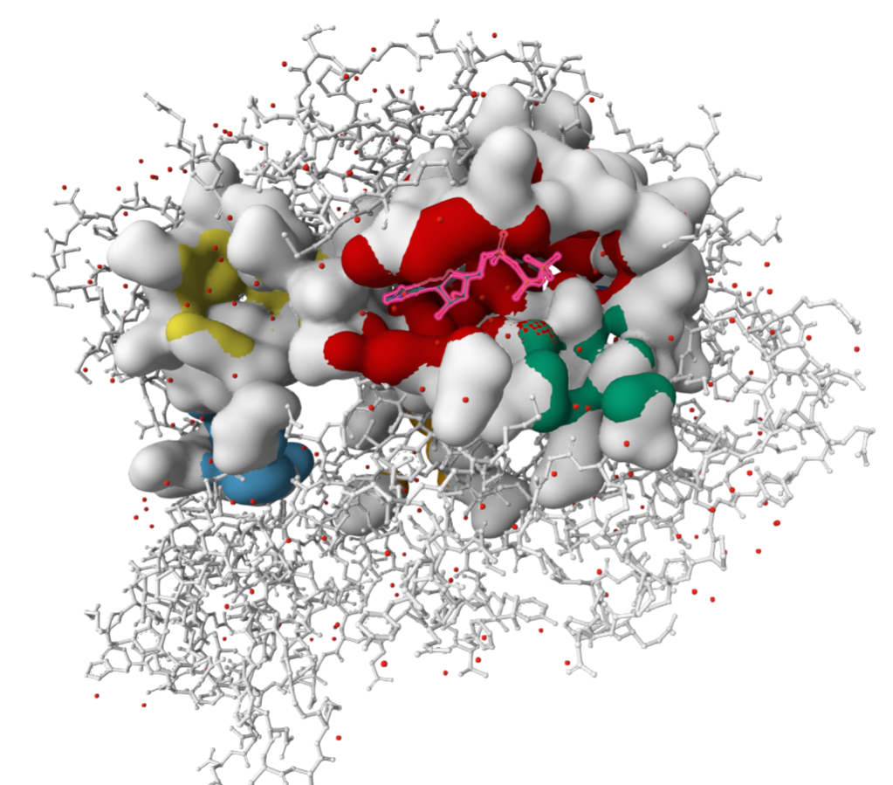
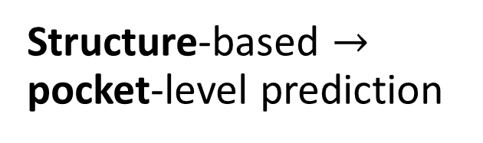
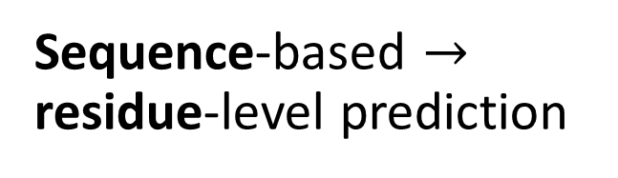
De novo binding site/residue prediction
Structure-based $→$ pocket-level prediction
Sequence-based $→$ residue-level prediction
….FPWFGMDIGGTLVKLSYFEPIDITAEEEQEEVES….
docking, ligand generation, drug repurposing, function discovery, protein engineering, variant interpretation, …
variant effect prediction, function discovery, feature annotation, …
Notes:
asymmetry is that most of these are annotation and prioritization, whereas the site-level list is dominated by design and simulation. Sequence-level residue prediction tells you where to look; site-level prediction gives you something to compute with.

Slide 4
Pocket-level prediction

Slide 5
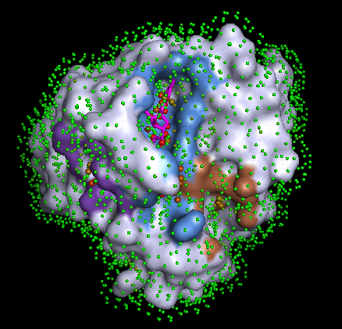
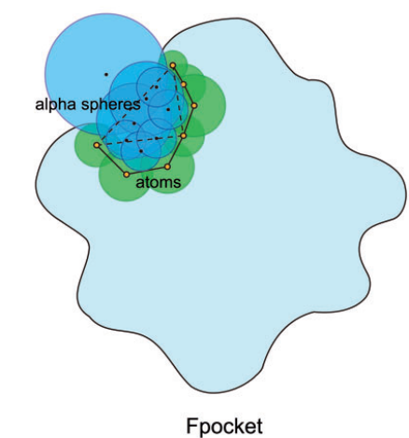
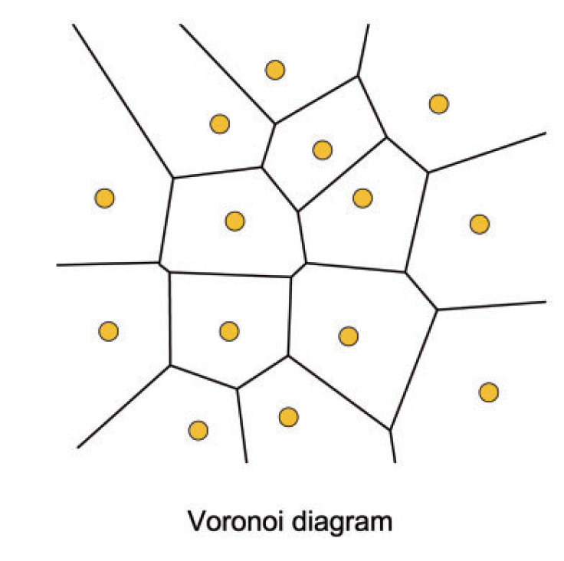
Fpocket
P2Rank
Notes:
A sphere is uniquely determined by four points that are not coplanar
using alpha spheres, a geometric feature of a protein’s Voronoi diagram, to map out concave interaction space at the surface of a protein - https://pubs.acs.org/doi/pdf/10.1021/acs.jcim.5b00103
Alpha sphere radii reflect the local curvature defined by the four atoms: 4 atoms in a plane would correspond to an alpha sphere of infinite radius, and conversely, 4 atoms packed at the apex
of a tetrahedron would lead to a value of radius close to that of the Van der Waals radius. For a protein, very small spheres are located within the protein, large spheres at the exterior, and clefts and cavities correspond to spheres of intermediate radii
In practice, alpha sphere identification can be related to Voronoi decomposition of space: the centre of alpha spheres correspond to Voronoi vertices – points at which Voronoi regions intersect.
Fpocket uses alpha spheres with different radii to represent different roughness of the protein surface. The pockets can be identified by clustering the alpha spheres with proper radii

Slide 6
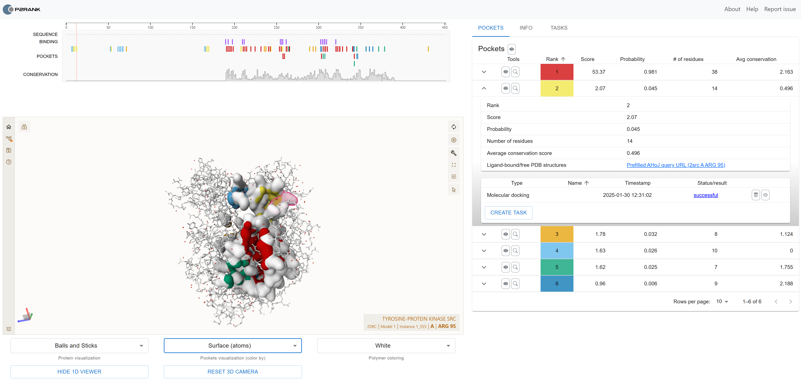
  https://prankweb.cz

Slide 7
From Residues to Predictions
Protein sequence
ESM-2 transformer
Embedding per residue
Structure
Function
M
K
V
L
A
Mutation effect
PRETRAINING — mask one residue, predict it from context
M
K
V
?
A
G
T
L
0.62
I
0.21
V
0.09

Slide 8
Residue-level prediction
Notes:
One can obviously take the predicted pockets and residues which are part of the pocket are labeled as binding residues. However, the advantage of residue-level prediction is that one does not really need the 3D structure

Slide 9
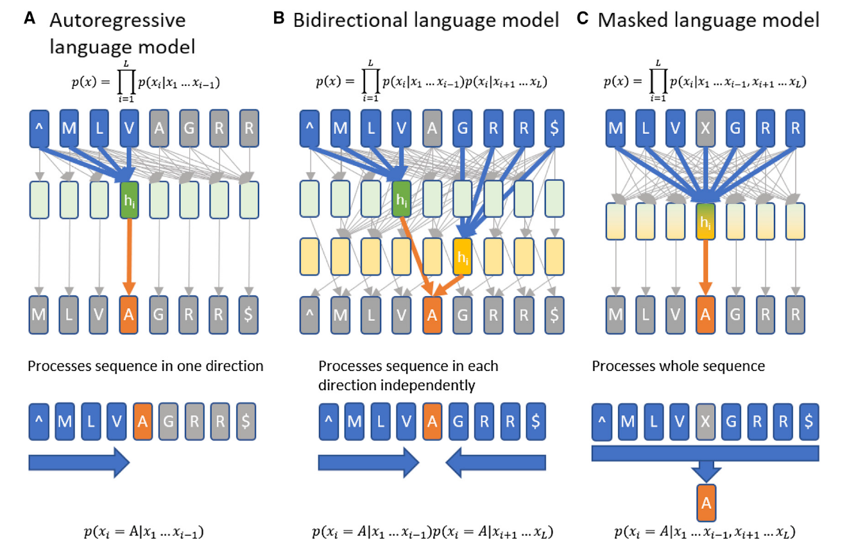
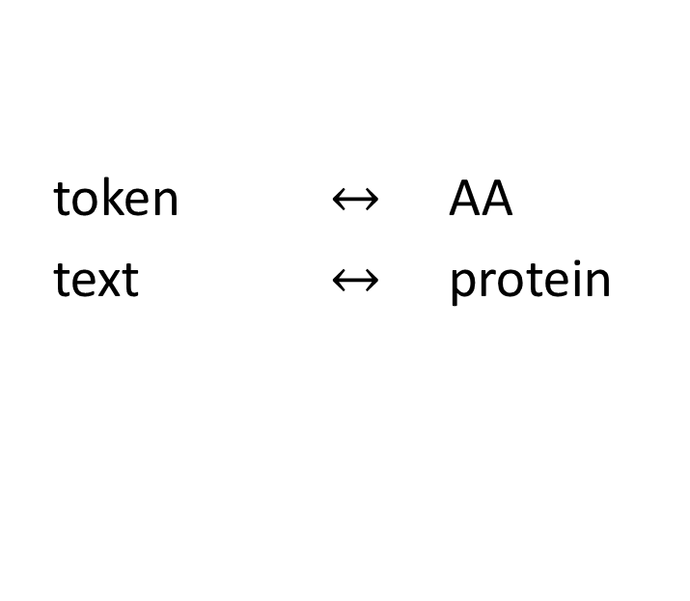
Protein Language Models
token $↔$ AA
text $↔$ protein

Slide 10
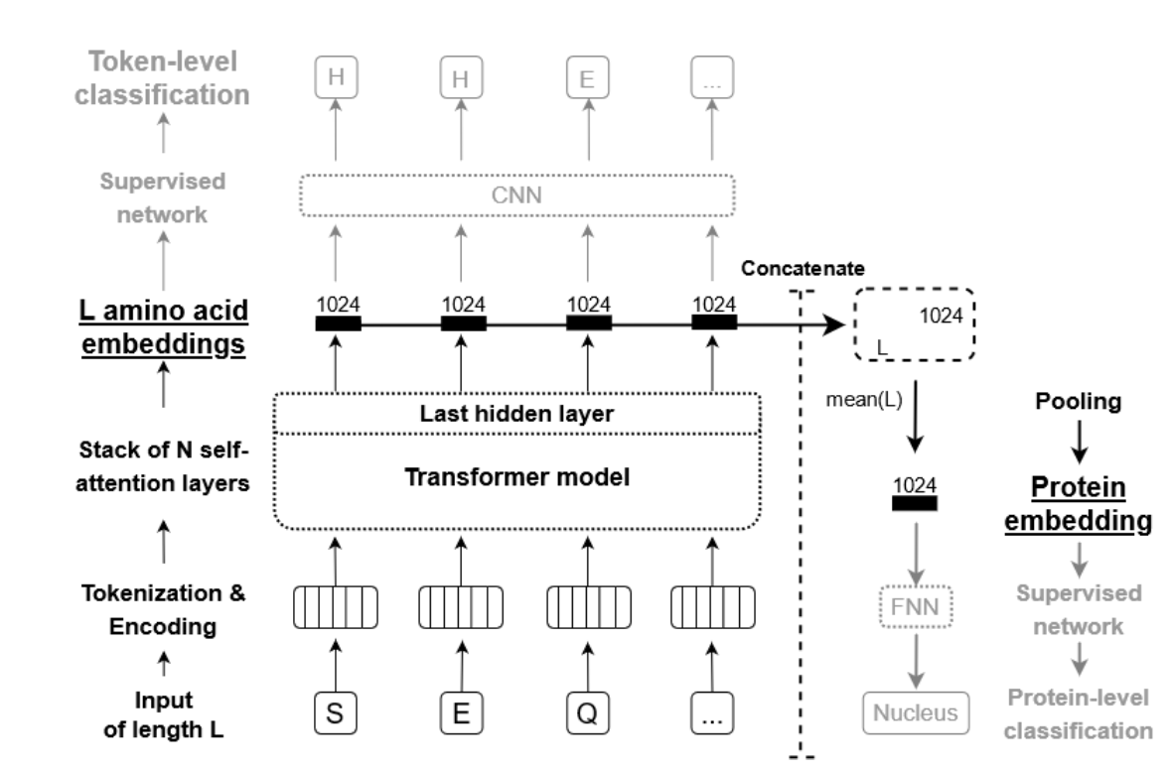
Transfer learning with PLMs
residue-level classification
protein-level classification
adapted from: Elnaggar, Ahmed, et al. "Prottrans: Toward understanding the language of life through self-supervised learning." IEEE transactions on pattern analysis and machine intelligence 44.10 (2021): 7112-7127.

Slide 11
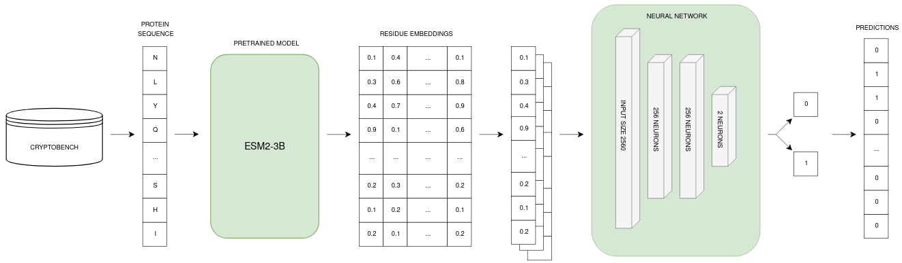
PLM-based binding residue prediction

Slide 12
Benchmarking datasets
LIGYSIS
CRYPTOBENCH
Reference set of protein–ligand binding sites
Biologically relevant ligands only (BioLiP)
Biological assemblies, not asymmetric units
Interactions aggregated across all structures of a protein
Redundant interfaces removed
~30,000 proteins; human subset: 2,775 chains, 6,882 sites
Benchmark dataset of cryptic binding sites
Apo (ligand-free)–holo (ligand-bound) pairs
Predefined train/test and 4-fold splits, clustered to avoid leakage
1107 apo structures, 1361 cryptic pockets

Slide 13
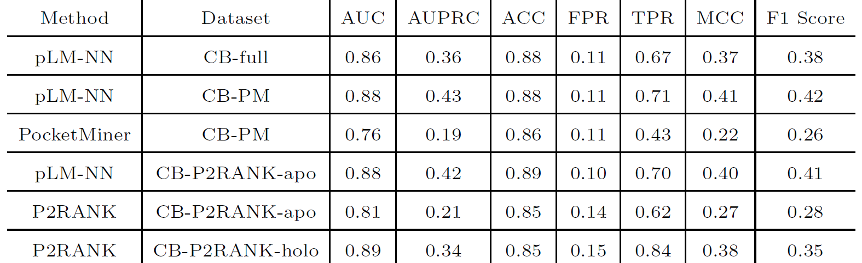
Notes:
Not fair to p2rank, since hyperparameters optimized for pocket-level prediction

Slide 14
PLM-based binding pocket prediction
Residue-level prediction
(fine-tuning)
Smoothing
Clustering
Structure selection
Seq2Pocket
Škrhák, V., Polák, L., Novotný, M., & Hoksza, D. (2026). Seq2Pocket: Augmenting protein language models for spatially consistent binding site prediction. bioRxiv, 2026-01.

Slide 15
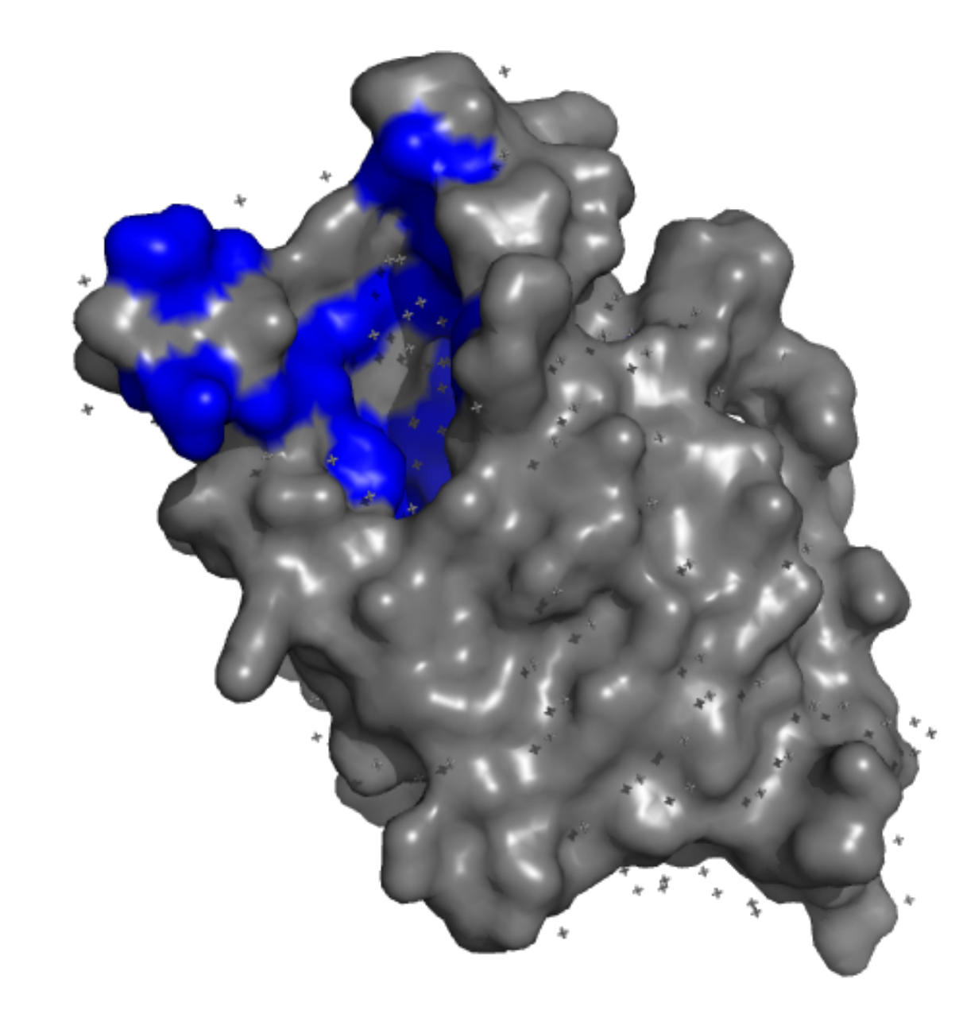
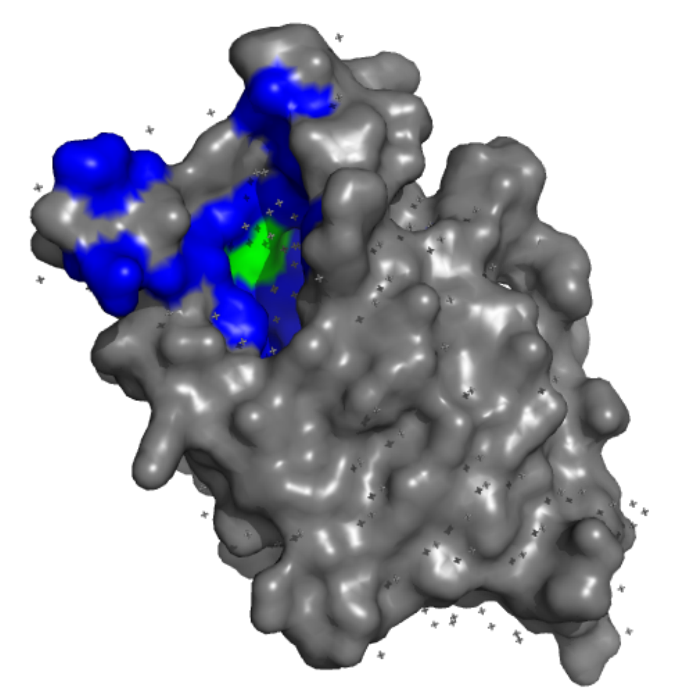
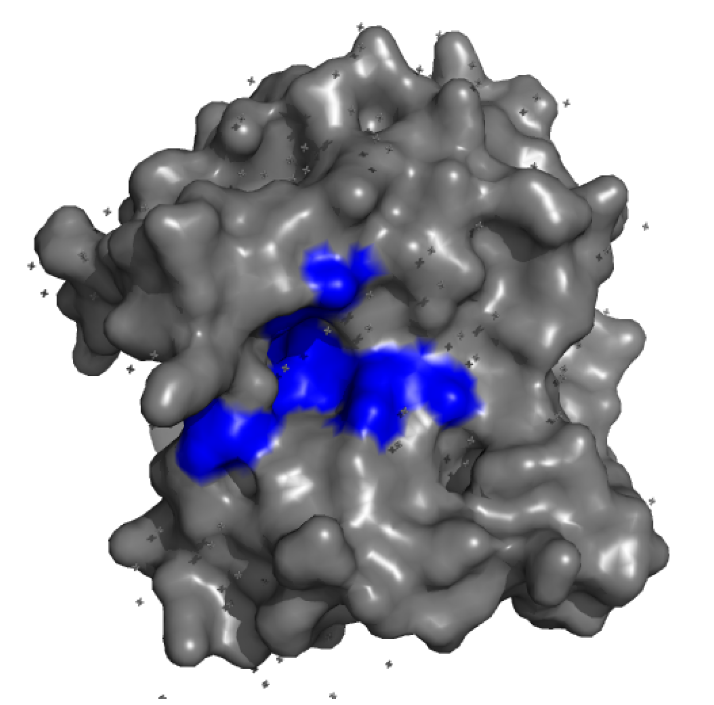
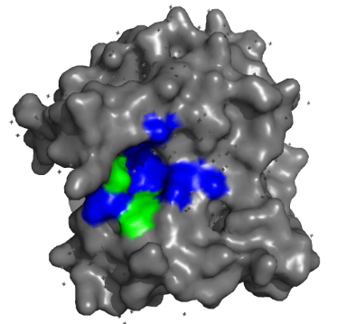
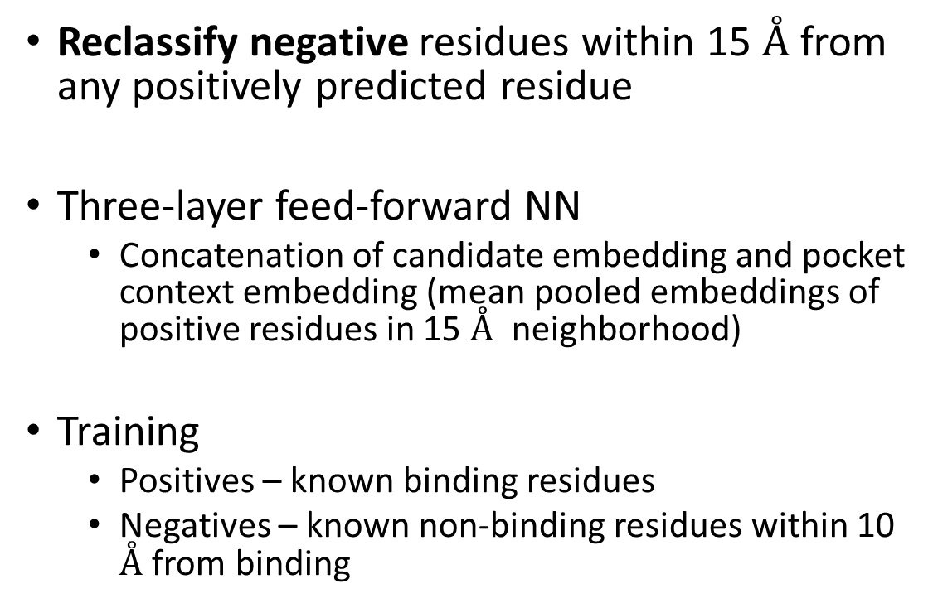
Smoothing
Reclassify negative residues within 15 $Å$ from any positively predicted residue
Three-layer feed-forward NN
  Concatenation of candidate embedding and pocket context embedding (mean pooled embeddings of positive residues in 15 $Å$ neighborhood)
Training
  Positives – known binding residues
  Negatives – known non-binding residues within 10 $Å$ from binding
PDB: 6ISU_A
PDB: 5YQP_A
Notes:
We introduce a binary classifier designed to decide whethera candidate residue should be incorporated into a predictedbinding pocket. The purpose is to recover residues that aremissed in the initial residue-level prediction.
The classifier is implemented as a three-layer feed- forwardneural network. It consists of two hidden layers with 2048neurons each, followed by a single-neuron output layer witha sigmoid activation for binary classification. Training is carriedout for 19 epochs using a batch size of 512 and a dropout rate of0.5. We optimize the model using binary cross- entropy loss withthe AdamW optimizer and L2 regularization. Class weighting is applied to counter the imbalance between positive and negativeexamples. Hyperparameters are selected based on validationexperiments on one of the training subsets, optimizing the areaunder the precision–recall curve (AUPRC).

Slide 16
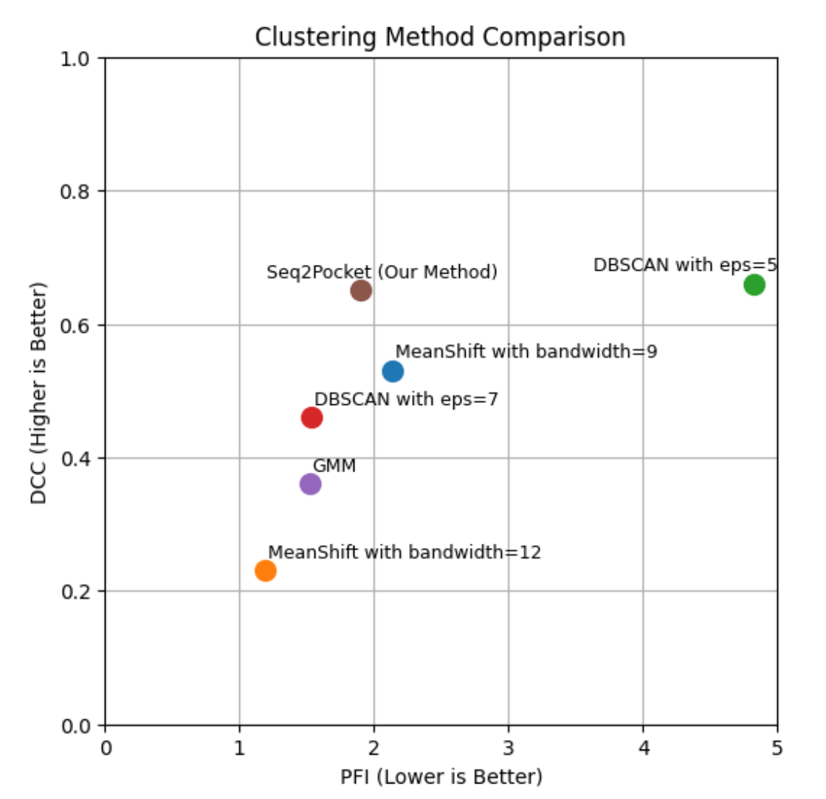
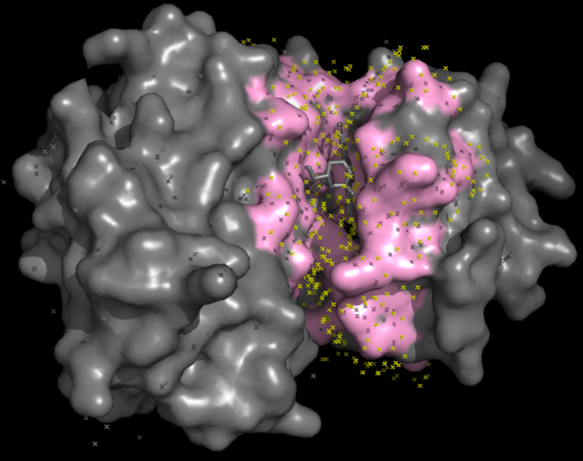
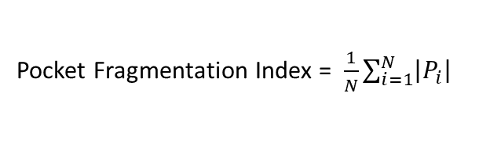
Clustering
SAS points for binding residue atoms
MeanShift clustering
Pocket Fragmentation Index = $\frac{1}{N}\sum_{i=1}^{N}{\left|P_{i}\right|}$
PDB: 1BYG_A
Notes:
Two complementary measures
Pocket Fragmentation Index (PFI), which measures the average number of predicted clusters assigned to each groundtruth Pocket
After residue-level prediction and smoothing, predicted binding residues are grouped into discrete three-dimensional regions using a surface-based clustering procedure. For each atom belonging to a predicted binding residue, we generate solventaccessible surface (SAS) points using the Shrake–Rupley algorithm [46], with a probe radius of 1.6 ˚A and a point density of 50. We employ a modified implementation from the Biopython library [10]. The resulting SAS point cloud is then
clustered into candidate binding pockets using the Mean Shift algorithm [7] with a bandwidth of 9 ˚A (see Supplementary section 3: hyperparameter tuning).

Slide 17
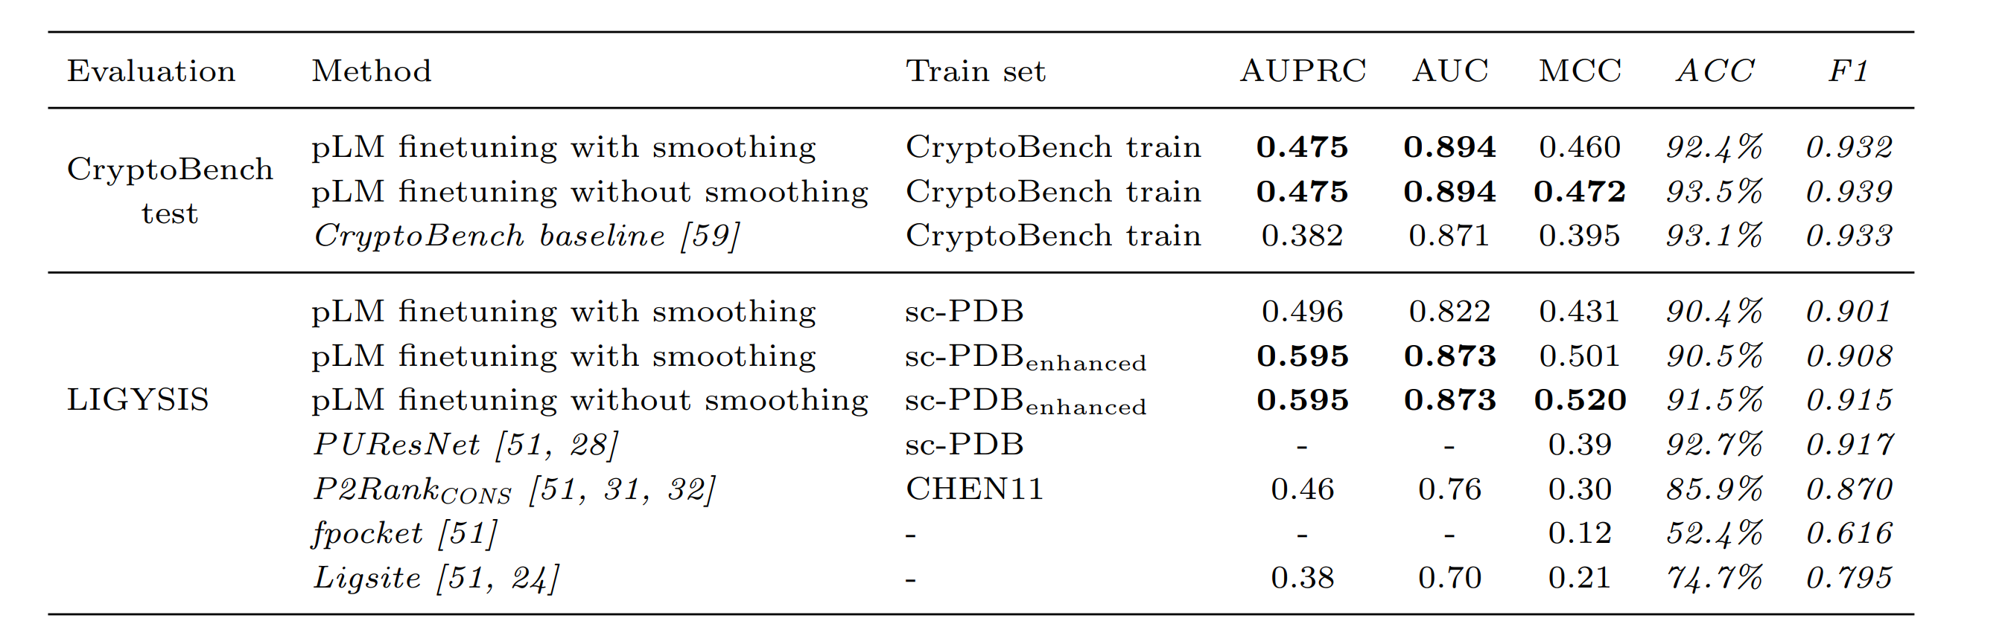
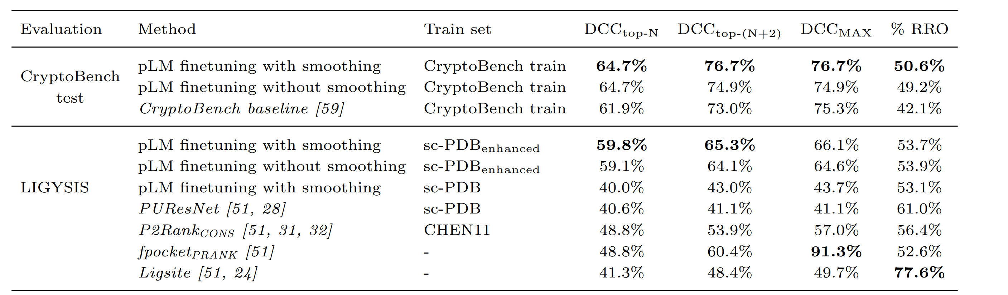
Seq2Pocket – (C)BS prediction performance
Residue-level
Pocket-level

Slide 18





Acknowledgements

Slide 19

Questions

Slide 20
Improving over PLM baseline
Method | AUC | MCC | AUPRC | ACC
transfer learning | 0.871 | 0.395 | 0.382 | 93.12%
Škrhák, V., Gamouh, H., & Hoksza, D. (2025, October). Hidden in protein sequences: Predicting cryptic binding sites. In Proceedings of the 16th ACM International Conference on Bioinformatics, Computational Biology, and Health Informatics (pp. 1-6).
Notes:
we took sequences from cryptobench and used a simple transfer learning approach to prove the usefulness of the dataset
we extracted embeddings from a pLM ESM2 3b version, used these embeddings as an input for each residue and performed a binary classification where 1 denotes residues being a part of cryptic binding site and 0 denoting the opposite
let me point out that the dataset is highly imbalance (95% residues negative) therefore traditional metrics as ACC might be misleading. Therefore, we mainly focus on AUC, MCC and AUPRC, and report ACC only to complete the picture

Slide 21
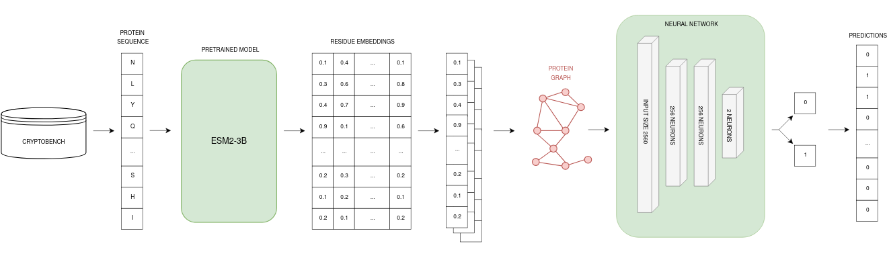
Improving over PLM baseline - GAT
Method | AUC | MCC | AUPRC | ACC
transfer learning | 0.871 | 0.395 | 0.382 | 93.12%
GAT | 0.872 | 0.390 | 0.374 | 93.25%
Notes:
first idea was to leverage the structure information, that was done using the graph neural network
the idea is that you create graph - adding the edge when the aas are close to each other - and in the training stage, you pass the information from the node to its neighbor nodes and combine the information using some weight
however using this approach did not improve the results

Slide 22
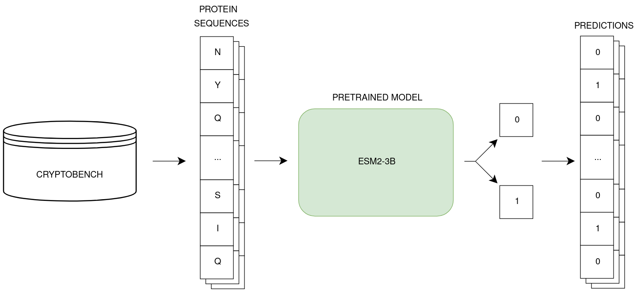
Improving over PLM baseline - finetuning
Method | AUC | MCC | AUPRC | ACC
transfer learning | 0.871 | 0.395 | 0.382 | 93.12%
GAT | 0.872 | 0.390 | 0.374 | 93.25%
e2e finetuning | 0.888 | 0.448 | 0.446 | 92.82%
Notes:
we turned back to the pure sequence based approaches
we took the ESM2 protein language model and used a end-to-end finetuning strategy on the CBS prediction task, where we used the data from CryptoBench
specifically we removed the last layer of the pLM ESM2 and appended a new binary layer. We then trained the whole model on CryptoBench
This improved the performance across majority of metrics

Slide 23
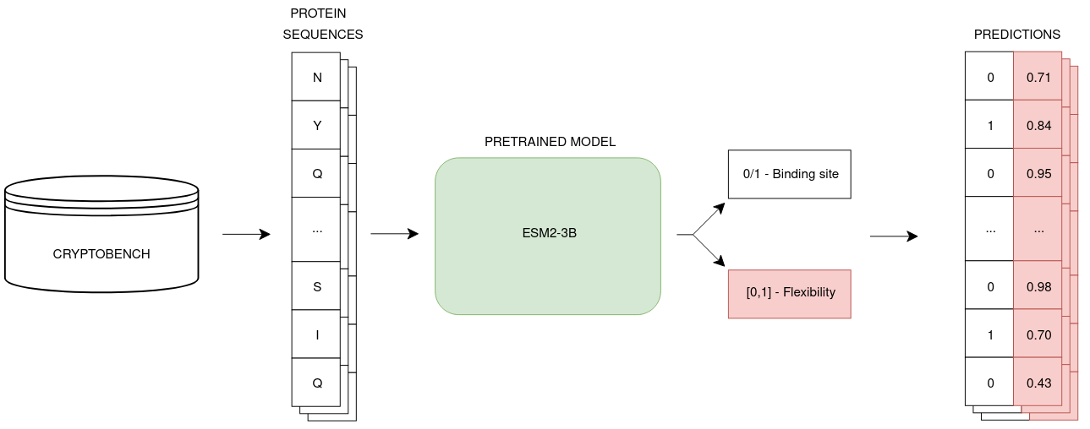
Improving over PLM baseline - multitask learning
Method | AUC | MCC | AUPRC | ACC
transfer learning | 0.871 | 0.395 | 0.382 | 93.12%
e2e finetuning | 0.888 | 0.448 | 0.446 | 92.82%
+ multitask | 0.889 | 0.446 | 0.440 | 92.66%
Notes:
How to further improve the prediction?
Train on similar tasks (multitask learning)
Train on similar data
Input more features
We hypothetized that due to the flexible nature of CBSs, the prediction of protein flexibility is a task interconnected to predicting CBS
Where available, we used the residue apo-holo distance as a estimator of flexibility and incorporated the error on estimating flexibility into the final loss function
this approach slightly improved the prediction, although not radical improvement

Slide 24
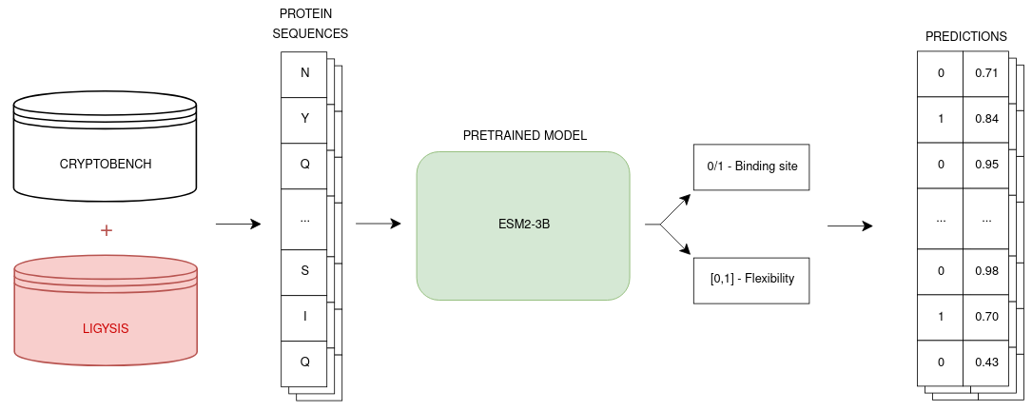
Improving over PLM baseline – similar data training
Method | AUC | MCC | AUPRC | ACC
transfer learning | 0.871 | 0.395 | 0.382 | 93.12%
e2e finetuning + multitask | 0.889 | 0.446 | 0.440 | 92.66%
+ data | 0.894 | 0.472 | 0.475 | 93.57%
Notes:
Another hypothesis was that not only we can improve the performance by utilizing multitask learning, but also by using data, which is underlyingly similar to the CBS
therefore we used another dataset of GENERAL binding sites to pre-train the protein language model and only after this pretraining, we applied the CryptoBench dataset.
This approach increased the performance of the model significantly

Slide 25
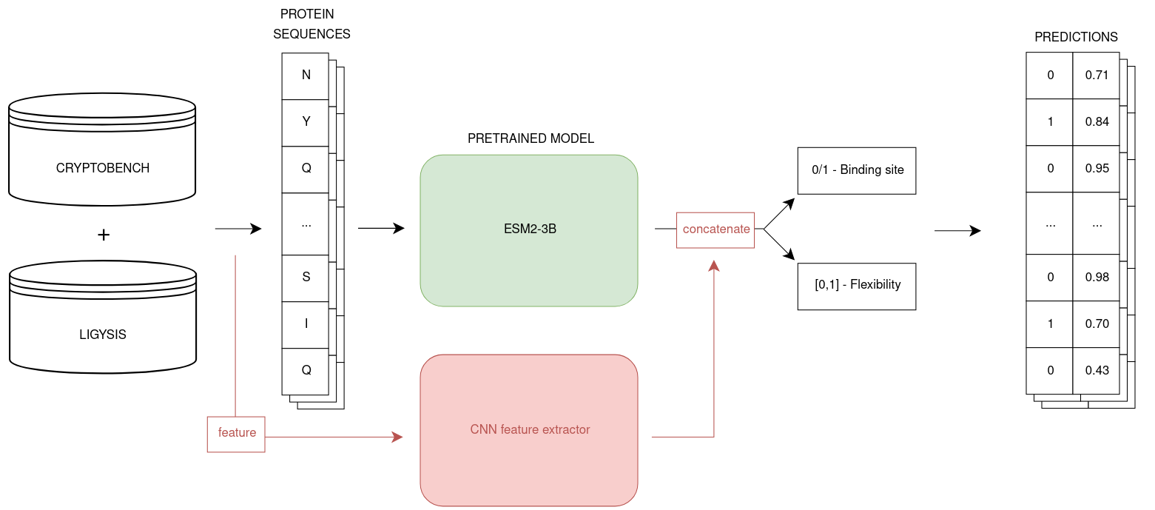
Improving over PLM baseline - CNN feature extractor
Method | AUC | MCC | AUPRC | ACC
e2e finetuning + multitask + data | 0.894 | 0.472 | 0.475 | 93.57%
+ CNN feature extractor | 0.886 | 0.455 | 0.456 | 92.71%
Notes:
To integrate additional features into the pLM-based model, we employed one-dimensional convolutional layers to process the flexibility vectors. This approach, previously shown effective in similar contexts [15], allows the model to extract local patterns from the input features. The output of the convolutional feature extractor was concatenated with the output of the finetuned pLM, and the combined representation was used for prediction. Specifically, the convolutional feature extractor consisted of
three layers, each with a kernel size of 15 and 128 output channels. The resulting 128-dimensional feature vector was appended to the pLM output, using the same model configuration described in section 3.3.2. Since apo–holo distances are not available at inference time, reflecting the real-world scenario where only the apo structure is known, we used pLDDT values as a representative for residue flexibility.
lastly we wondered how additional features can be incorporated into protein language model.
we came up with an approach where the vector of features of a particular protein is processed by a stack of convolutional layers
its input is then concatenated with the input of the ESM2 model
Suprisingly, this approach led to a performance drop

Slide 26
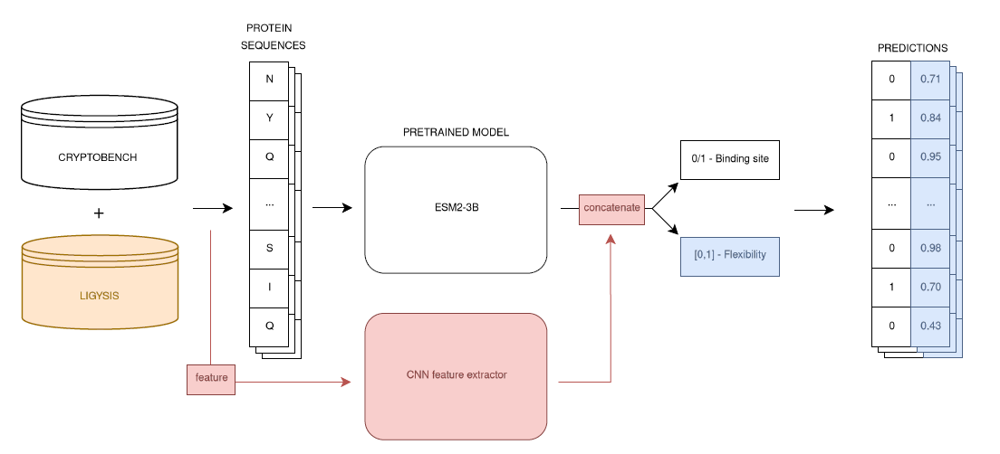
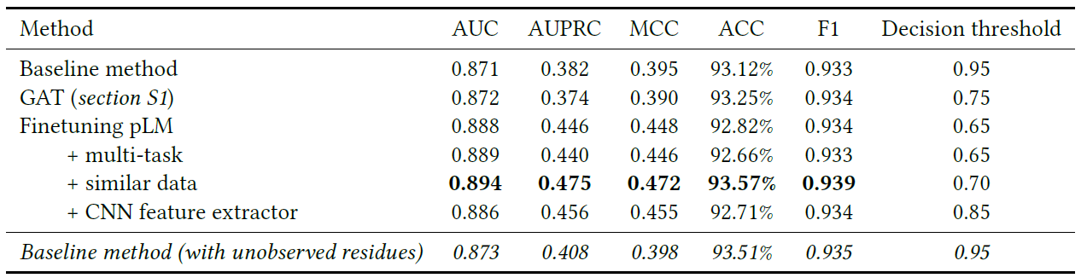
Improving PLM
Notes:
Multi-task learning. Training a model on multiple related tasks has been shown to yield competitive or even state-of-theart results in fields such as natural language processing [12], and computer vision [20]. We hypothesized that jointly finetuning the model on a task closely related to CBS prediction could improve its effectiveness. Since cryptic binding sites are closely associated with residue flexibility, as conformational changes are required for successful ligand binding, we selected residue-level flexibility prediction as an auxiliary task. Therefore, the model was trained to perform both binary classification of CBS and regression of residue flexibility. By jointly training the model to predict both CBS residues and residue-level flexibility, we aimed to improve its awareness of protein dynamics and enhance its ability to detect cryptic binding sites.
We applied hard parameter sharing [23], where the majority of the model parameters are shared across tasks, and only the final layer is task-specific. The hyperparameter configuration followed the setup described in subsection 3.2, with the only modification being the addition of two output neurons in the final layer to support the regression task for residue flexibility (denoted by blue color in Figure 1) - one for the prediction of pLDDT, the other for prediction of apo-holo distance. The overall loss function was defined as the sum of the binary cross-entropy loss for CBS classification and the mean squared error losses for flexibility prediction.
3.3.2 Training on similar data. Another hypothesis was related to the enrichment of training data. We theorized that training the model not only on a related task, but also on data with similar characteristics, could further enhance performance on the CBS prediction task. To test this, we incorporated an additional dataset alongside the CBS-specific CryptoBench: the recently introduced LIGYSIS dataset of general protein–ligand complexes (see section 2). The model architecture remained identical to that used in section 3.3.1. However, the finetuning process was divided into two stages:

