Slide 1
The Dark Side of Docking Scores
D. Horvath
Laboratoire de Chemoinformatique, UMR 7140 CNRS/Univ. Strasbourg, FR; dhorvath@unistra.fr

Slide 2
Outline
The Docking/Scoring Problem…
  Ugly things behind the scenes… it’s hard to be rigorous!
What is a docking benchmark worth?
  Sometimes it “works” – but what does that mean?
All models are wrong, but some are useful!

Slide 3
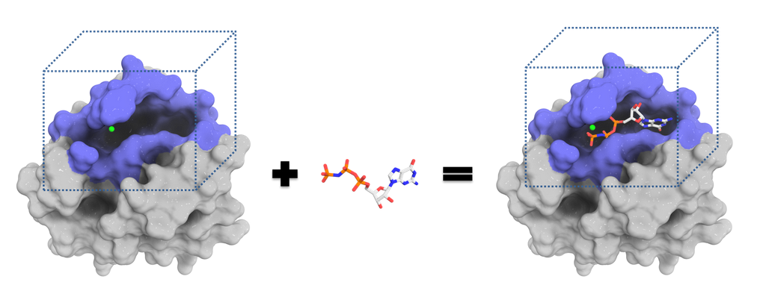
Docking: Computational Prediction of the Binding Mode and Affinity of a Ligand…
https://dockthor.lncc.br/v2/
Needs
  A model of protein-ligand-complex energy in function of geometry
  An Optimizer/Sampler to find energetically favorable geometries
  Some way to infer affinity from the predicted site-ligand interactions

Slide 4
Beware! Docking begins way before the actual “docking” – with the preparation of the protein site, and standardization of ligand structures
If you did not correctly specify the protonation states of your ligand molecules, or you have forgotten to delete the large detergent molecule X-rayed in the protein active site… don’t blame the docking software for your epic failure!

Slide 5
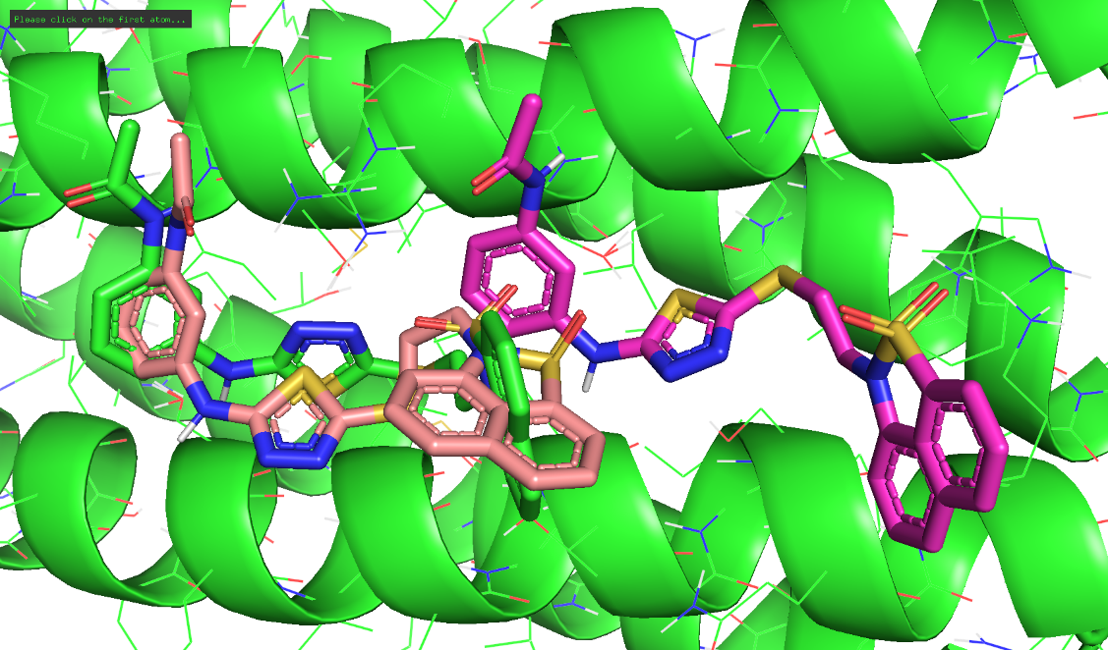
Docking of a Ligand Results in an Ensemble of Poses, which are characterized:
By their Energy E
  More stable poses are a priori more relevant!
Alternatively, by a Contact Fingerprint
  Poses establishing key contacts already seen in strong binders are more relevant!

Slide 6
Nice, but… we are not really interested in the detailed biography of each of these poses!
What docking is all about is predict how active the ligand will be – somehow based on the properties of those poses!

Slide 7


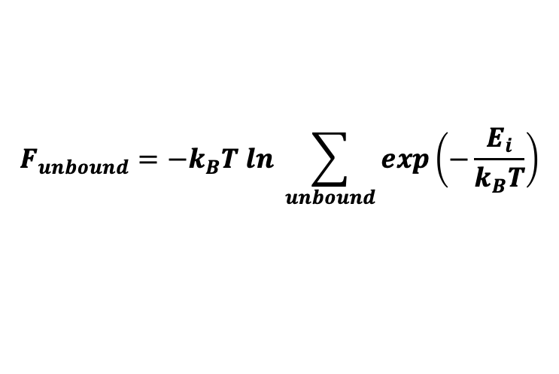
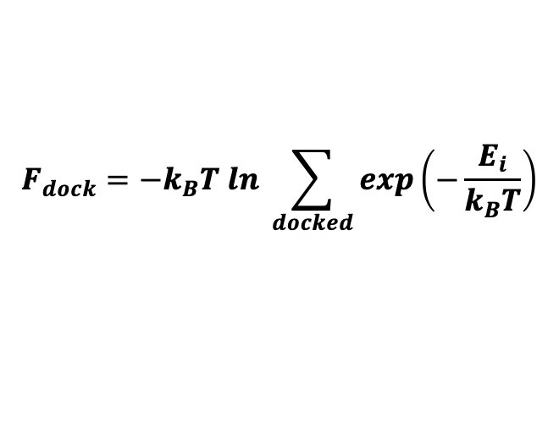
Docking-driven Virtual Screening…
¡Viva la Energia Libre, camaradas!
molecular 2D sketches
Molecular
Database
(filtering)
(3D-BUILDER)
$$F_{dock}=−k_{B}T ln \sum_{docked}{exp\left(−\frac{E_{i}}{k_{B}T}\right)}$$
stable unbound conformers
stable bound conformers
$$F_{unbound}=−k_{B}T ln \sum_{unbound}{exp\left(−\frac{E_{i}}{k_{B}T}\right)}$$
O
O
O
(DOCKING)
O
O
$$∆F=F_{docked}−F_{unbound}$$
Force Field (FF) energy..
?
ΔE

Slide 8
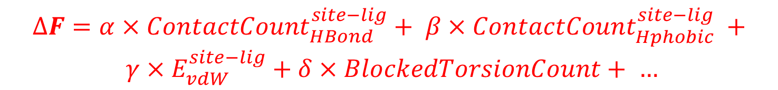
Scoring Functions: The Revenge of Empiricism over Boltzmann’s Ensemble Physics
We can not apply rigorous statistical physics:
  We cannot – at least not without using large-scale computing facilities – enumerate all the relevant states of the Ensemble.
  The inaccuracy of force field energies goes way beyond k_{B}T≈0.6 kcal/mol – so much for exp(-E/k_{B}T)
The state-of-the-art response was to fit a QSPR equation, aiming to predict the binding ΔF from contacts seen in the most stable pose returned by docking, or in crystal structures...
  Such a construct is called a scoring function.
$$∆F=α×{ContactCount}_{HBond}^{site−lig}+ β×{ContactCount}_{Hphobic}^{site−lig} +$$
$$γ×E_{vdW}^{site−lig}+δ×BlockedTorsionCount+ …$$

Slide 9
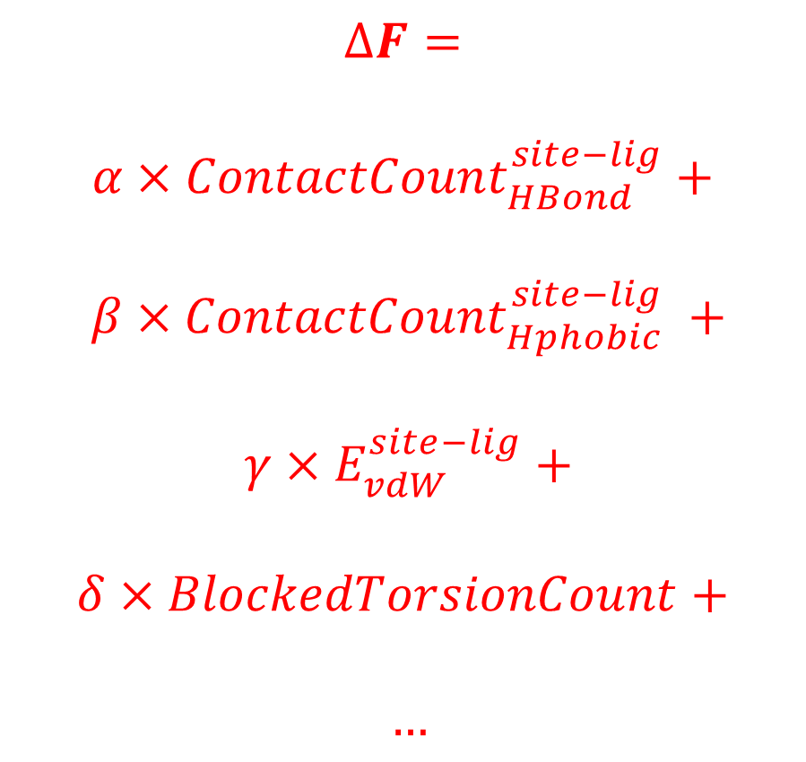
Anatomy of a Scoring Function
$$∆F=$$
$$α×{ContactCount}_{HBond}^{site−lig}+$$
$$β×{ContactCount}_{Hphobic}^{site−lig} +$$
$$γ×E_{vdW}^{site−lig}+$$
$$δ×BlockedTorsionCount+$$
$$…$$
Bonus for specific interactions
Implicit Accounting for Solvent Effects
Scaled-down (γ<<1) FF interaction energy terms
Entropic Penalty Terms
Strain energy in ligand ??
Pason, L. P.; Sotriffer, C. A., Empirical Scoring Functions for Affinity Prediction of Protein-ligand Complexes. Molecular Informatics 2016, 35 (11-12), 541-548

Slide 10
Anatomy of a Scoring Function
This was an example of an « Force Field-based, linear-regression-driven » scoring function, the most typical. Alternatives include:
Knowledge-based potentials
  scoring contacts according to the likelihood to be encountered in experimentally determined site-ligand structures
Non-linear scoring functions produced by advanced machine learning (neural nets, etc).
Contact Fingerprint-based scores
  specifically gratifying site-ligand contacts known to happen in reference ligands, over putative contacts that were not (yet) observed in X-ray structures…
… but all of them are EMPIRICAL!

Slide 11
BUT…
… let’s sit back and think about what all this implies!

Slide 12
1. Type Mismatch Error ?
The Free Energy is the property of an entire conformational space zone, hosting an ensemble of (very) many possible geometries…
  Yet, the scoring function approach claims to predict it based on a single « representative » geometry.
  … not to mention that ΔF calculation also requires a sampling of the ensemble of unbound ligand conformers – almost always ignored in commercial docking tools.

Slide 13
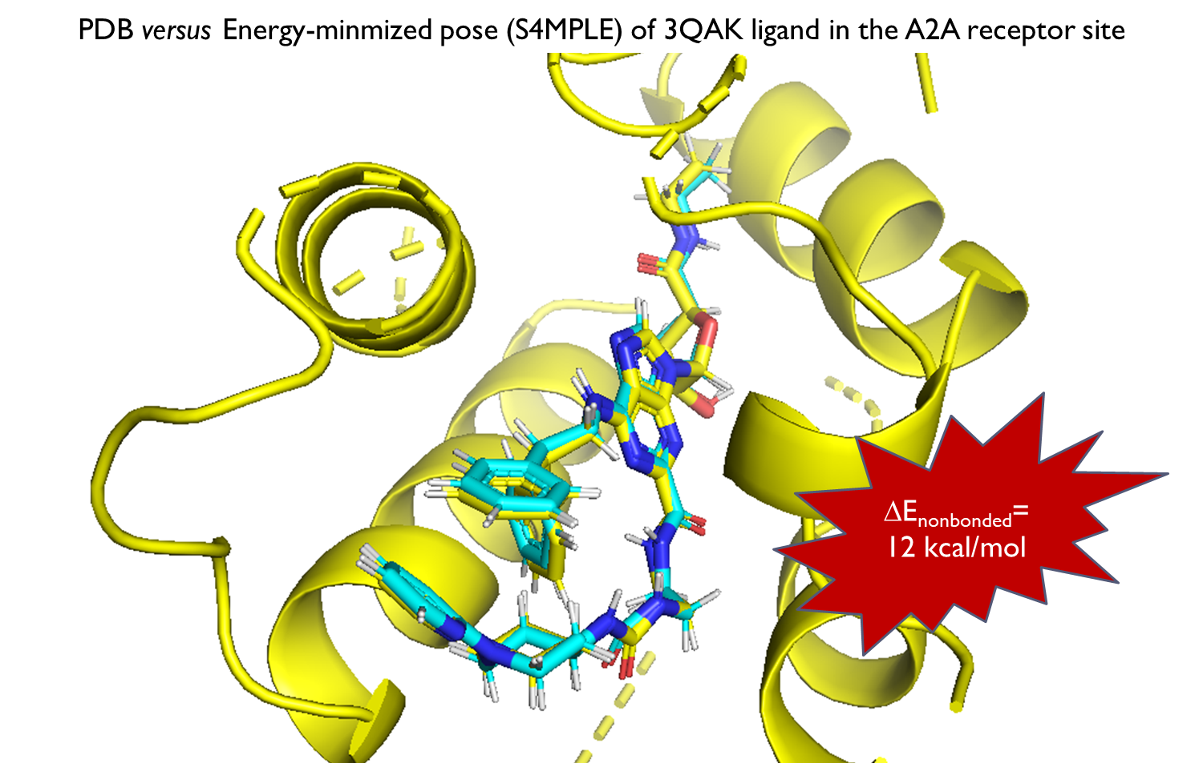
2. Fine, but… which « representative » geometry ?
Any member of the populated ensemble may represent the ensemble?
The geometry of minimal energy?
The geometry of optimal scoring function value?
Docking and rescoring protocols should be fine-tuned to work with each other… yet, in practice, commercial docking tools offer dozens of rescoring schemes.

Slide 14
Outline
The Docking/Scoring Problem…
  Ugly things behind the scenes… it’s hard to be rigorous!
What is a docking benchmark worth?
  Sometimes it “works” – but what does that mean?
All models are wrong, but some are useful!

Slide 15
Two Classes of Docking Benchmarks
Pose Benchmarking (Pbench): is the tool able to predict the X-ray pose of known ligands?
  … starting with the protein site geometry as seen in that actual X-ray structure, in presence of the concerned ligand (“Redocking”)
  … starting with a protein site geometry X-rayed in presence of a different ligand (“Cross-docking”)
Affinity Benchmarking (Abench): dock and score a series of known ligands, then check whether the ranking by docking score of best pose matches actual ranking by affinity
  Subtility: if the best pose is not the native one, one should ignore that ligand in Abench…
  but in practice that pose is in many cases not even known! So what if we get great Abench performance... based on wrong poses?

Slide 16
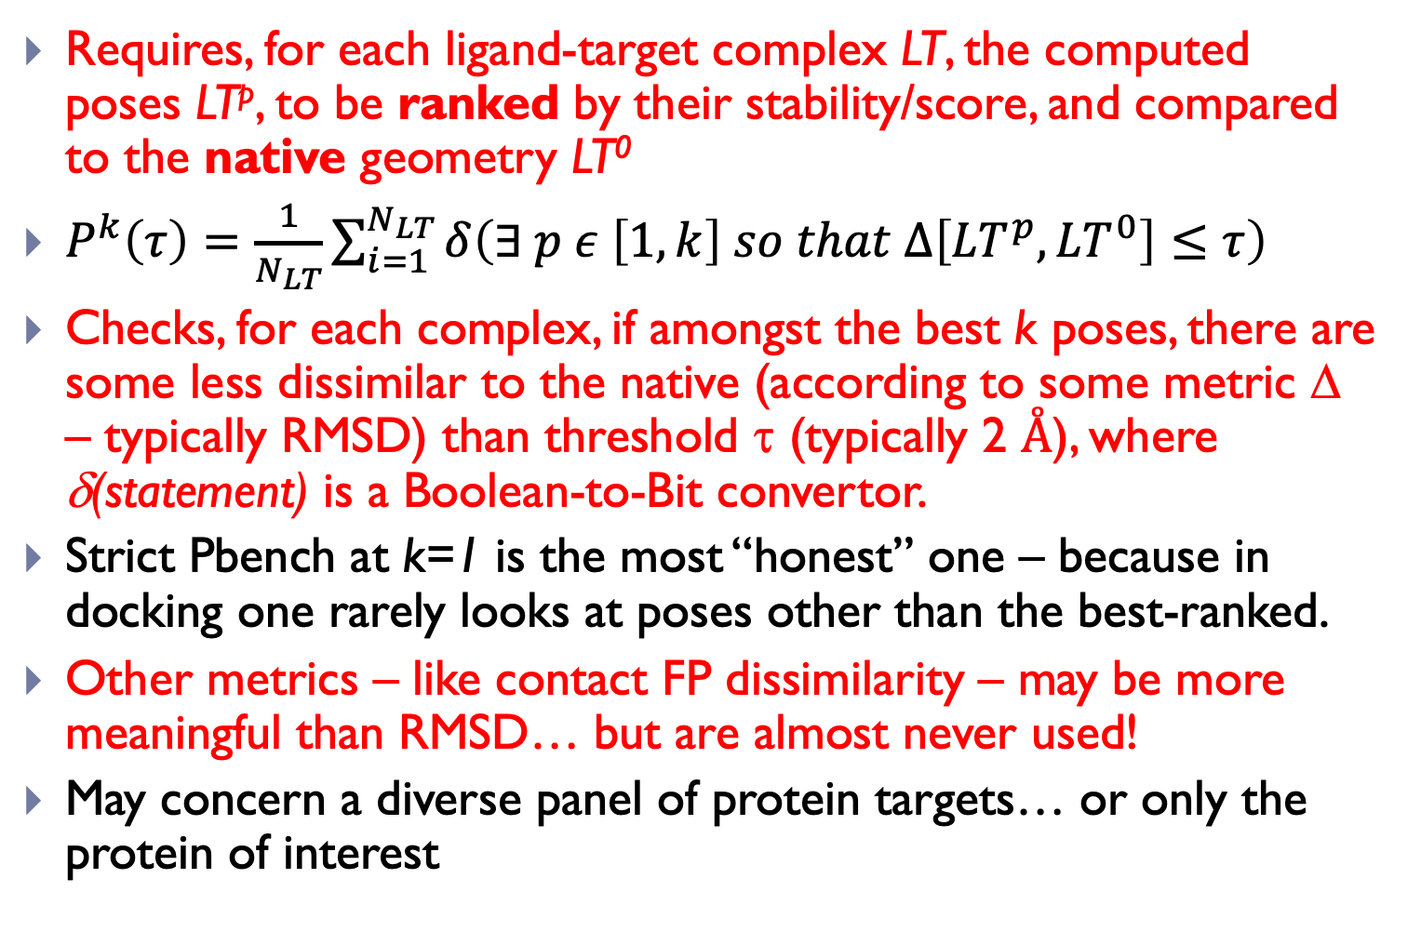
Pose Benchmarking (Pbench) is most popular!
Requires, for each ligand-target complex LT, the computed poses LT^{p}, to be ranked by their stability/score, and compared to the native geometry LT⁰
$P^{k}\left(τ\right)=\frac{1}{N_{LT}}\sum_{i=1}^{N_{LT}}{δ\left(∃ p ε \left[1,k\right] so that ∆\left[{LT}^{p},{LT}^{0}\right]≤τ\right)}$
Checks, for each complex, if amongst the best k poses, there are some less dissimilar to the native (according to some metric Δ – typically RMSD) than threshold τ (typically 2 Å), where δ(statement) is a Boolean-to-Bit convertor.
Strict Pbench at k=1 is the most “honest” one – because in docking one rarely looks at poses other than the best-ranked.
Other metrics – like contact FP dissimilarity – may be more meaningful than RMSD… but are almost never used!
May concern a diverse panel of protein targets… or only the protein of interest

Slide 17
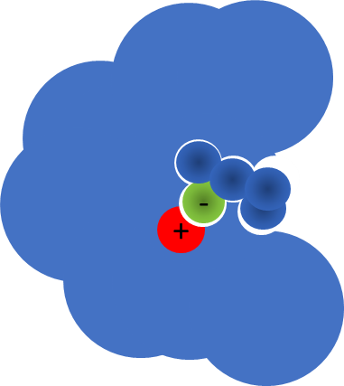
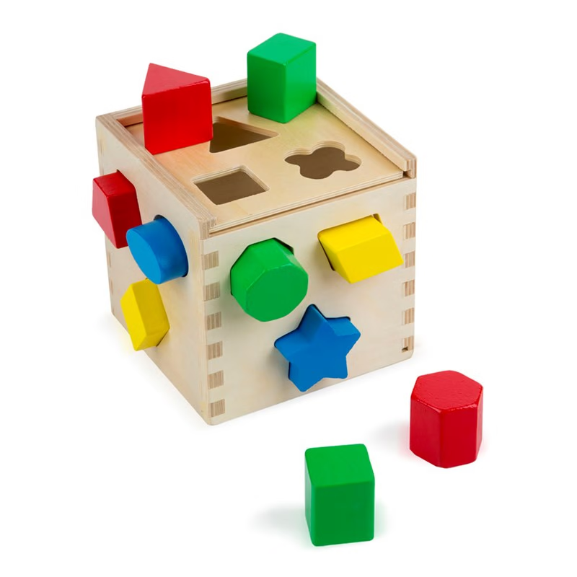
An example, using the Astex Diverse Set of protein-ligand complexes…
Docking works!
  At least when the benchmarking is conciliant! Most docking programs manage to generate some native-like pose within their outputs…
  However… many of those examples are way too obvious (will be correct whatever you do!)
  … while others are too difficult (water-mediated?), so getting them right may only happen by chance!
Docking Tools (Scoring) | Success Rate (%) Top ranked-pose | Success Rate (%) Saved poses
S4MPLE (Core FF) | 76 | 93
S4MPLE (Fit FF) | 85 | 96
GOLD (Goldscore) | 75-81 | Unavailable
FlexX | 71 | 91
Plants (ChemPLP) | 87 | 97
Plants (PLP) | 84
LGA (LargeAll) | 63 | Unavailable
RosettaLig | 58 | 92
SKATE | 87 | 98
Hoffer, L. et. al. S4MPLE-Sampler for Multiple Protein-Ligand Entities: Methodology and Rigid-Site Docking Benchmarking. Molecules, 20 (5), 8997-9028 (2015)

Slide 18
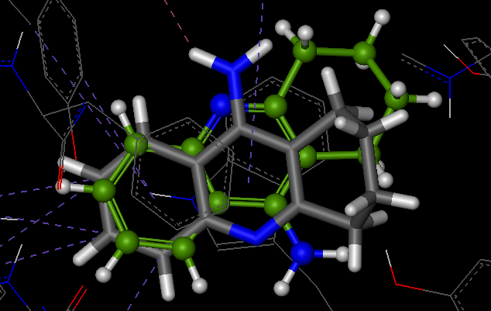
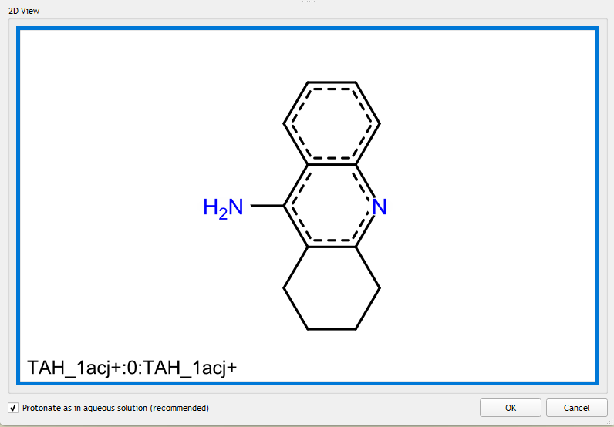
Case Study: Redocking Tacrine into Acetyl Choline Esterase, with LeadIT (BioSolveIT)
Default preparation of the 1ACJ AChE-Tacrine complex, definig the binding site as all aminoacids within 6.5 Å around the experimentally bound Tacrine
Crystallographic waters DELETED…
FAIL!

Slide 19
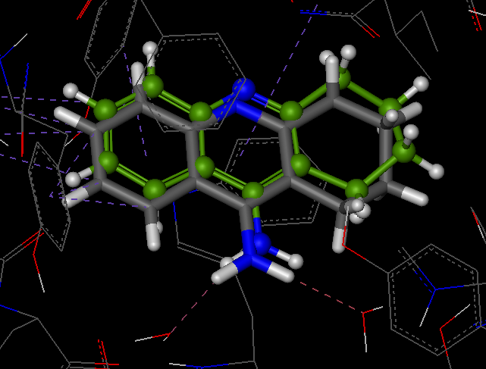
Case Study: Redocking Tacrine into Acetyl Choline Esterase, with LeadIT (BioSolveIT)
SUCCESS!
Default preparation of the 1ACJ AChE-Tacrine complex, definig the binding site as all aminoacids within 6.5 Å around the experimentally bound Tacrine
Crystallographic waters KEPT… (cheating!)

Slide 20
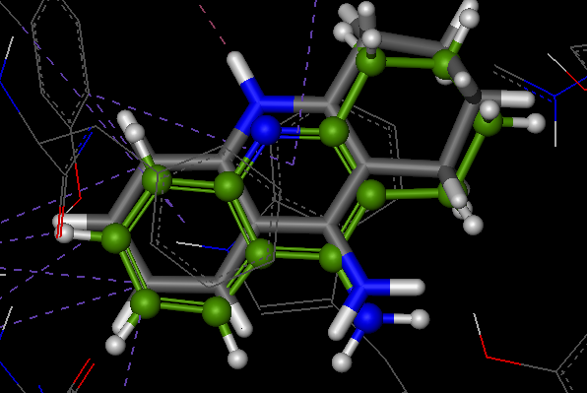
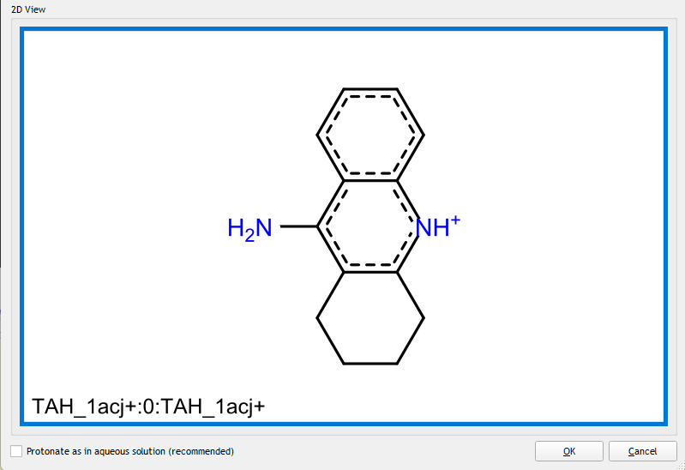
Protonate as LeadIt thinks? Not really…
SUCCESS!

Slide 21
Right for the Wrong Reasons…
Correct protonation with crystallographic waters also leads to the correct docking pose…
However, capturing a single of the two key mechanisms defining the orientation of Tacrine turns out to be « good enough » to pass the benchmark
Sometimes, docking tools are good… and sometimes they are lucky
  Getting the correct protonation state of the ligand in its unbound state is difficult enough – best done by the user at ligand preparation stage…
  But even a perfect acidity constant predictor may fail if protonation states change during the docking!

Slide 22
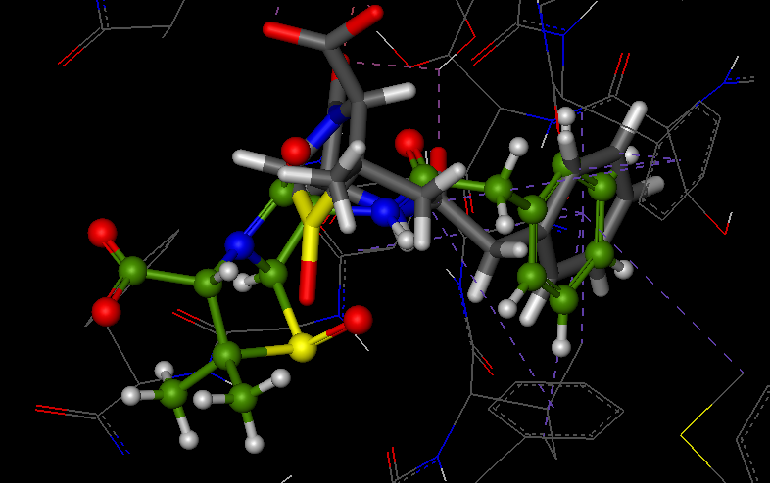
Pose benchmark failure? Maybe not!
Failing to match crystallographic pose within a RMSD of 2 Å (or whichever empirical cutoff) suggests, in most cases, that there is a problem with the docking program…
But not always!
  Pseudo-symmetrical ligands
  Ligands with moieties not involved in any close binding site contacts…

Slide 23
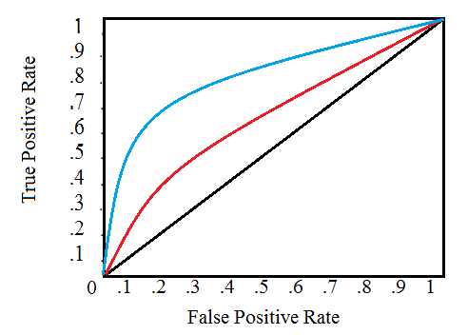
Affinity Benchmarking (Abench):
Good Docking = Nice ROC Curves!
Successful docking should systematically return better affinity values for actual actives, compared to non-binders
(fraction of selected actives)
Ligands sorted by docking score
(fraction of selected inactives)

Slide 24
So – does success in Pose Benchmarking imply success in Affinity Benchmarking, and reciprocally?
NO WAY!

Slide 25
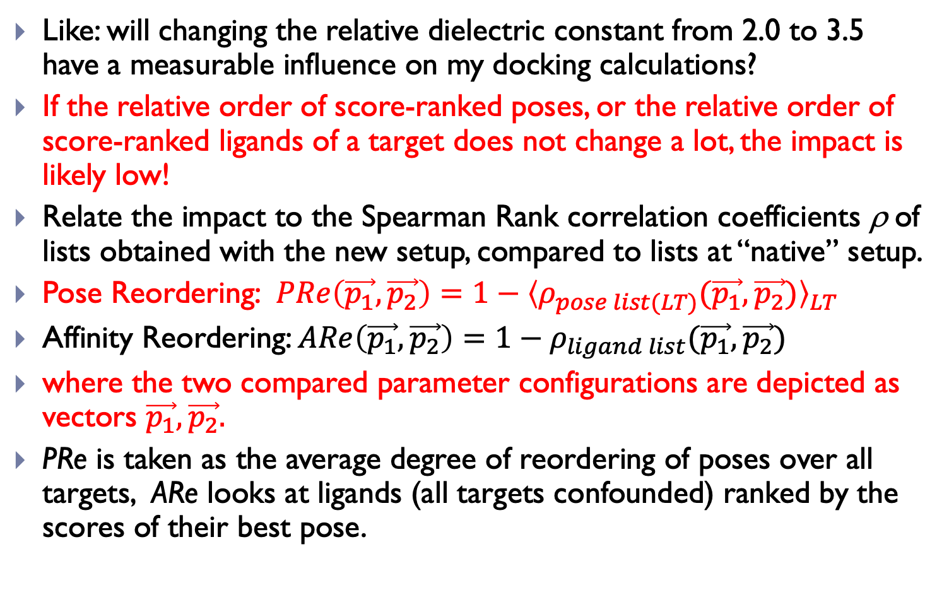
A Simple Question: What is the Impact of Changing an Empirical Parameter Value of my Scoring Function?
Like: will changing the relative dielectric constant from 2.0 to 3.5 have a measurable influence on my docking calculations?
If the relative order of score-ranked poses, or the relative order of score-ranked ligands of a target does not change a lot, the impact is likely low!
Relate the impact to the Spearman Rank correlation coefficients ρ of lists obtained with the new setup, compared to lists at “native” setup.
Pose Reordering: $PRe\left(\vec{p_{1}},\vec{p_{2}}\right)=1−{〈ρ_{pose list(LT)}(\vec{p_{1}},\vec{p_{2}})〉}_{LT}$
Affinity Reordering: $ARe\left(\vec{p_{1}},\vec{p_{2}}\right)=1−ρ_{ligand list}(\vec{p_{1}},\vec{p_{2}})$
where the two compared parameter configurations are depicted as vectors $\vec{p_{1}},\vec{p_{2}}.$
PRe is taken as the average degree of reordering of poses over all targets, ARe looks at ligands (all targets confounded) ranked by the scores of their best pose.

Slide 26
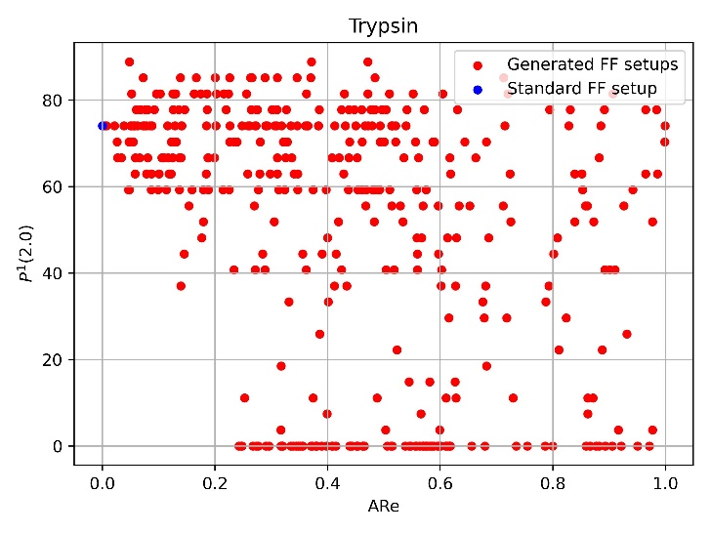
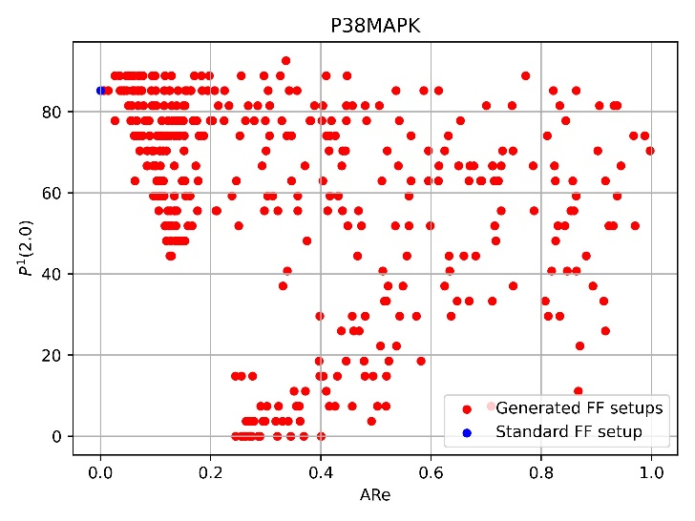
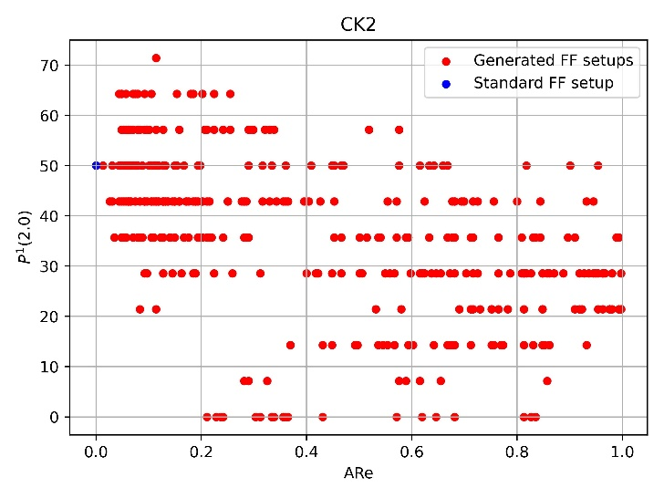
Optimizing Pbench criteria may NOT simultaneously grant maximal Abench success!
A “standard” docking parameter set* for the S4MPLE tool (blue dot) guarantees good Pbench statistics… but many other setups (out of 400 random parameterization schemes) lead to similar or better Pbench success, all while proposing significantly differing ligand rank orders!
* Hoffer, L. et. al. S4MPLE-Sampler for Multiple Protein-Ligand Entities: Methodology and Rigid-Site Docking Benchmarking. Molecules, 20 (5), 8997-9028 (2015)

Slide 27
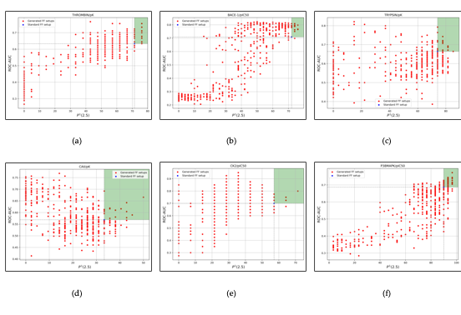
Pbench and Abench success are not strongly correlated – even when looking at ligand series of a same target!
👍 Ok, at least we have some setups that improve both Abench and Pbench with respect to the standard setup!
Thrombin BACE-1 Trypsin
👎👎 However, these setups are hardly shared, but rather specific to each target!!
CAII. CK2 P38MAPK

Slide 28
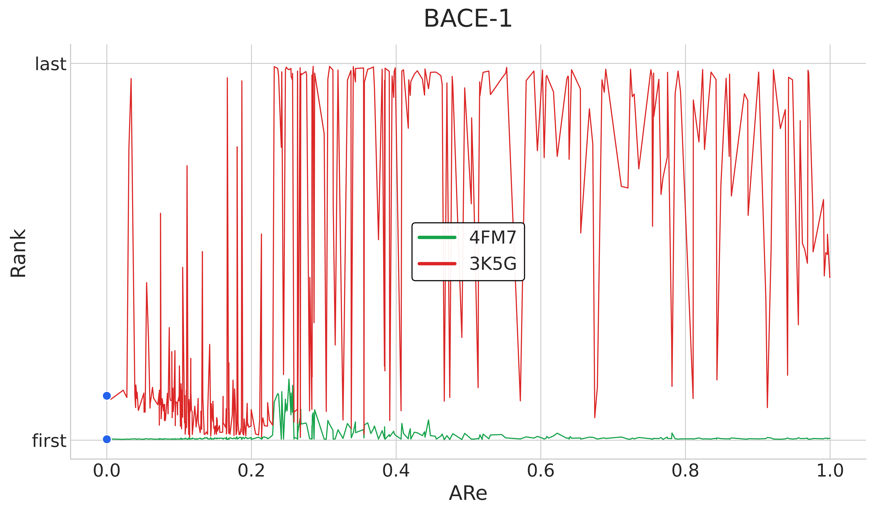
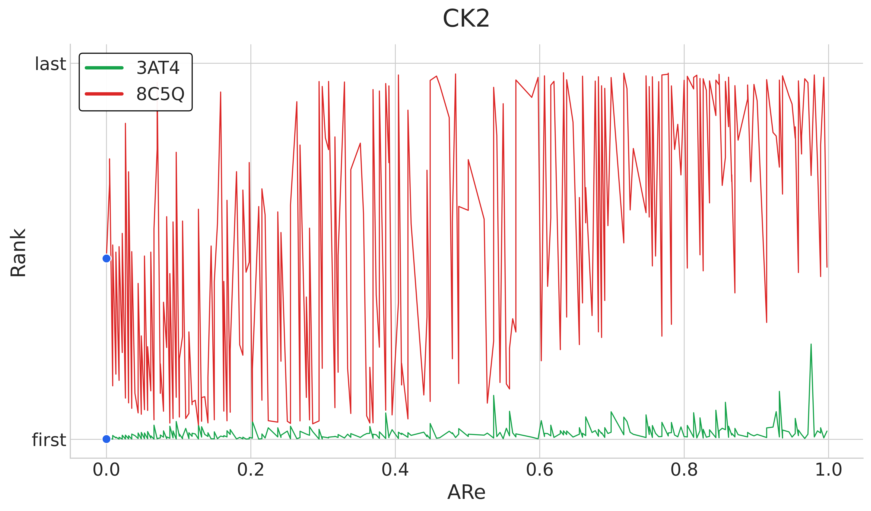
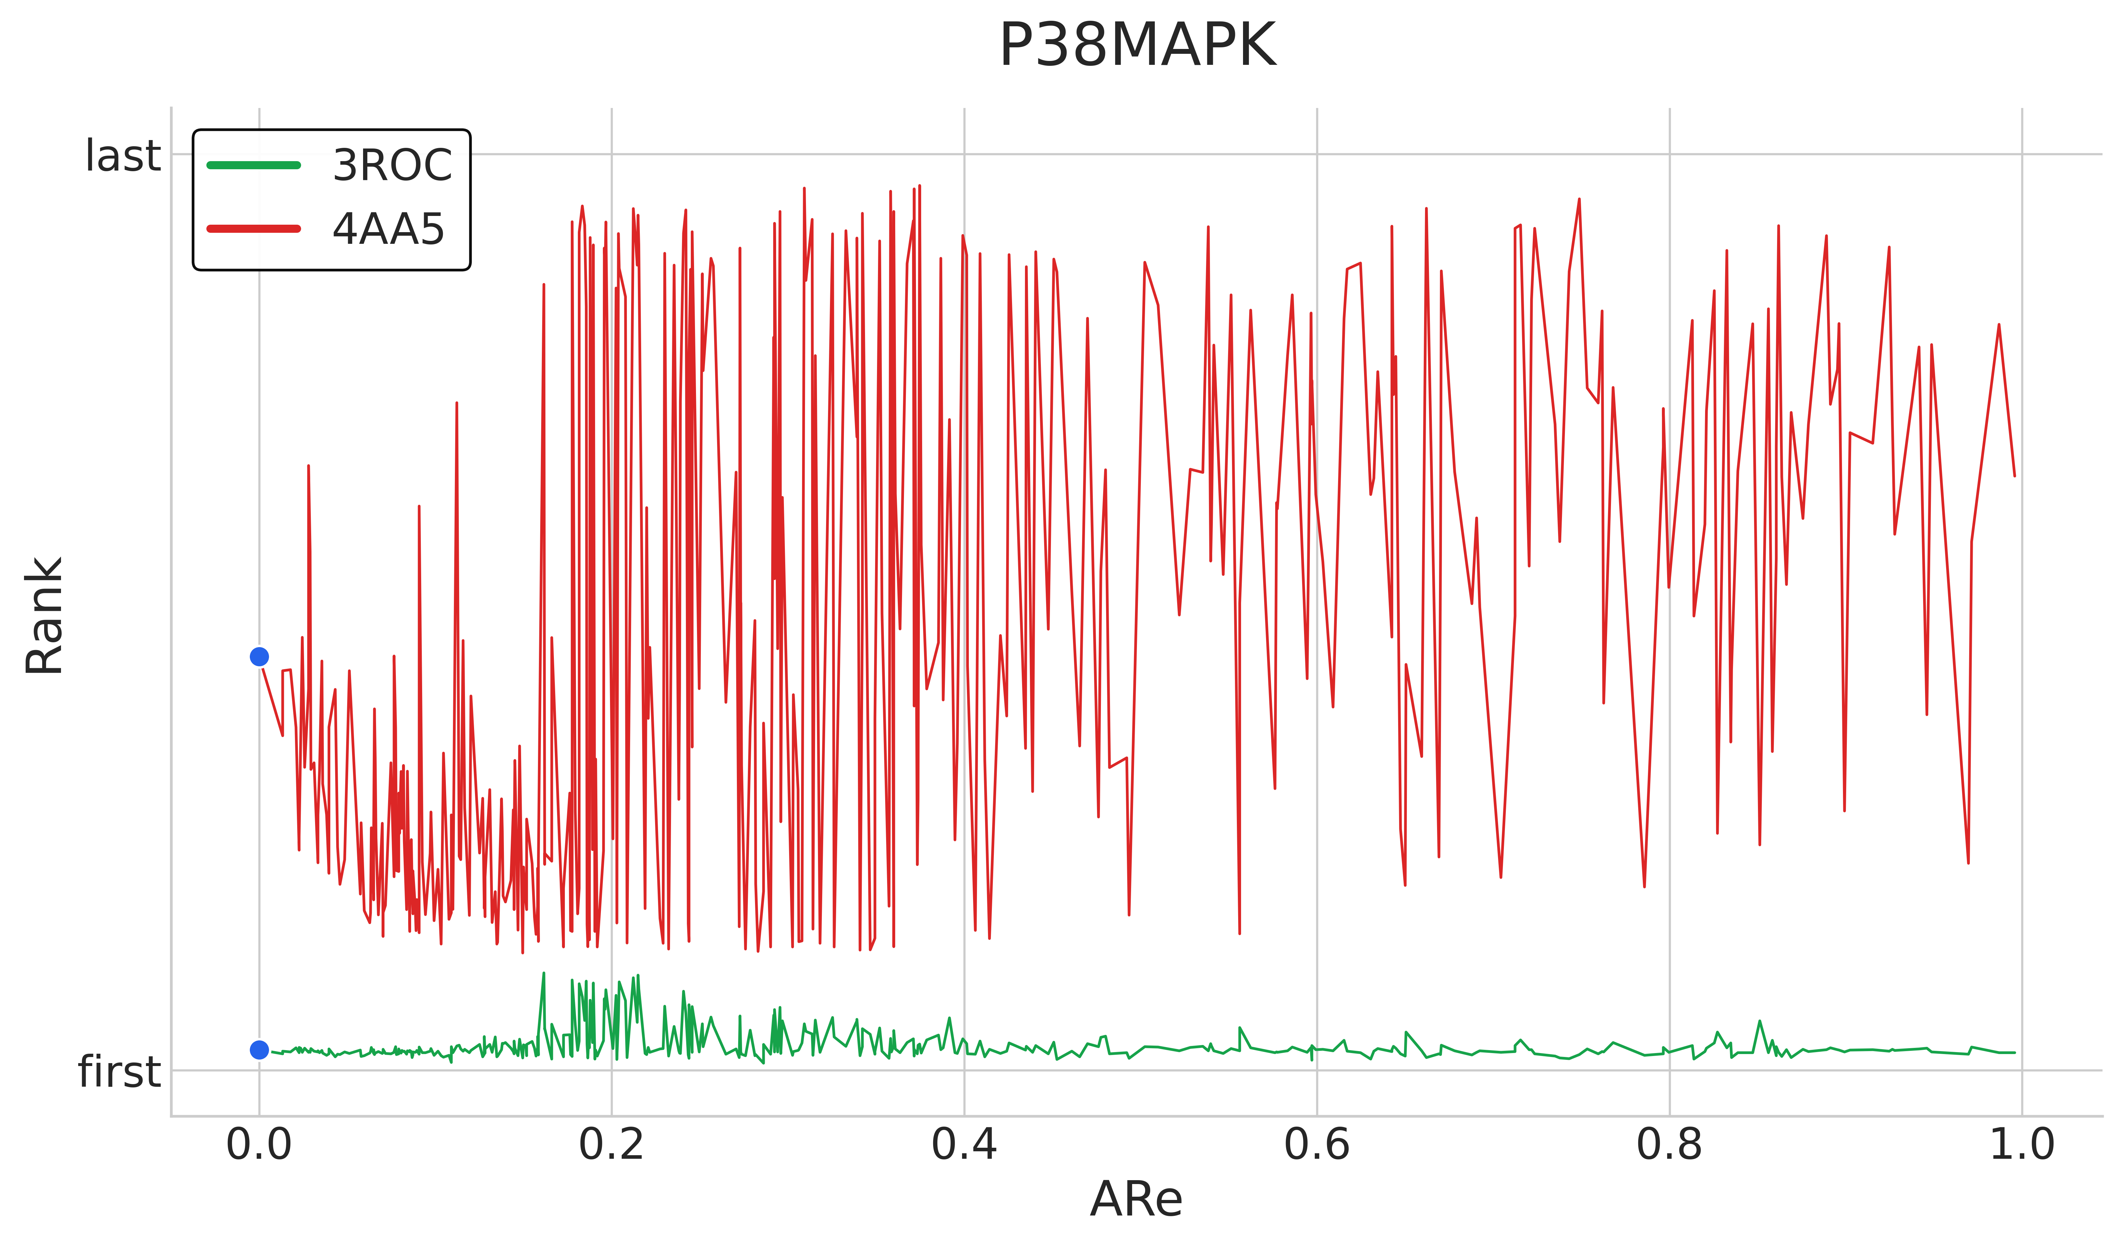
As Expected, Some Ligand have Poses Highly Sensitive to Docking Parameters, Others are “Immune”…
Our cliché “infallible ligand” is unfortunately not a far-fetched Gedankenexperiment, but a source of much inflated benchmark criteria!
The rank of the native-like pose may fluctuate a lot… or very little with respect to the parameterization scheme.
Interestingly, when it does not fluctuate, the native geometry is consistently number one - the only viable way to bind.
Be aware of this when you pick your score training & benchmarking compound sets! An excess of “green” ligands in your set will give great… but useless Pbench scores!

Slide 29
Outline
The Docking/Scoring Problem…
  Ugly things behind the scenes… it’s hard to be rigorous!
What is a docking benchmark worth?
  Sometimes it “works” – but what does that mean?
All models are wrong, but some are useful!

Slide 30
So, what do we learn from this?
If there is one real active among the 10 top-scored ligands, the docking tool achieved its goal…
  … because, without docking, 100+ compounds would have to be tested in blind High Throughput Screening in order to find one active.
Nonetheless, docking is more often wrong than right – therefore, it makes no sense to run docking if you do not intend to experimentally validate the selected compounds
  Docking does not provide answers, but generates useful working hypotheses for drug design!
  It is certainly not the answer to your quest to understand an action mechanism!
Protonation states, water mediation, protein flexibility, covalent binding are still waiting for solutions
  … at least for solutions fast enough for virtual screening.

Slide 31
So, what do we learn from this?
Predicting the correct pose does not imply that the underlying mathematical model is correct…
… and does not imply that Affinity Ranking will be correct either
Tuning a Scoring Function (if you can close an eye on all the fundamental incoherencies such a construct implies) may only succeed if a maximum of experimental data (both Pbench AND Abench challenges) are included,
  at huge computational cost…
And within a well-defined Applicability Domain!
  … or, nobody uses this classical QSAR concept in conjunction to scoring functions, albeit interaction fingerprint matching implicitly plays this role!
Take your time! Dock fewer candidates, but well, rather than billions with bogus scores…

Slide 32

Like it or not, Docking has a Key Role in Modern Drug Discovery!
Thank you for listening… and don’t mess with the dockers!

