Slide 1


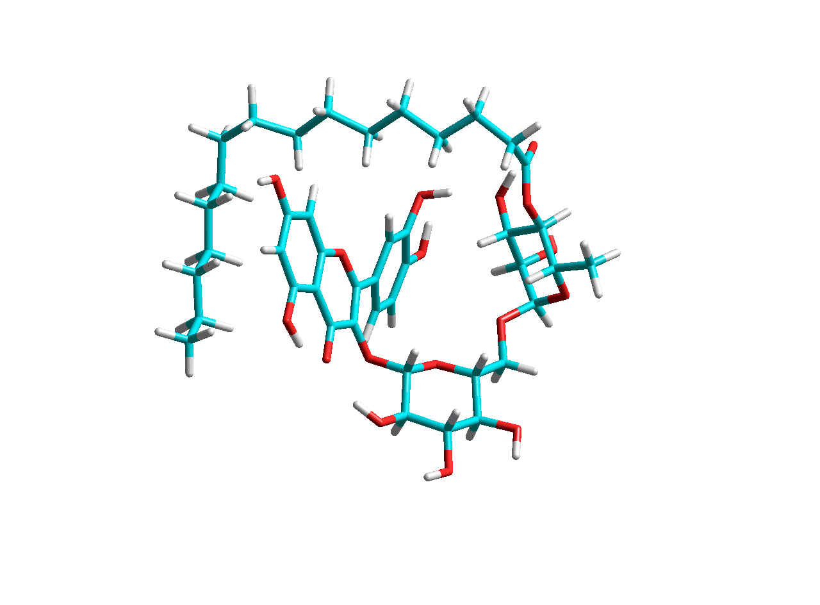

Polyphenol fatty acid esters – structure, activity, and pharmacological potential
Magdaléna Májeková
Centre of Experimental Medicine
Slovak Academy of Sciences,
Bratislava, Slovakia
CECEC 2026, Prague, 7 September 2026

Slide 2

Natural polyphenolic compounds
organic compounds with multiples of various phenol units
- antioxidant properties
specific effects
"promiscuous" compounds (PAINS)
long-term use at lower doses
restricted bio-distribution

Slide 3
Prof. Šturdík et al., Bratislava
Rutin, phloridzin and esculin
+ their fatty acid esters
Rutin, phloridzin and esculin - enzymatically acylated with saturated and unsaturated fatty acids of C4 – C22 using Candida antarctica lipase in 2-methylbutan-2-ol at 60°C.
Quercetin - a natural polyphenolic reference compound
4-guanidinobenzoate - the synthetic standard
The potential and practical applications of acylated flavonoids
Viskupicová, J; Ondrejovic, M and Sturdík, E
PHARMAZIE, 2009, 64(6), pp.355-360
Notes:
3

Slide 4
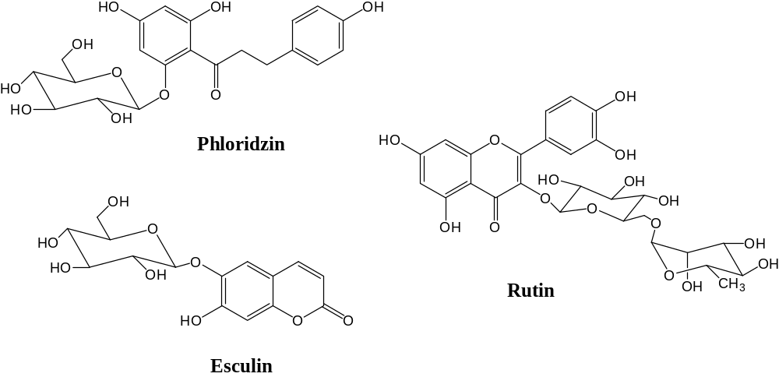
Parrent polyphenolic compounds enzymatically modified
acylation sites

Slide 5

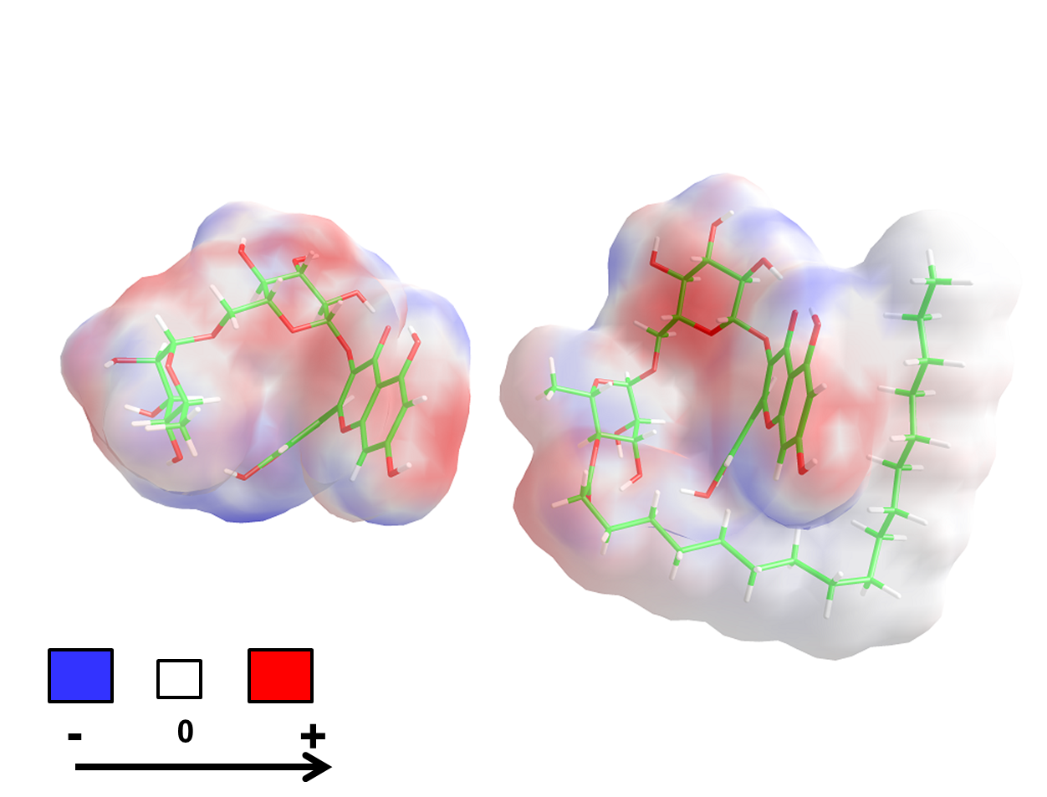
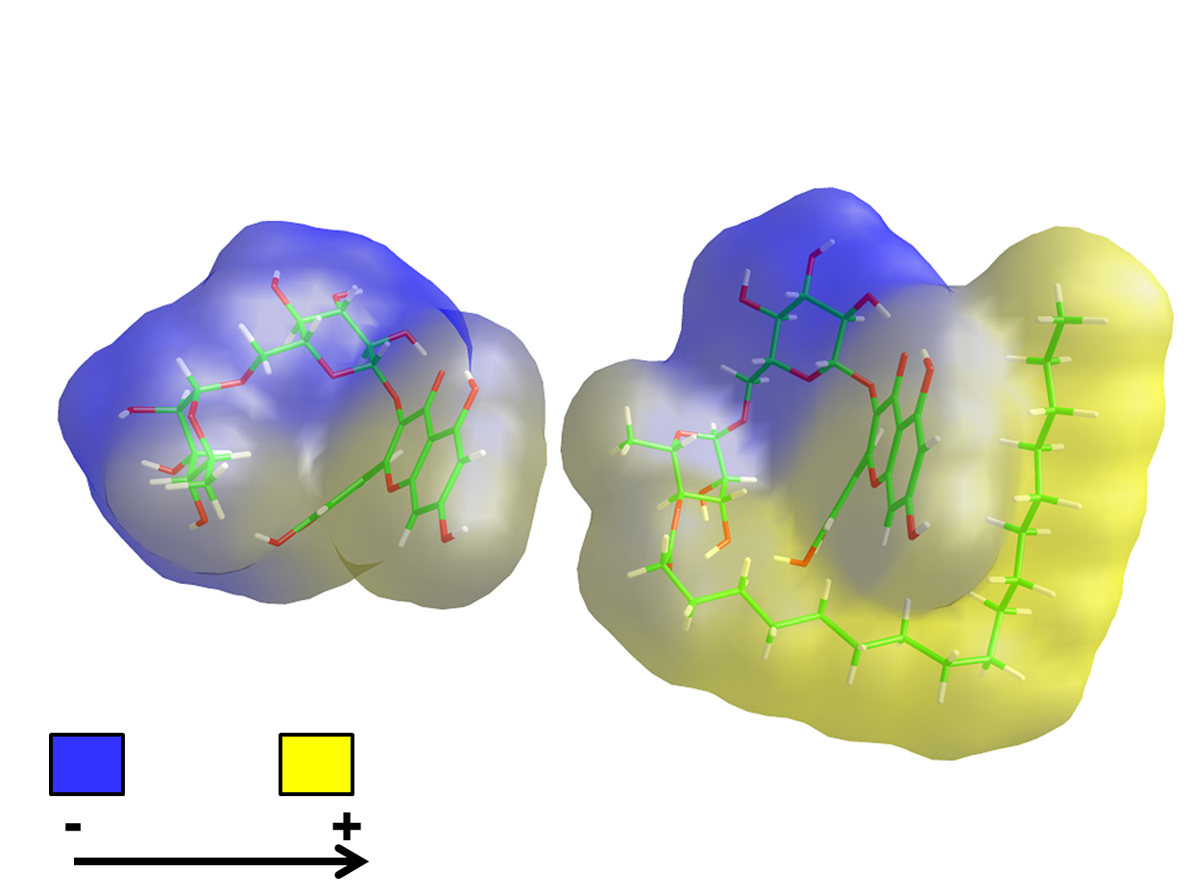
Molecular lipophilicity potential – Molecular electrostatic potential
Notes:
Vážené dámy, vážení páni! Pripadla mi česť informovať Vás o výsledkoch práce oddelenia biochemickej farmakológie, ktoré sa týkajú možností terapie chronických komplikácií diabetu (v zastúpení Ing Štefeka, ktorému neodkladné pracovné povinnosti zabránili zúčastniť sa tohto podujatia).

Slide 6
 | Ester | Abbreviation | R_{t} (min)
2 | Rutin butyrate | R-4 | 5.34
3 | Rutin capronate | R-6 | 7.10
4 | Rutin caprylate | R-8 | 8.90
5 | Rutin caproate | R-10 | 9.42
6 | Rutin laurate | R-12 | 12.53
7 | Rutin myristate | R-14 | 14.89
8 | Rutin palmitate | R-16 | 17.40
9 | Rutin stearate | R-18 | 19.82
10 | Rutin oleate | R-18:1 | 16.38
11 | Rutin linoleate | R-18:2 | 17.16
12 | Rutin linolenate | R-18:3 | 17.90
13 | Rutin arachidonate | R-20:4 | 18.59
14 | Rutin erucate | R-22:1 | 20.93
16 | Phloridzin laurate | F-12 | 14.53
17 | Phloridzin myristate | F-14 | 17.23
18 | Phloridzin palmitate | F-16 | 19.72
19 | Phloridzin stearate | F-18 | 21.96
21 | Esculin laurate | E-12 | 15.58
22 | Esculin myristate | E-14 | 17.84
23 | Esculin palmitate | E-16 | 19.98
24 | Esculin stearate | E-18 | 21.88

Slide 7
The first aim – antioxidants in oily food
Lipophilic rutin derivatives for antioxidant protection of oil-based foods
Viskupicova, J; Danihelova, M; (...); Sturdik, E
FOOD CHEMISTRY, 2010, 123(1), pp.45-50

Slide 8
Inhibition of serin proteases:
thrombin, trypsin, urokinase, and elastase
 | Compound | IC₅₀ (μM)
 |  | Trypsin | Thrombin | Urokinase | Elastase
1 | Rutin | 40 | 25 | 6 | 100
2 | Rutin butyrate | >500 | 22 | 8 | >500
3 | Rutin capronate | >500 | 32 | 14 | >500
4 | Rutin caprylate | >500 | 25 | 32 | >500
5 | Rutin caproate | >500 | 32 | 20 | >500
6 | Rutin laurate | 90 | 14 | 50 | >500
7 | Rutin myristate | 130 | 10 | 15 | >500
8 | Rutin palmitate | 40 | 3 | 15 | >500
9 | Rutin stearate | 40 | 8 | 15 | >500
10 | Rutin oleate | 60 | 9 | 25 | >500
11 | Rutin linoleate | 45 | 5 | 30 | >500
12 | Rutin linolenate | 50 | 7 | 20 | >500
13 | Rutin arachidonate | 75 | 5 | 9 | >500
14 | Rutin erucate | 10 | 10 | 30 | >500
15 | Phloridzin | 90 | 320 | 80 | 100
16 | Phloridzin laurate | 55 | 70 | 9 | >500
17 | Phloridzin myristate | 65 | 75 | 33 | >500
18 | Phloridzin palmitate | 60 | 75 | 18 | >500
19 | Phloridzin stearate | 215 | 65 | 13 | >500
20 | Esculin | 150 | 250 | 25 | 100
21 | Esculin laurate | 350 | 60 | 100 | 20
22 | Esculin myristate | 120 | 54 | 100 | 25
23 | Esculin palmitate | 210 | 54 | 100 | 30
24 | Esculin stearate | 50 | 52 | 89 | 60
25 | Quercetin | 10 | 35 | 20 | 50
26 | 4-Guanidinobenzoate | 450 | 400 | 20 | 500

Slide 9
Inhibition of serine proteases: trypsin, thrombin, elastase, and urokinase
SP - biological functions (digestion, immune response, blood
pressure regulation, blood clotting, cardiovascular function,
hormone processing, angiogenesis, bone remodeling ...)
- pathological conditions (cancer, cardiovascular disorders,
inflammation, coagulation diseases, multiple sclerosis,
Alzheimer's disease, diabetes mellitus, atherosclerosis,
pancreatitis…)
Polyphenol fatty acid esters as serine protease inhibitors: a quantum-chemical QSAR analysis. Viskupicova, J; Danihelova, M; Majekova, M; et al. JOURNAL OF ENZYME INHIBITION AND MEDICINAL CHEMISTRY 27 Issue: 6 800-809
Notes:
9

Slide 10
Calculated values
hydration energy Eaq,
energy of the highest occupied molecular orbital EHOMO,
energy of the lowest unoccupied molecular orbital ELUMO,
dipole d,
molecular CPK volume V,
molecular CPK surface S,
topological polar surface area TPSA,
number of hydrogen bond donors HBD
number of hydrogen bond acceptors HBA.
water-octanol partition coefficient logP Ghose-Crippen
Notes:
10

Slide 11
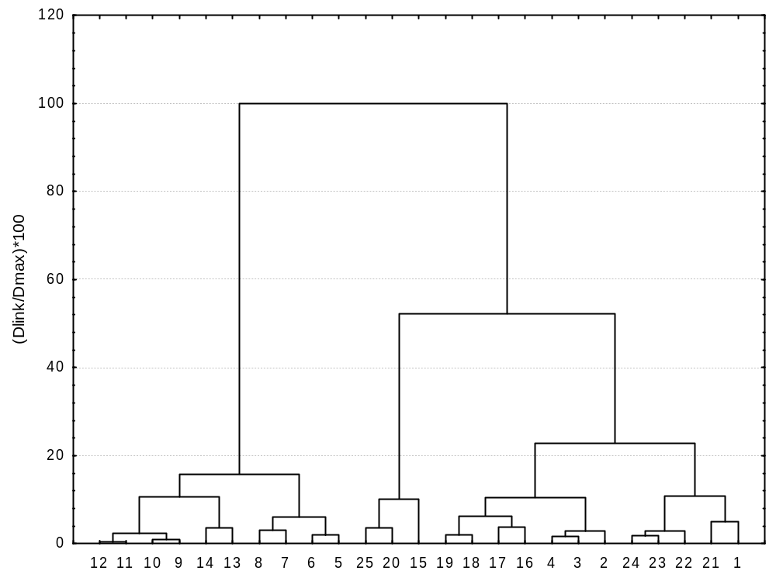
Cluster analysis
Ward method, Manhattan distances
hydration energy Eaq,
energy of EHOMO,
energy of ELUMO,
dipole d,
molecular CPK volume V,
molecular CPK surface S,
topological polar surface area TPSA,
number of hydrogen bond donors HBD
number of hydrogen bond acceptors HBA.
water-octanol partition coefficient logP
rutin esters with long
fatty acid chain R=>10
original polyphenols + E, P esters +
rutin esters with short fatty acid chain

Slide 12
Inhibition of sarco/endoplasmatic reticulum Ca²⁺ ATPase SERCA
SERCA – calcium homeostasis in cells, preserves regular calcium signalling
- pathological conditions – cardiovascular, metabolic, muscular
and neurologic disorders.
Inhibition leads to apoptosis (cancer treatment).
Notes:
12

Slide 13
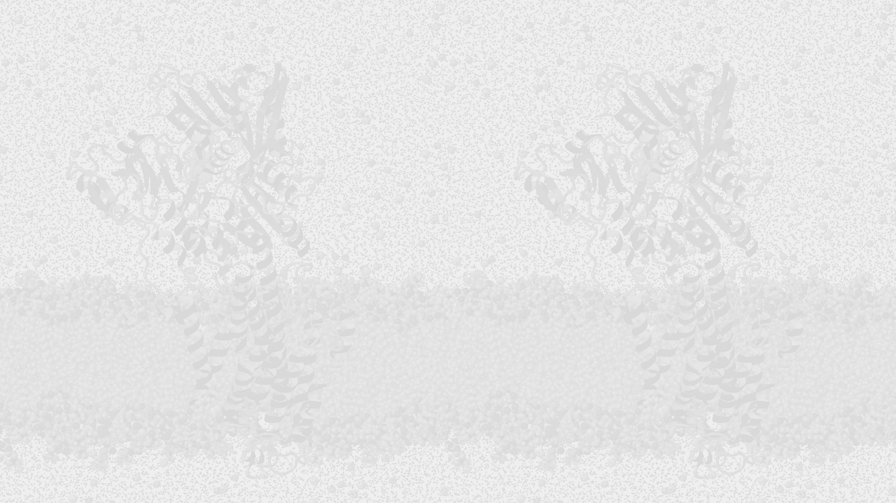
Rutin derivatives
Rutin | derivative | Abbreviation | Corresponding acyl | IC₅₀ (µM)
Rutin | palmitate | R16 | Palmitoyl | 64 ± 12
Rutin | stearate | R18 | Stearoyl | 35 ± 6.5
Rutin | oleate | R18:1 | Oleoyl | 50 ± 8.5
Rutin | linoleate | R18:2 | Linoleoyl | 25 ± 5.5
Rutin | linolenate | R18:3 | a-Linolenoyl | 62 ± 9
Rutin | arachidonate | R20:4 | Arachidonoyl | 23 ± 6.5
Rutin | erucate | R22:1 | Erucoyl | 50 ± 8
Conformational changes of SERCA induced by rutin and its derivatives (R16–R22:1). Studied by a) FITC, b) NCD-4 and c) Trp fluorescence.
Viskupicova, J. Majekova M. et al. J Muscle Res Cell Motility (2015) 36, 183-194

Slide 14
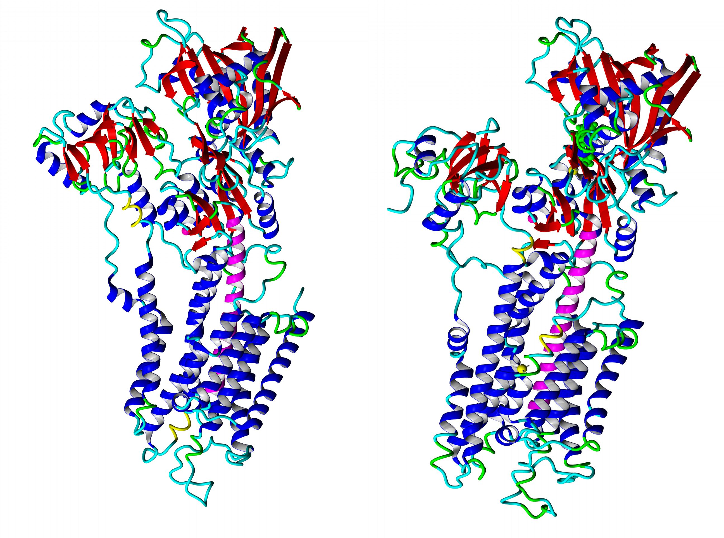
E2 vs E1 conformation
Keeping M5 helix (sequence 742-775) in bent shape (left 3w5c, E2 state) instead of straight shape (right 3w5b, E1.Mg²⁺ state). M5 helix moves A and N parts of the SERCA head deviated each from other and open the head for ATP binding and phosphorylation.
3w5b, E1.Mg2+ and analog of ATP
3w5c, E2

Slide 15
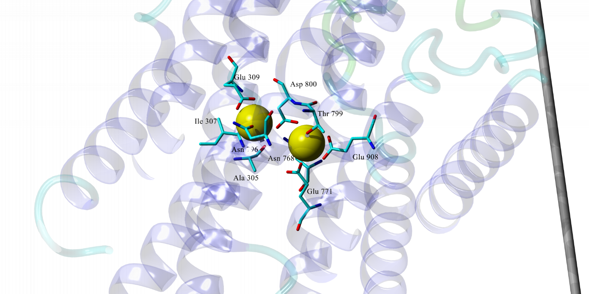
Calcium binding site and residues of proton transfer
Chemistry towards Biology 2022
Majekova: SERCA

Slide 16
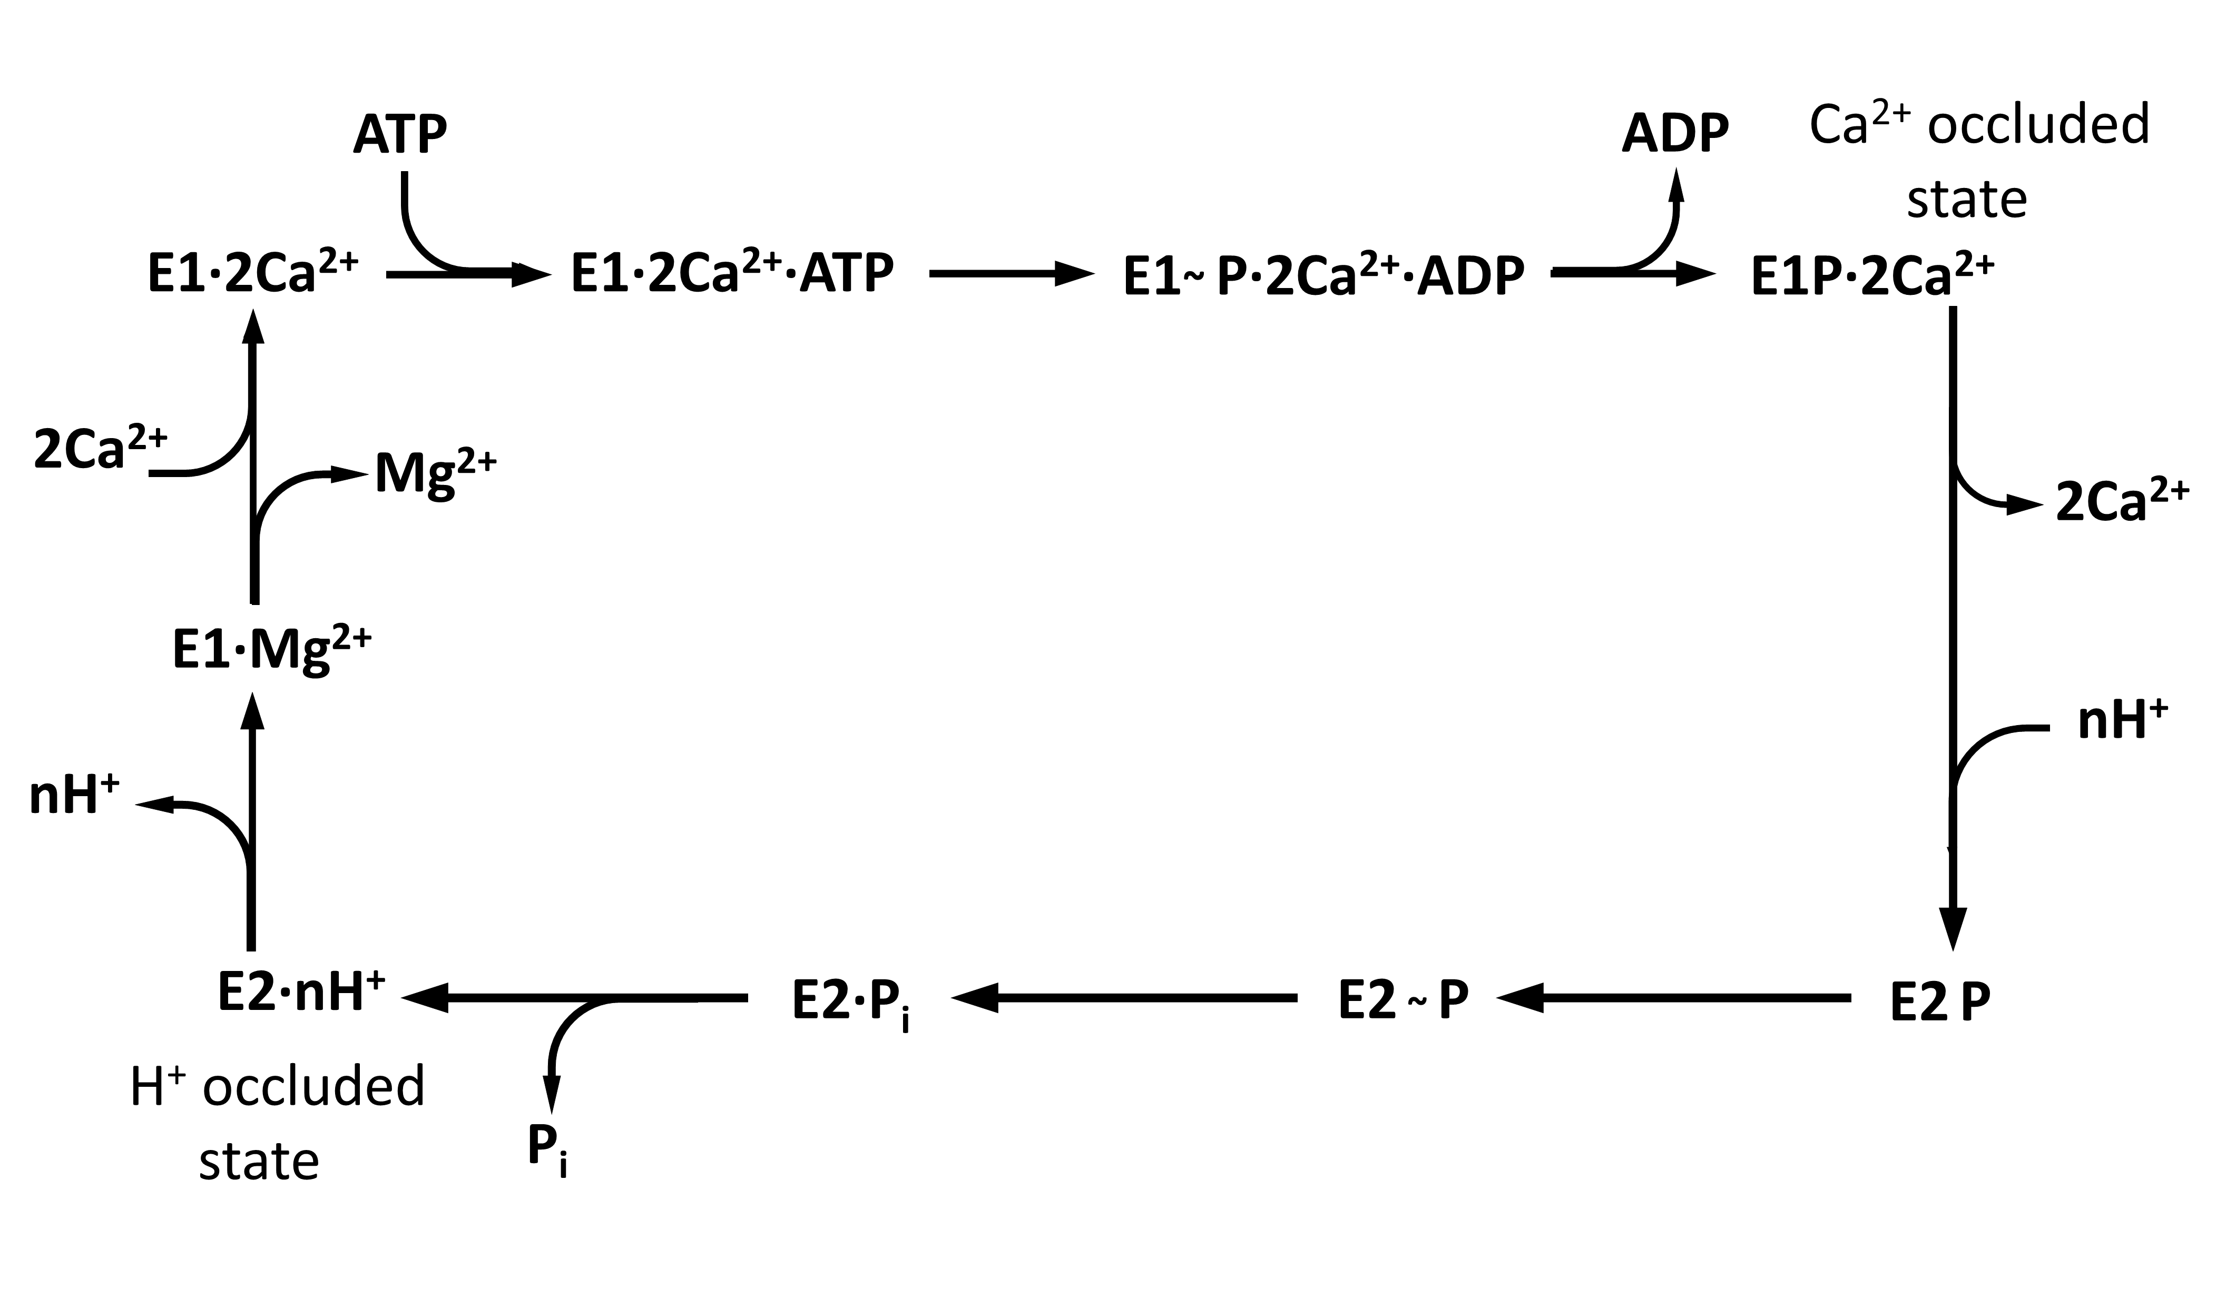
Reaction diagram

Slide 17
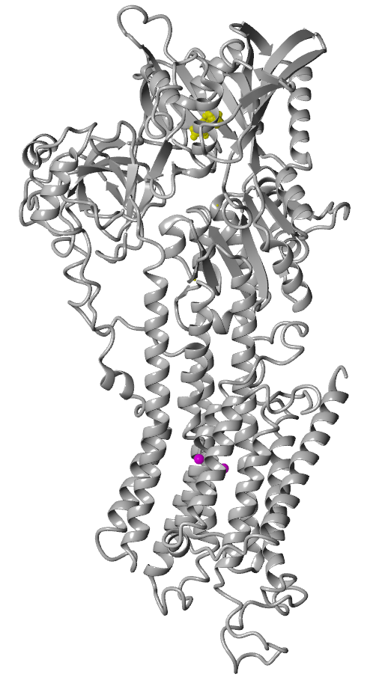
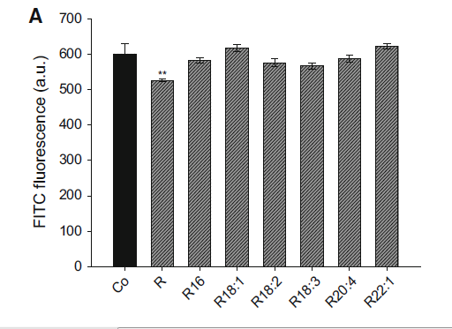
Rutin + rutin derivatives
– FITC (fluorescein-5-isothiocyanate) probe
Lys515

Slide 18
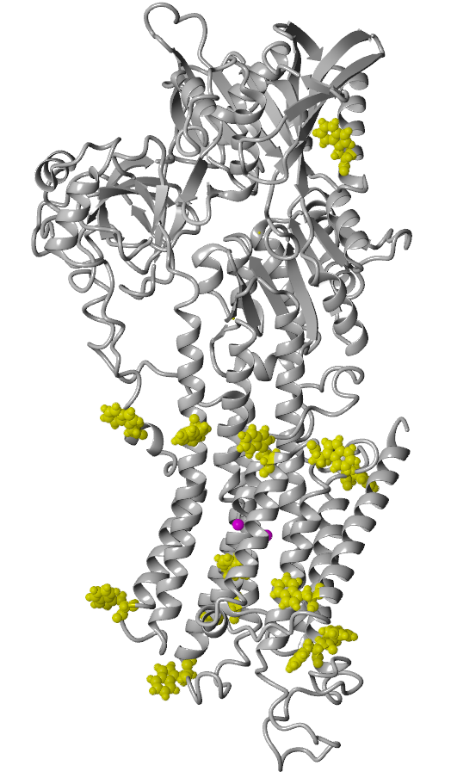
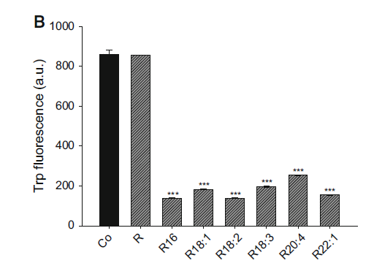
Rutin + Rutin derivatives
– Trp fluorescence

Slide 19
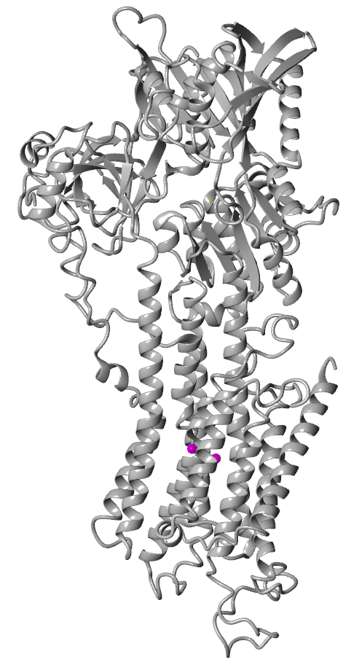
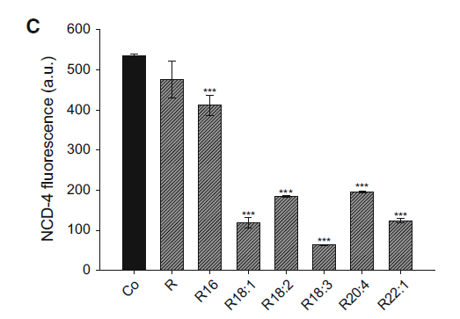
Rutin + Rutin derivatives – NCD-4 probe
(N-cyclohexyl-N‘-(4-dimethylaminol-naphthyl) carbodiimide)

Slide 20
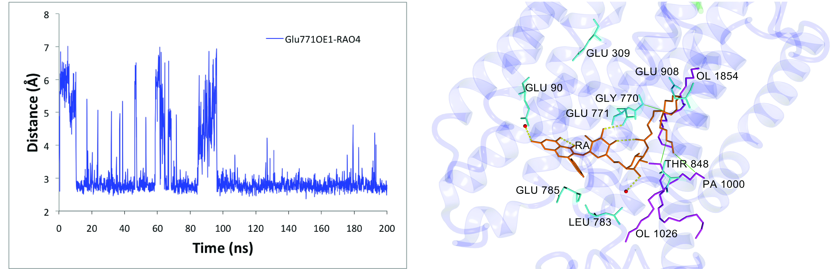
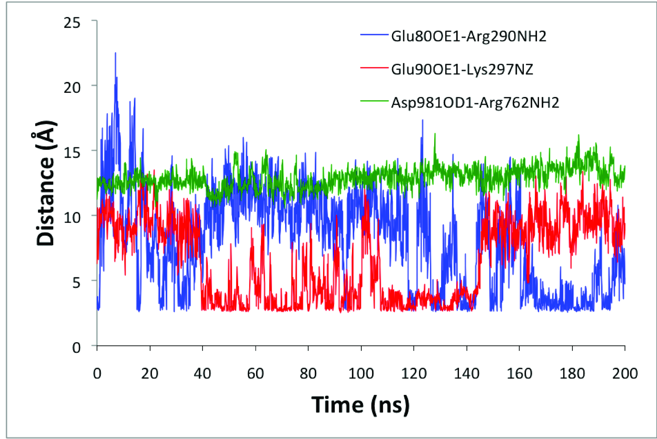
Results of MD simulation
Rodríguez, Y, Majekova M. Biomolecules 2020, 10, 214. https://doi.org/10.3390/biom10020214

Slide 21
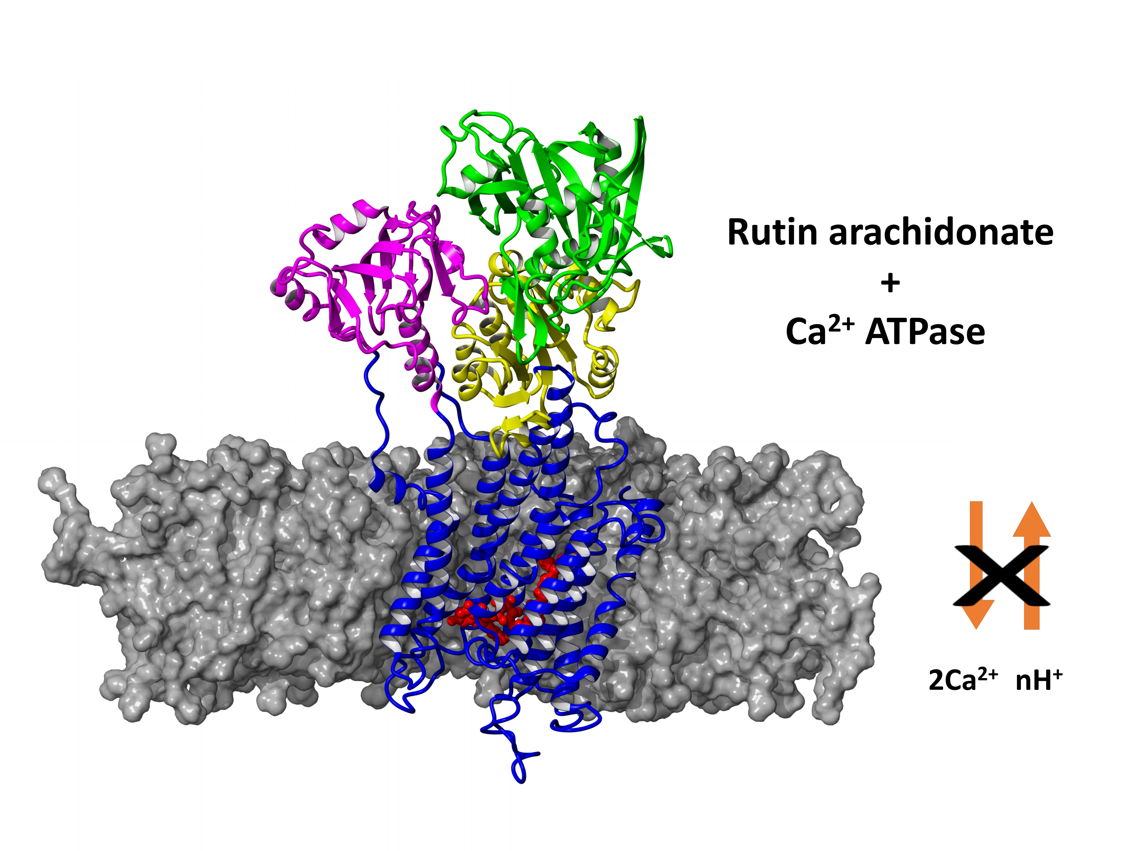
MD – rutin arachidonate
SERCA1a is kept in the E2 conformation preventing the formation of important salt bridges between the side chains of several residues, primarily Glu90 and Lys297. The stable hydrogen bond between Glu771 and rutin arachidonate plays a key role in the binding. The structural changes induced by the binding of rutin arachidonate to SERCA1a may shift proton balance near the titrable residues Glu771 and Glu309 into neutral species hence preventing the binding of calcium ions to the transmembrane binding sites and thus affecting calcium homeostasis.

Slide 22
Protonation of titrable residues
Mean values of predicted pKa under the influence of the environment for titrable residues Glu309, Glu771, and Glu908 calculated for MD simulation.
Predicted pKa
Glu309 Glu771 Glu908
1-200 ns 7.85 ± 0.77 8.65 ± 0.51 10.59 ± 1.76
The first proton transport to the cytoplasm region occurred by means of Glu309. Under the presence of RA, the value of pKa for Glu309 decreased from 9.04 to 7.31 after 200 ns of simulation. However, its average value for the whole 200 ns MD simulation (7.85 ± 0.77) was slightly higher compared to the second half of the MD simulation, which was 7.50 ± 0.34.
Thus, the probability of the first proton transport was lower when compared with unsubstituted SERCA1a.
The second proton transport, which came from Glu771, was not probable.

Slide 23

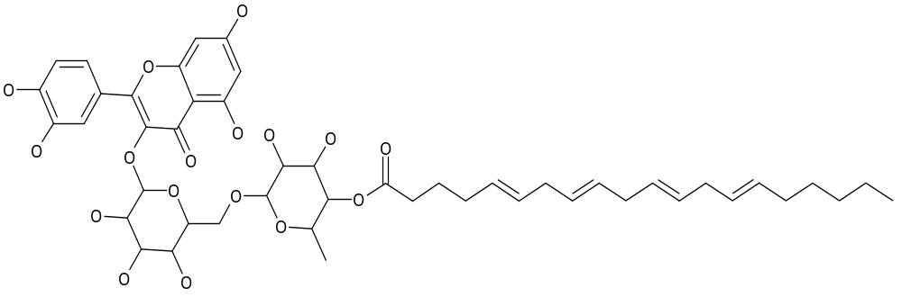
Conclusions
Rutin stearate, rutine linoleate and rutin arachidonate showed the highest inhibitory potency against SERCA
Rutin stearate, rutine linoleate and rutin arachidonate belong to the group of efficient inhibitors of urokinase
The binding site for the interaction of rutin arachidonate and efficient inhibitors is situated in the transmembrane region of SERCA and overlaping the binding site for transported calcium ions
Rutin fatty acid esters have a potential in searching for new compounds for cancer treatment

Slide 24
Acknowledgement
Prof. Šturdík E.  STU Bratislava
Danihelova M. STU Bratislava
Majek P, STU Bratislava
Horakova L, Viskupicova J, Rezbarikova P., CEM SAV Bratislava
Ondrejovič M UCM Trnava
Rodríguez Y, Mount Sinai School of Medicine & HOSTOS CUNY New York, US

Slide 25
Acknowledgement
Organizers
Prof. Daniel Svozil
Head of the Department of Informatics and Chemistry
University of Chemistry and Technology Prague & CZ-OPENSCREEN
Slovak Research and Development Agency under the contract NO. APVV-20-0543
SAS agency grants VEGA 2/0127/18, VEGA 2/0111/16, VEGA 2/0136/25
COST CA15135 - MuTaLig - Multi-target paradigm for innovative ligand identification in the drug discovery process
Fulbright Commission for awarding scholarship to Y. Rodríguez n Slovak Republic.
Thank You for Your Attention

Slide 28
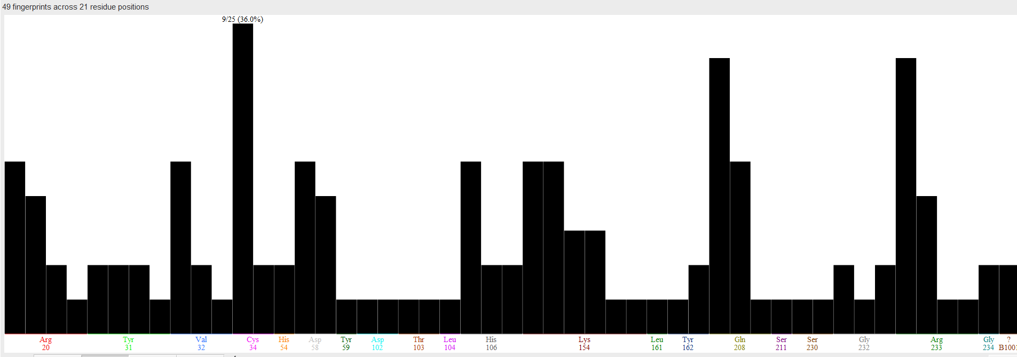
Binding modes analysis – urokinase pdb 1sqo
similar to compound 12b co-crystallized

