Slide 1
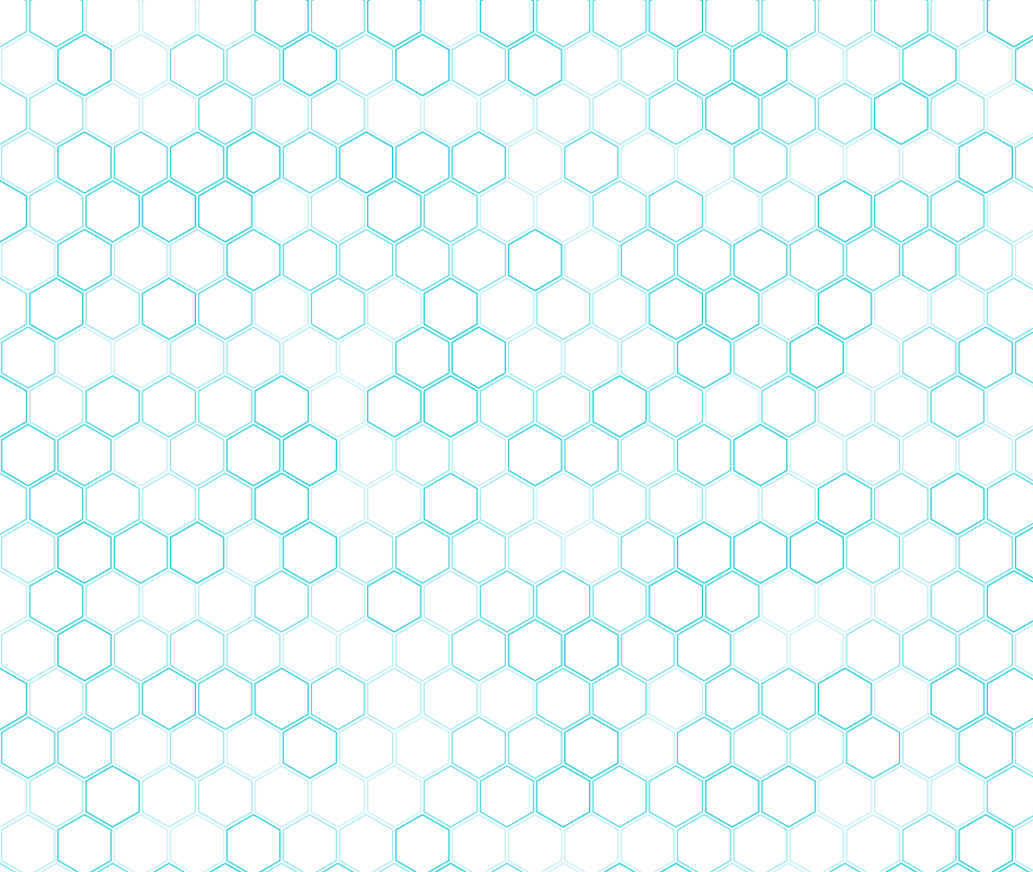


Dušan Malenov
Exploring
noncovalent interactions
via the
Cambridge Structural Database
CECEC
2026
Praha, 7 September

Slide 2

Cambridge Structural Database (CSD)
compiled and maintained by the
Cambridge Crystallographic Data Centre (CCDC)
founded in 1965
the largest database of crystal structures (> 1.4 million)
repository and resource of organic, metal-organic and organometallic structures
crystal structures can be visualized and analyzed using the software offered by the CCDC (CSD Portfolio)
main program of the CSD Portfolio – Mercury – is offered in alternative, free version
specific subsets of crystal structures are freely available for educational purposes

Slide 3










CSD Portfolio
program package for visualization and analysis of crystal structures
Mercury
Mogul
ConQuest
CrossMiner
IsoStar
enCIFer
Hermes
CSD Python API
GOLD
CSD-Editor

Slide 4
Cambridge Structural Database
extensive database of noncovalent interactions
Mercury
Mogul
ConQuest
CrossMiner
NONCOVALENT
INTERACTIONS
IsoStar
enCIFer
Hermes
CSD Python API
GOLD
CSD-Editor

Slide 5
Exploring noncovalent interactions
via the Cambridge Structural Database
Cheminformatics analysis of CSD data
disperse structural information
generalizable principles
on noncovalent interactions
atom positions from the
large amount of structures
length and directionality
of hydrogen bonds
Exploring stacking interactions through
Cambridge Structural Database and computational chemistry

Slide 6
Exploring noncovalent interactions
via the Cambridge Structural Database
Cheminformatics analysis of CSD data
disperse structural information
generalizable principles
on noncovalent interactions
atom positions from the
large amount of structures
displacement of stacked aromatic rings
Exploring stacking interactions through
Cambridge Structural Database and computational chemistry

Slide 7
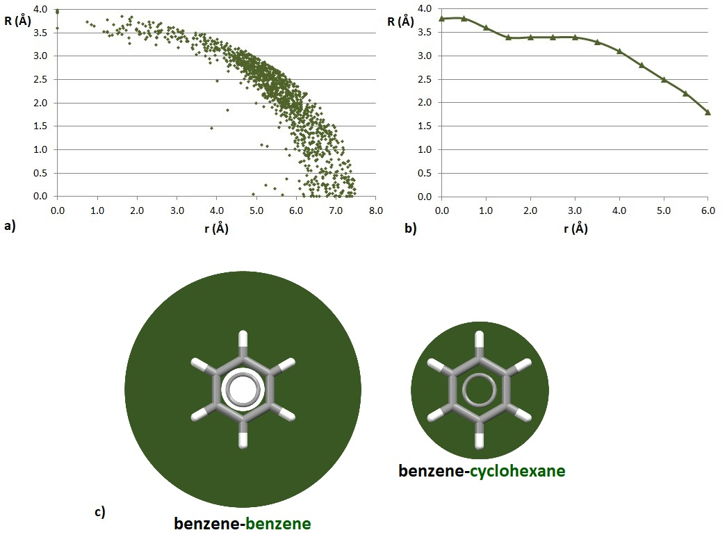
Stacking Interactions of Aromatic Molecules
benzene-benzene stacking in the CSD
quantum chemical calculations
larger horizontal displacement (r) means smaller normal distance (R)
Ninković et al., ChemPhysChem 12 (2011) 3511.
Malenov & Zarić, Coord. Chem. Rev. 419 (2020) 213338.

Slide 8
Stacking Interactions of Aromatic Molecules
benzene-benzene stacking in the CSD
quantum chemical calculations
larger horizontal displacement (r) means smaller normal distance (R)
ARE THE MOST STABLE DIMERS PRESENT IN REAL SYSTEMS?
Ninković et al., ChemPhysChem 12 (2011) 3511.
Malenov & Zarić, Coord. Chem. Rev. 419 (2020) 213338.

Slide 9
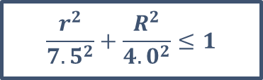
Stacking Interactions of Aromatic Molecules
benzene-benzene stacking in the CSD
quantum chemical calculations
larger horizontal displacement (r) means smaller normal distance (R)
ARE THE MOST STABLE DIMERS PRESENT IN REAL SYSTEMS?
CSD search criteria
angle between benzene planes < 10°
d(Ω₁···Ω₂) < 7.5 Å
$$\frac{r^{2}}{{7.5}^{2}}+\frac{R^{2}}{{4.0}^{2}}≤1$$
Ninković et al., ChemPhysChem 12 (2011) 3511.
Malenov & Zarić, Coord. Chem. Rev. 419 (2020) 213338.

Slide 10
Stacking Interactions of Aromatic Molecules
benzene-benzene stacking in the CSD
quantum chemical calculations
larger horizontal displacement (r) means smaller normal distance (R)
ARE THE MOST STABLE DIMERS PRESENT IN REAL SYSTEMS?
CSD search criteria
angle between benzene planes < 10°
d(Ω₁···Ω₂) < 7.5 Å
$$\frac{r^{2}}{{7.5}^{2}}+\frac{R^{2}}{{4.0}^{2}}≤1$$
Ninković et al., ChemPhysChem 12 (2011) 3511.
Malenov & Zarić, Coord. Chem. Rev. 419 (2020) 213338.

Slide 11
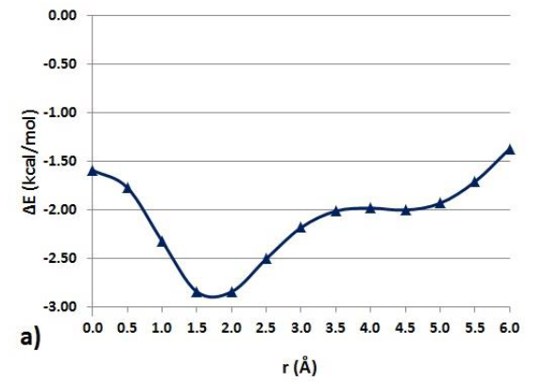
Stacking Interactions of Benzene Molecules in the CSD Crystal Structures
dominance of stacking interactions with large horizontal displacement
B2PLYP-D/def2-TZVP interaction energies
-1.6
kcal/mol
-2.8
kcal/mol
-2.0
kcal/mol
Ninković et al., ChemPhysChem 12 (2011) 3511.

Slide 12
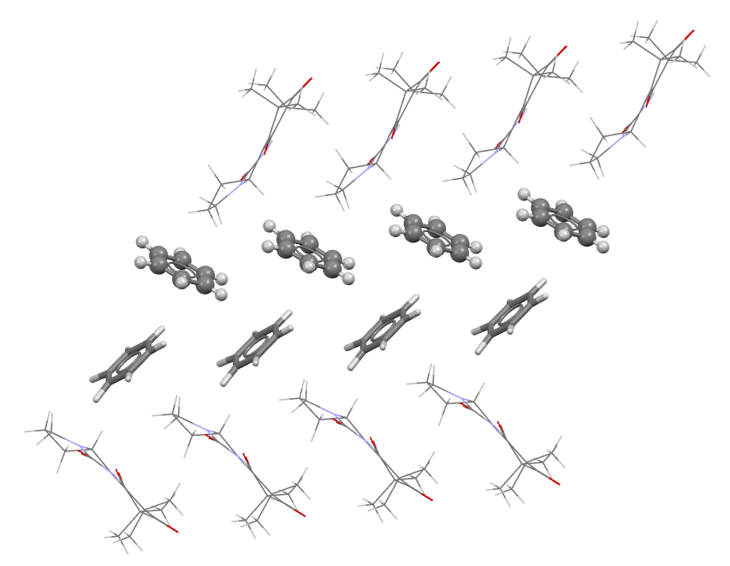
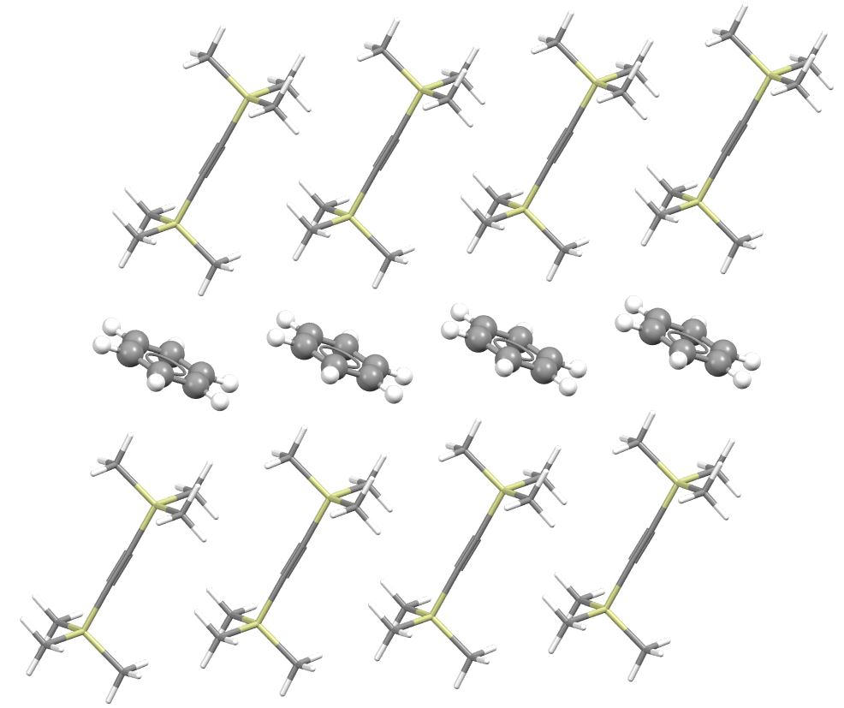
Stacking Interactions of Benzene Molecules in the CSD Crystal Structures
dominance of stacking interactions with large horizontal displacement
B2PLYP-D/def2-TZVP interaction energies
EVERY CRYSTAL STRUCTURE IS ONE BIG COMRPOMISE
Significant portion of energy of the strongest interaction is preserved (70%), and both faces are now available for additional interactions.
crystal structure
CENNUE
crystal structure
KURCAC
-1.6
kcal/mol
-2.8
kcal/mol
-2.0
kcal/mol
the strongest interaction does not need to be
the most frequent
Ninković et al., ChemPhysChem 12 (2011) 3511.

Slide 13
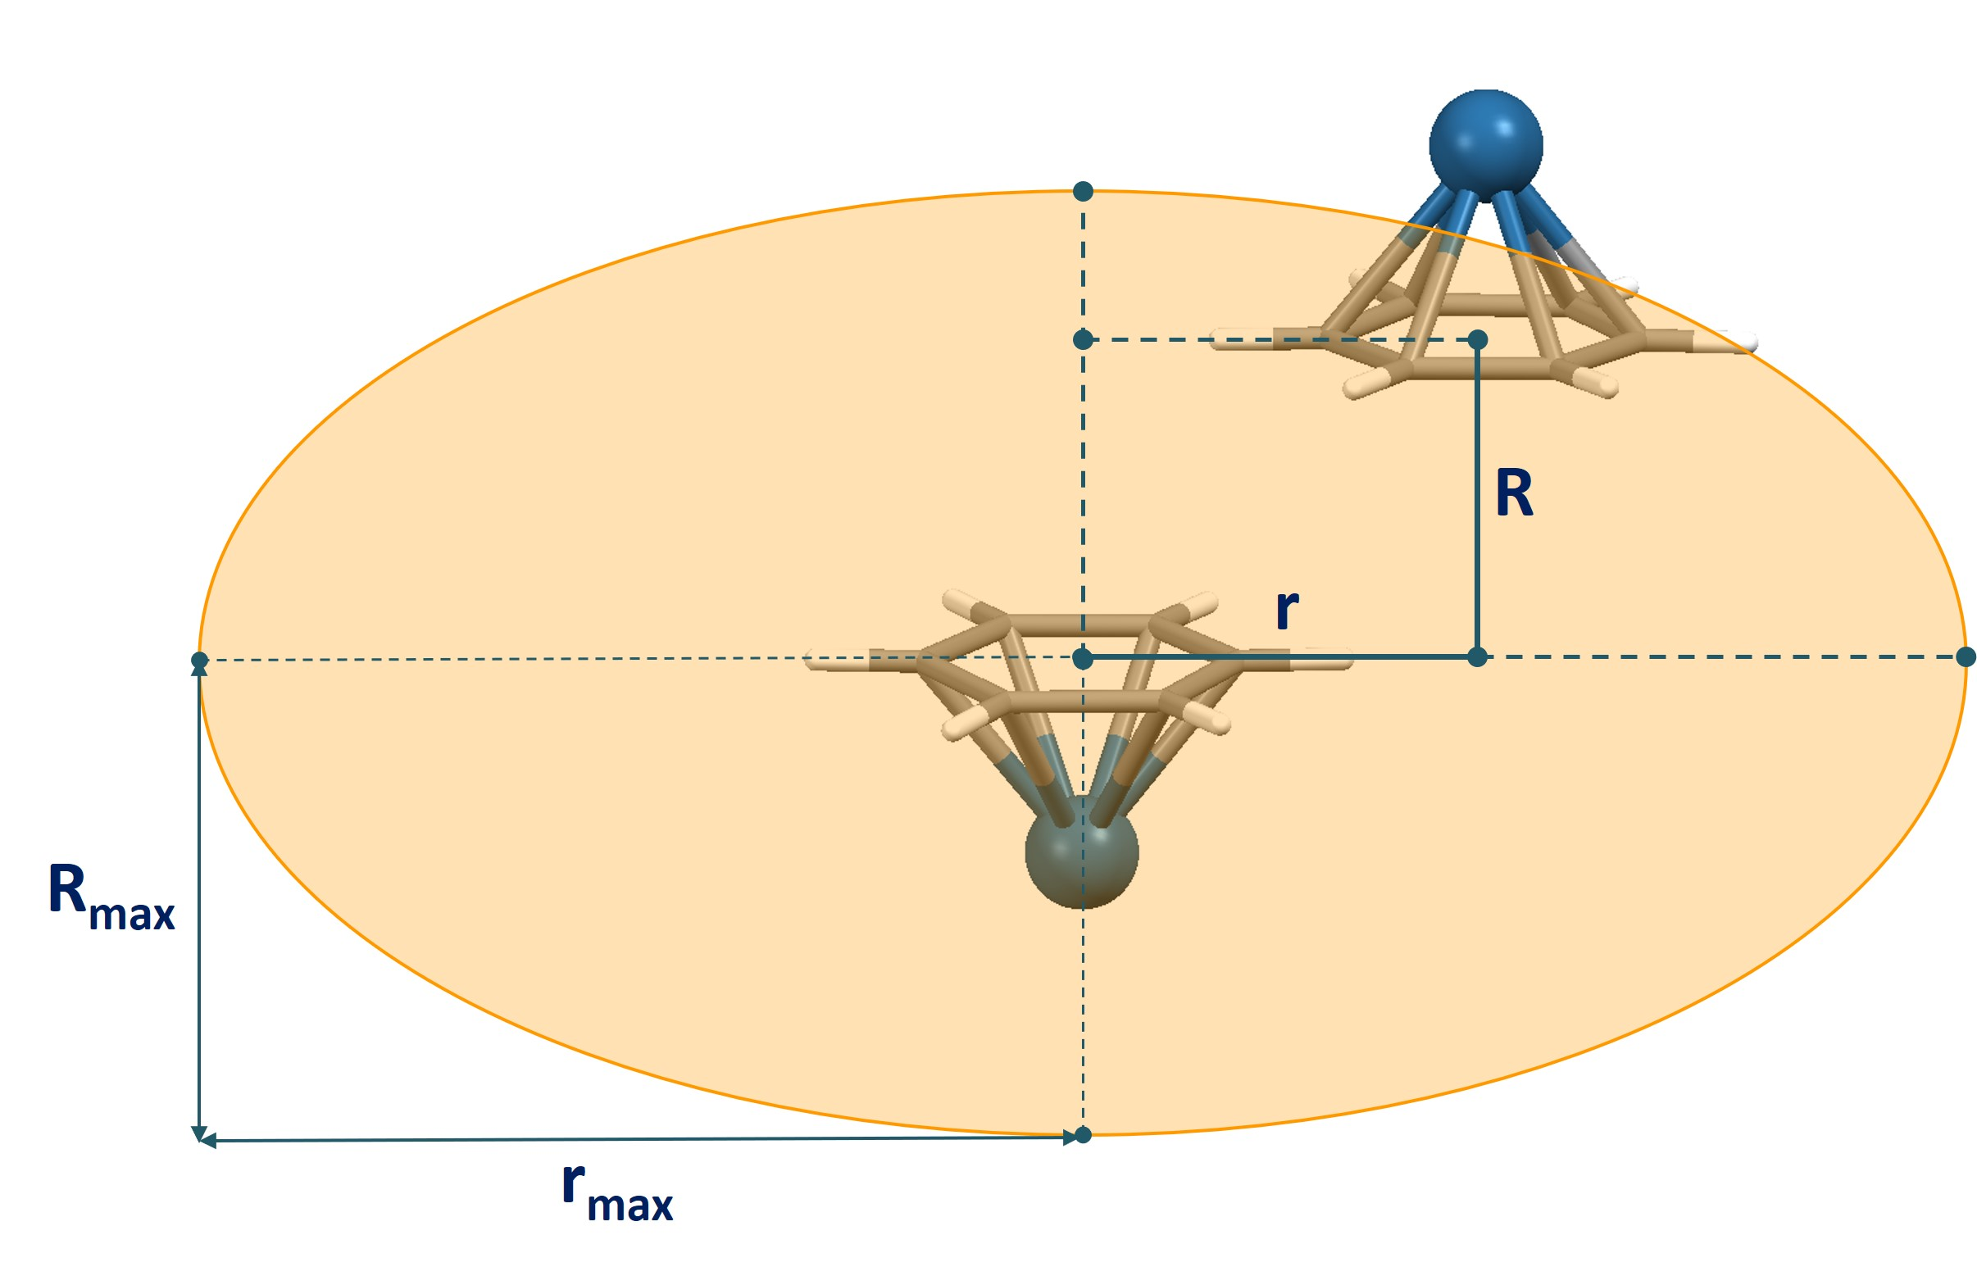
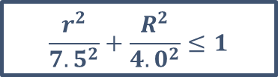
Stacking Interactions of Aromatic Ligands in Organometallic Compounds
in CSD crystal structures
angle between aromatic rings < 10°
distance between ring centres < 7.5 Å
$$\frac{r^{2}}{{7.5}^{2}}+\frac{R^{2}}{{4.0}^{2}}≤1$$
separate analysis of stacking interactions of sandwich and half-sandwich compounds
Malenov et al., Cryst. Growth Des. 16 (2016) 4169.
Malenov et al., CrystEngComm 20 (2018) 4506.

Slide 14
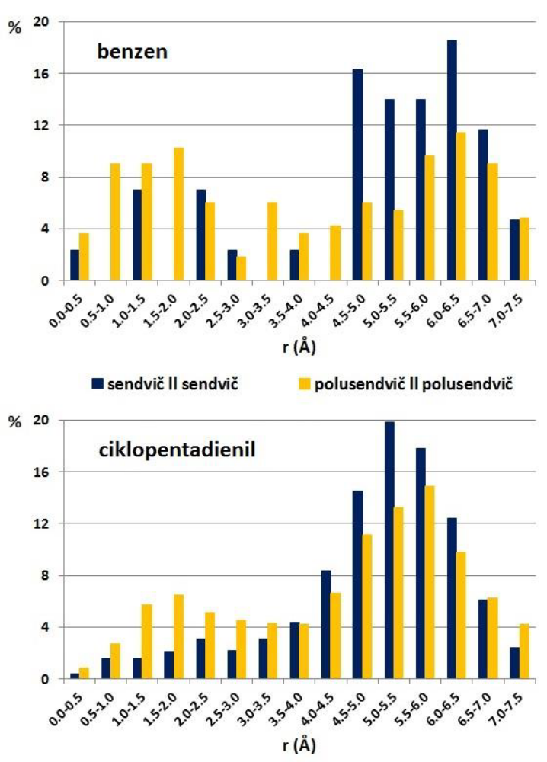
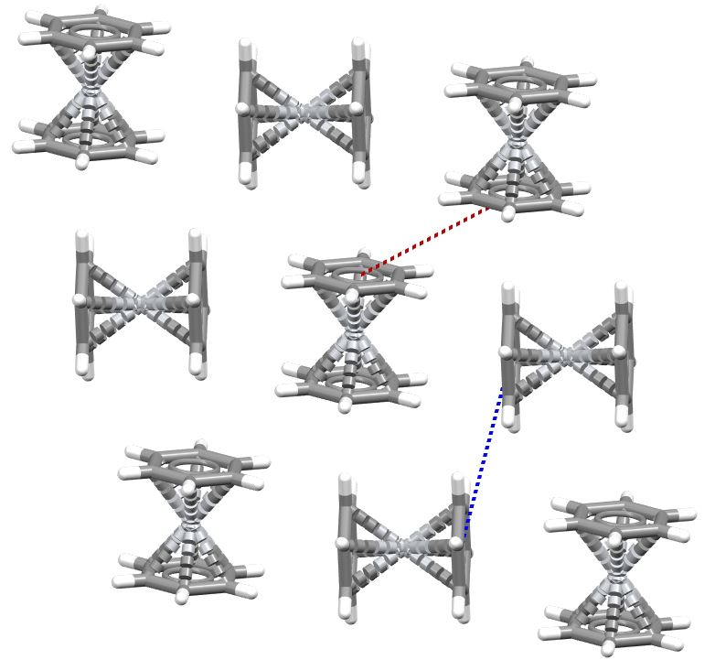
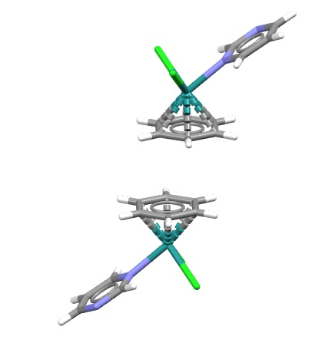
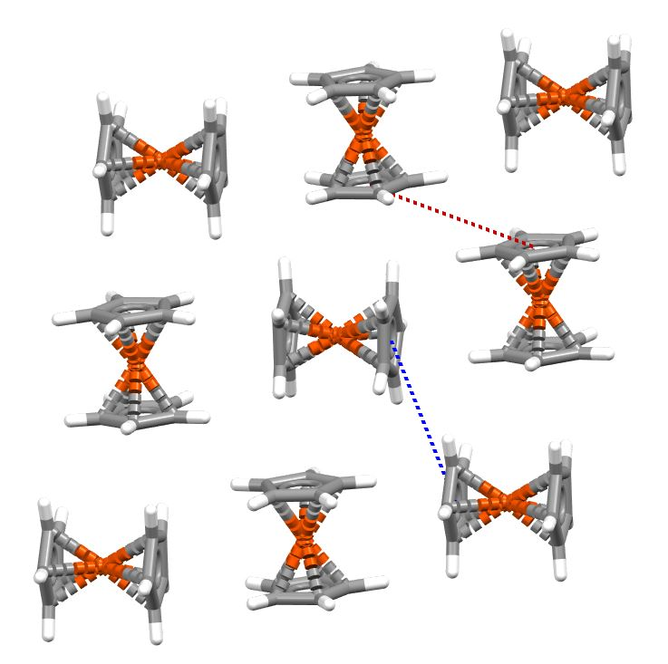
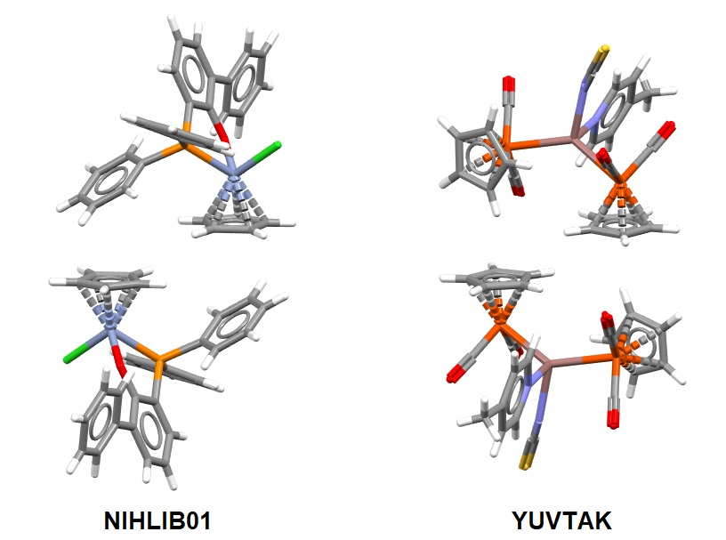
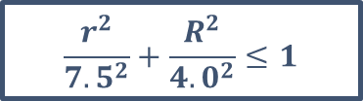
Stacking Interactions of Aromatic Ligands in Organometallic Compounds
in CSD crystal structures
benzene
BELGOO11
NAFDOP
sandwich
half-sandwich
angle between aromatic rings < 10°
distance between ring centres < 7.5 Å
cyclopentadienyl
$$\frac{r^{2}}{{7.5}^{2}}+\frac{R^{2}}{{4.0}^{2}}≤1$$
separate analysis of stacking interactions of sandwich and half-sandwich compounds
FEROCE18
Malenov et al., Cryst. Growth Des. 16 (2016) 4169.
Malenov et al., CrystEngComm 20 (2018) 4506.
YUVTAK

Slide 15
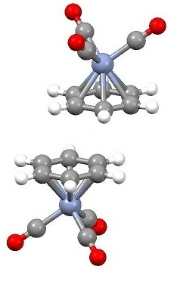
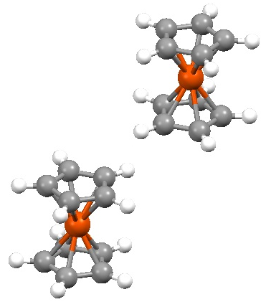
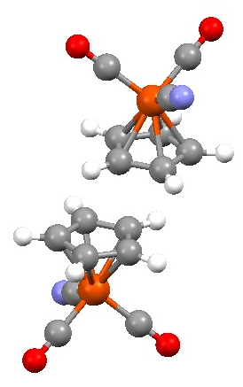
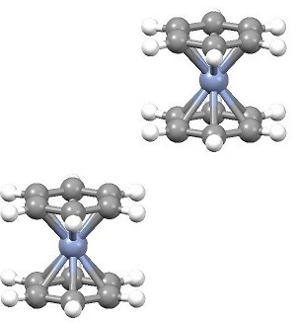
Stacking Interactions of Aromatic Ligands in Organometallic Compounds
CSD search + DFT calculations
S-S
HS-HS
TPSS-D2/def2-TZVP calculations
of interaction energies on model systems
S-S
HS-HS
benzene
cyclopentadienyl
Malenov et al., Cryst. Growth Des. 16 (2016) 4169.
Malenov et al., CrystEngComm 20 (2018) 4506.

Slide 16
Stacking Interactions of Aromatic Ligands in Organometallic Compounds
CSD search + DFT calculations
S-S
HS-HS
TPSS-D2/def2-TZVP calculations
of interaction energies on model systems
S-S
HS-HS
benzene
cyclopentadienyl
benzene | large offset stacking in crystals | preserved interaction energy
sandwich | 79% | 74%
half-sandwich | 46% | 46%
cyclopentadienyl | large offset stacking in crystals | preserved interaction energy
sandwich | 73% | 74%
half-sandwich | 60% | 29%
Malenov et al., Cryst. Growth Des. 16 (2016) 4169.
Malenov et al., CrystEngComm 20 (2018) 4506.
very weak interaction,
but still dominant in crystal structures

Slide 17
Large Offset Stacking of Half-Sandwich Cp Compounds
even if this interaction is very week
VISUAL ANALYSIS
BEPGAG
NIHLIB01
YUVTAK
Combination of large offset stacking
and aromatic C-H/π interactions
(mostly caused by the presence of phenylphosphine-type ligand in half-sandwich)
Malenov & Zarić, Coord. Chem. Rev. 419 (2020) 213338.
Malenov, Vojislavljević-Vasilev, Zarić, Crystallogr. Rev. 31 (2025) 60-95.

Slide 18
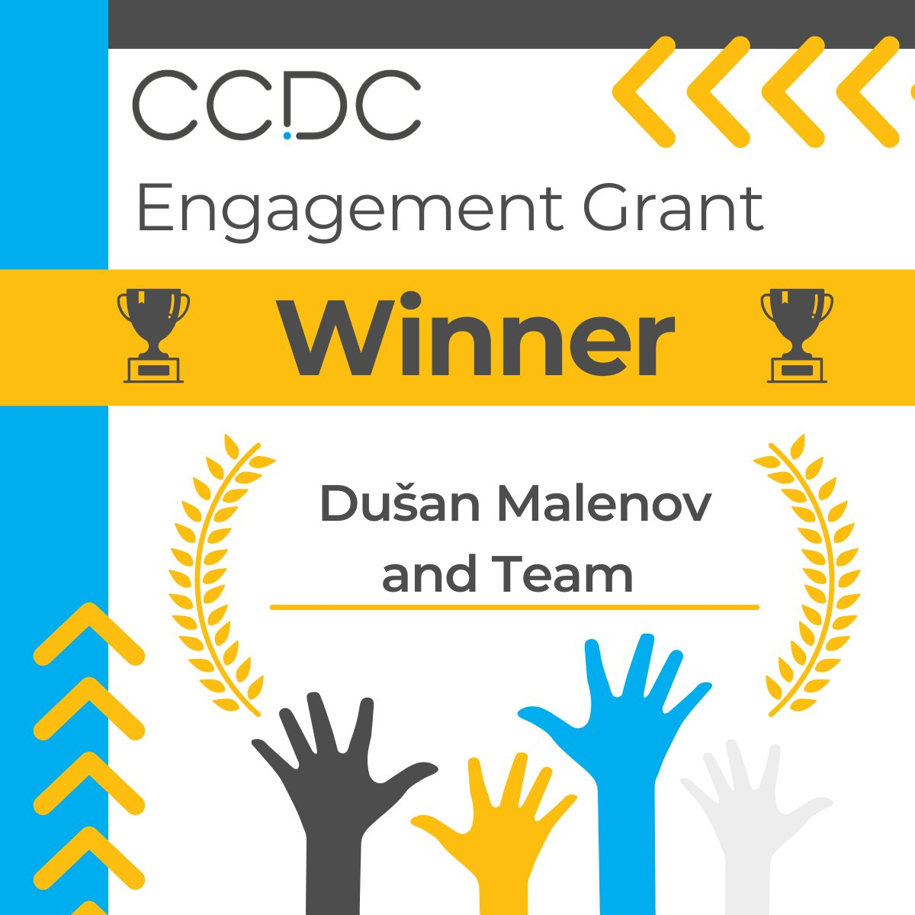
CCDC Engagement Grants
Grants to Create STEM Outreach Resources and Activities
2024/2025
„The CCDC Engagement Grants cover the costs for you to produce resources or activities to increase schools and public engagement in crystallography and structural science.
As part of our mission to advance structural science for the public benefit, we support education in the chemical sciences.
Through the CCDC Engagement Grants, launched in 2022, we aim to enable more people to create engaging resources for the next generation of scientists.“
Source:
https://www.ccdc.cam.ac.uk/community/ccdc-for-the-community/awards-and-sponsorship/ccdc-engagement-grants/
(postponed to 2026)

Slide 19
Empowering Chemistry Students
to Discover Noncovalent Interactions
via the Cambridge Structural Database –
CSD4NCI Workshop
MOTIVATION
noncovalent interactions are not appropriately represented in high school and undergraduate level university curriculums (in Serbia)
the use of CSD is not as extensive as it could be – less than 50% of the available CSD licenses for Serbia are activated (2024)
AIMS
to raise awareness of the importance of noncovalent interactions
to spread the use of CSD Portfolio
to engage more students in structural science
RESOURCES
presentations, instructions, handouts and assessment materials
that would guide students through the process of discovering
noncovalent interactions by using the CSD
will be made available to everyone through the CCDC website (NOVEMBER 2026)

Slide 20
Structure of the CSD4NCI Workshop
Pre-Test
to check what students already know/understand about noncovalent interactions
Presentation
introduction to the workshop, CSD and noncovalent interactions
First CSD search – hydrogen bonds
students are guided through the search by the presenter
Second CSD search – stacking interactions
Third CSD search – cation-π interactions
students work alone based on the detailed instructions given on paper (handout)
Fourth CSD search – (a little bit different) hydrogen bonds
Post-Test
students figure out how to set up the search in the discussion with the presenter
students work alone, no instructions, no help
to check how much students learned/understood the contents of the workshop

Slide 21
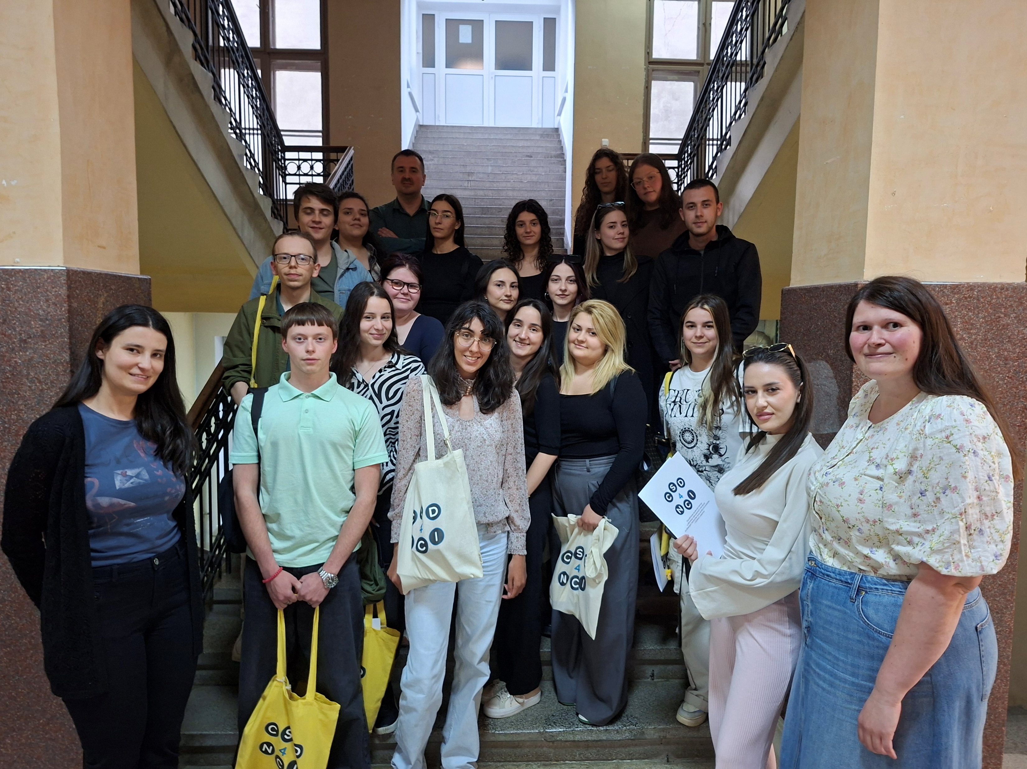
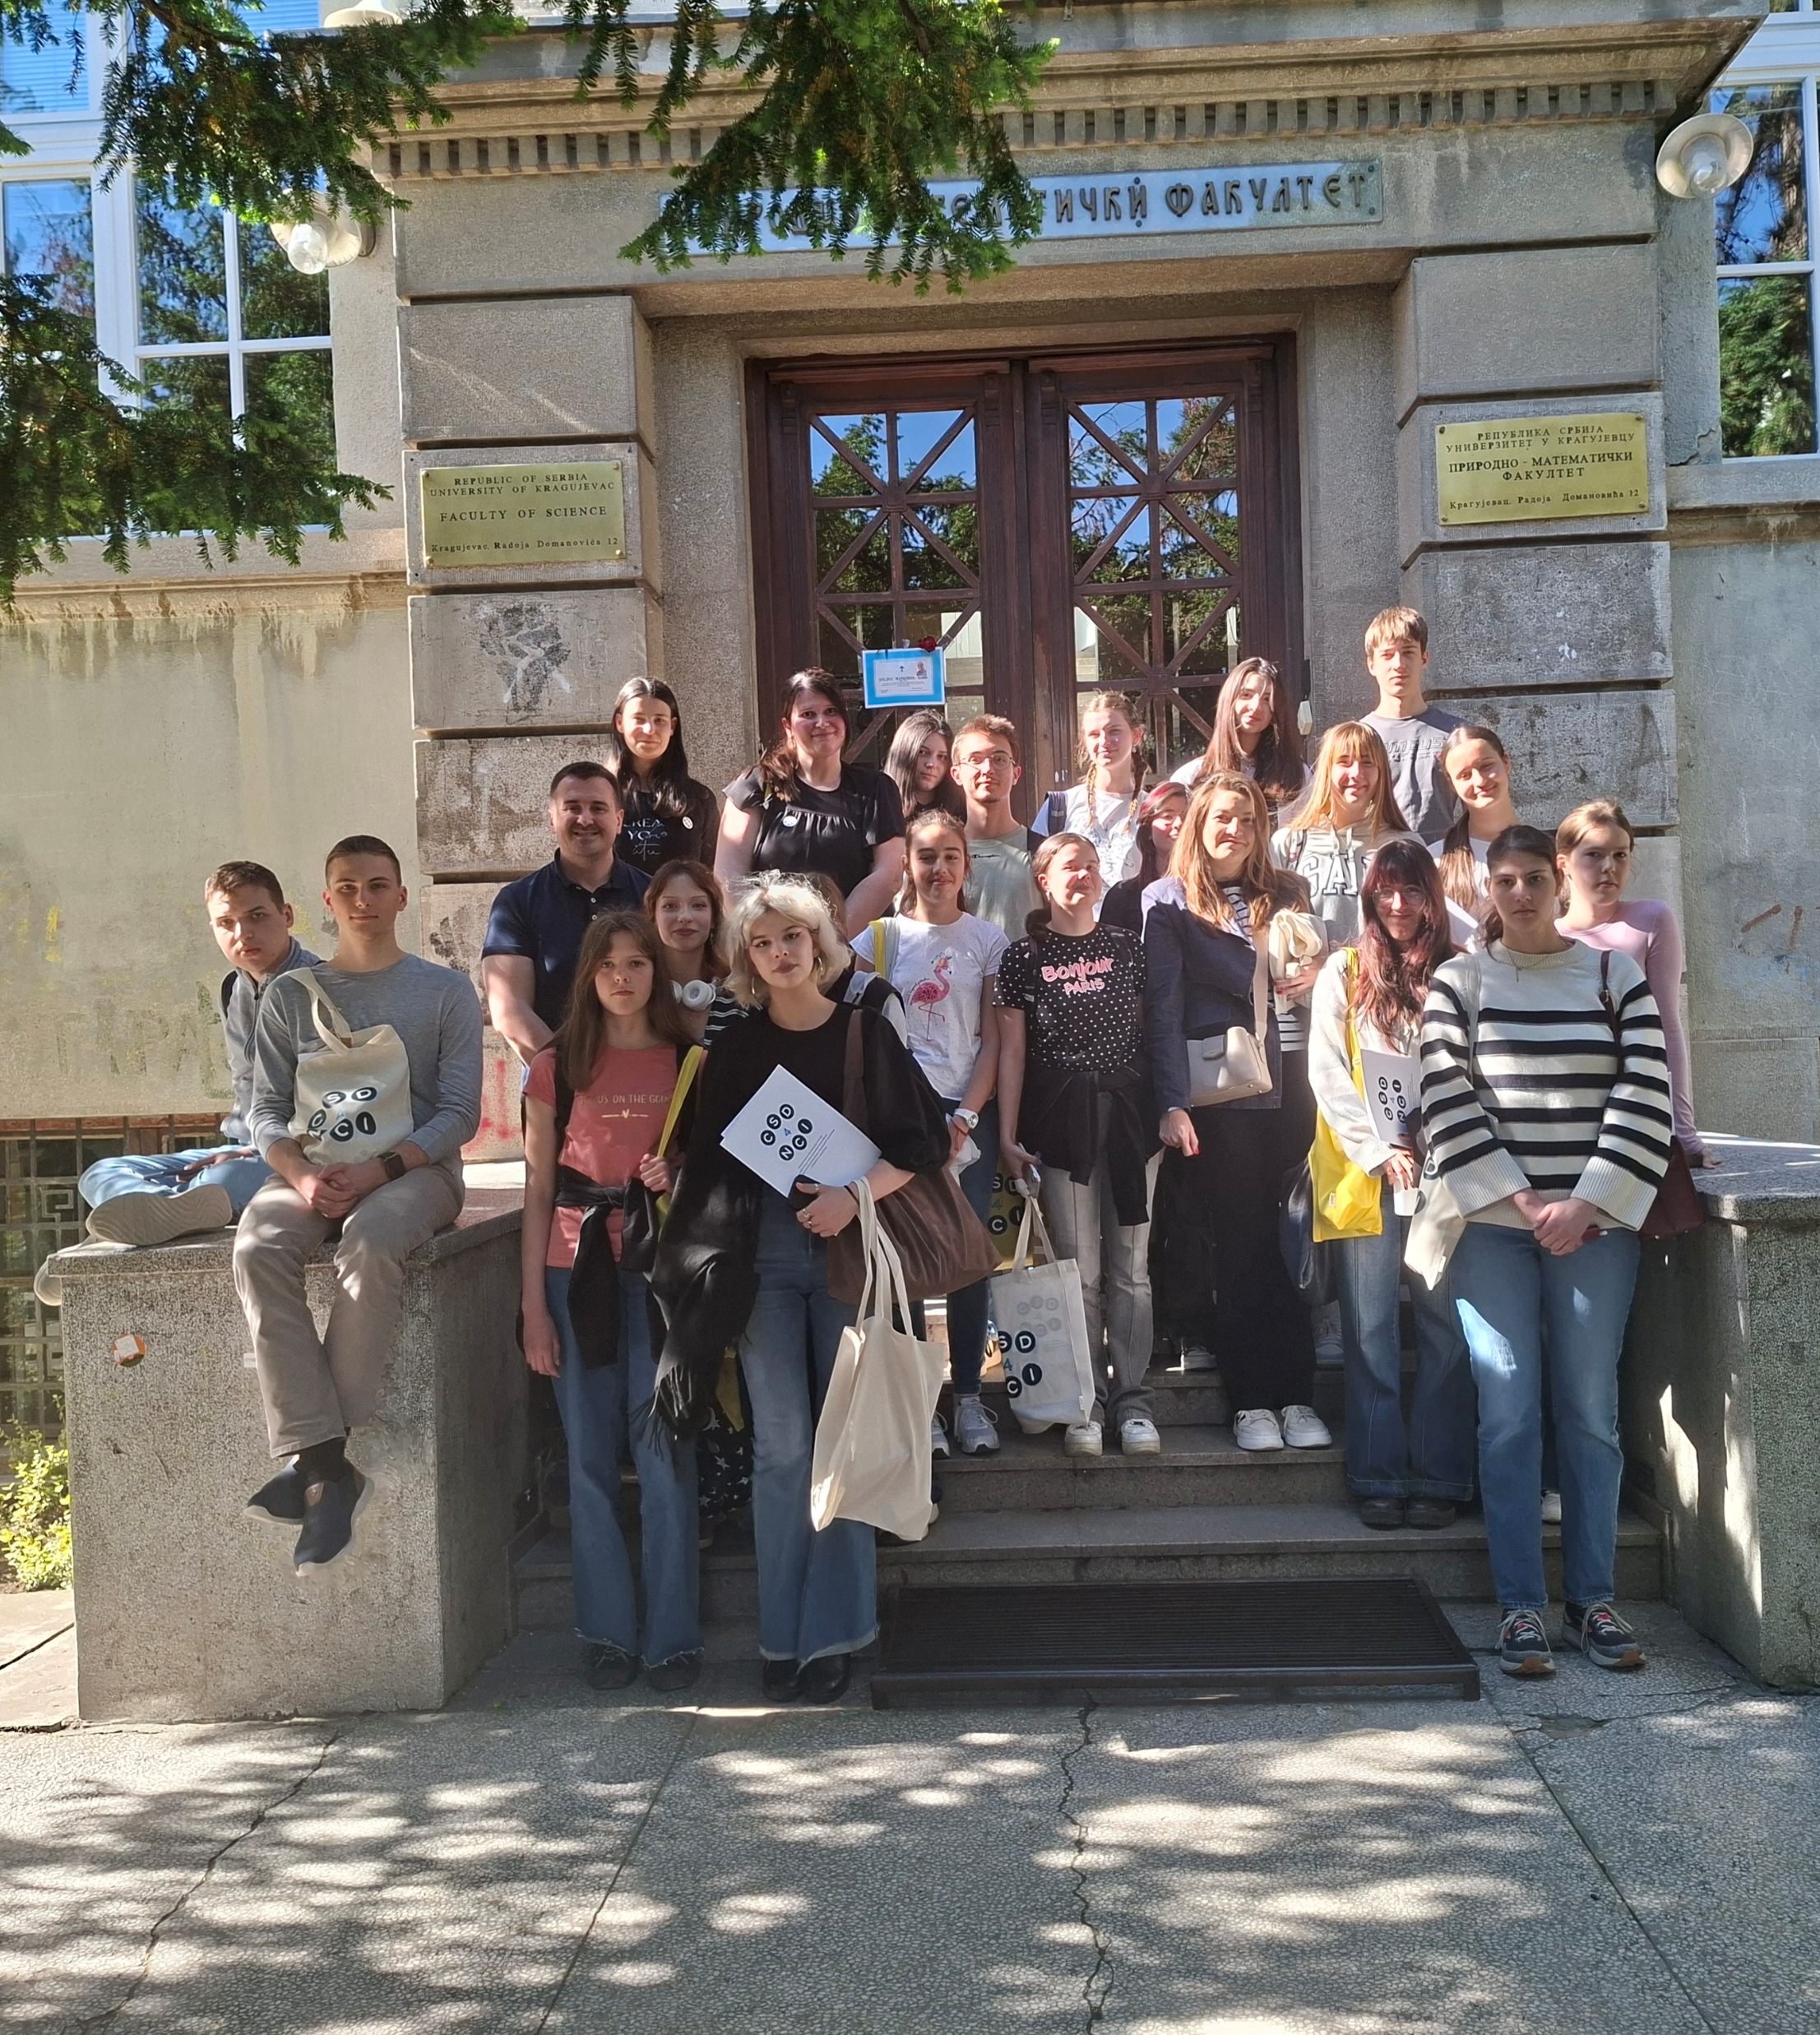
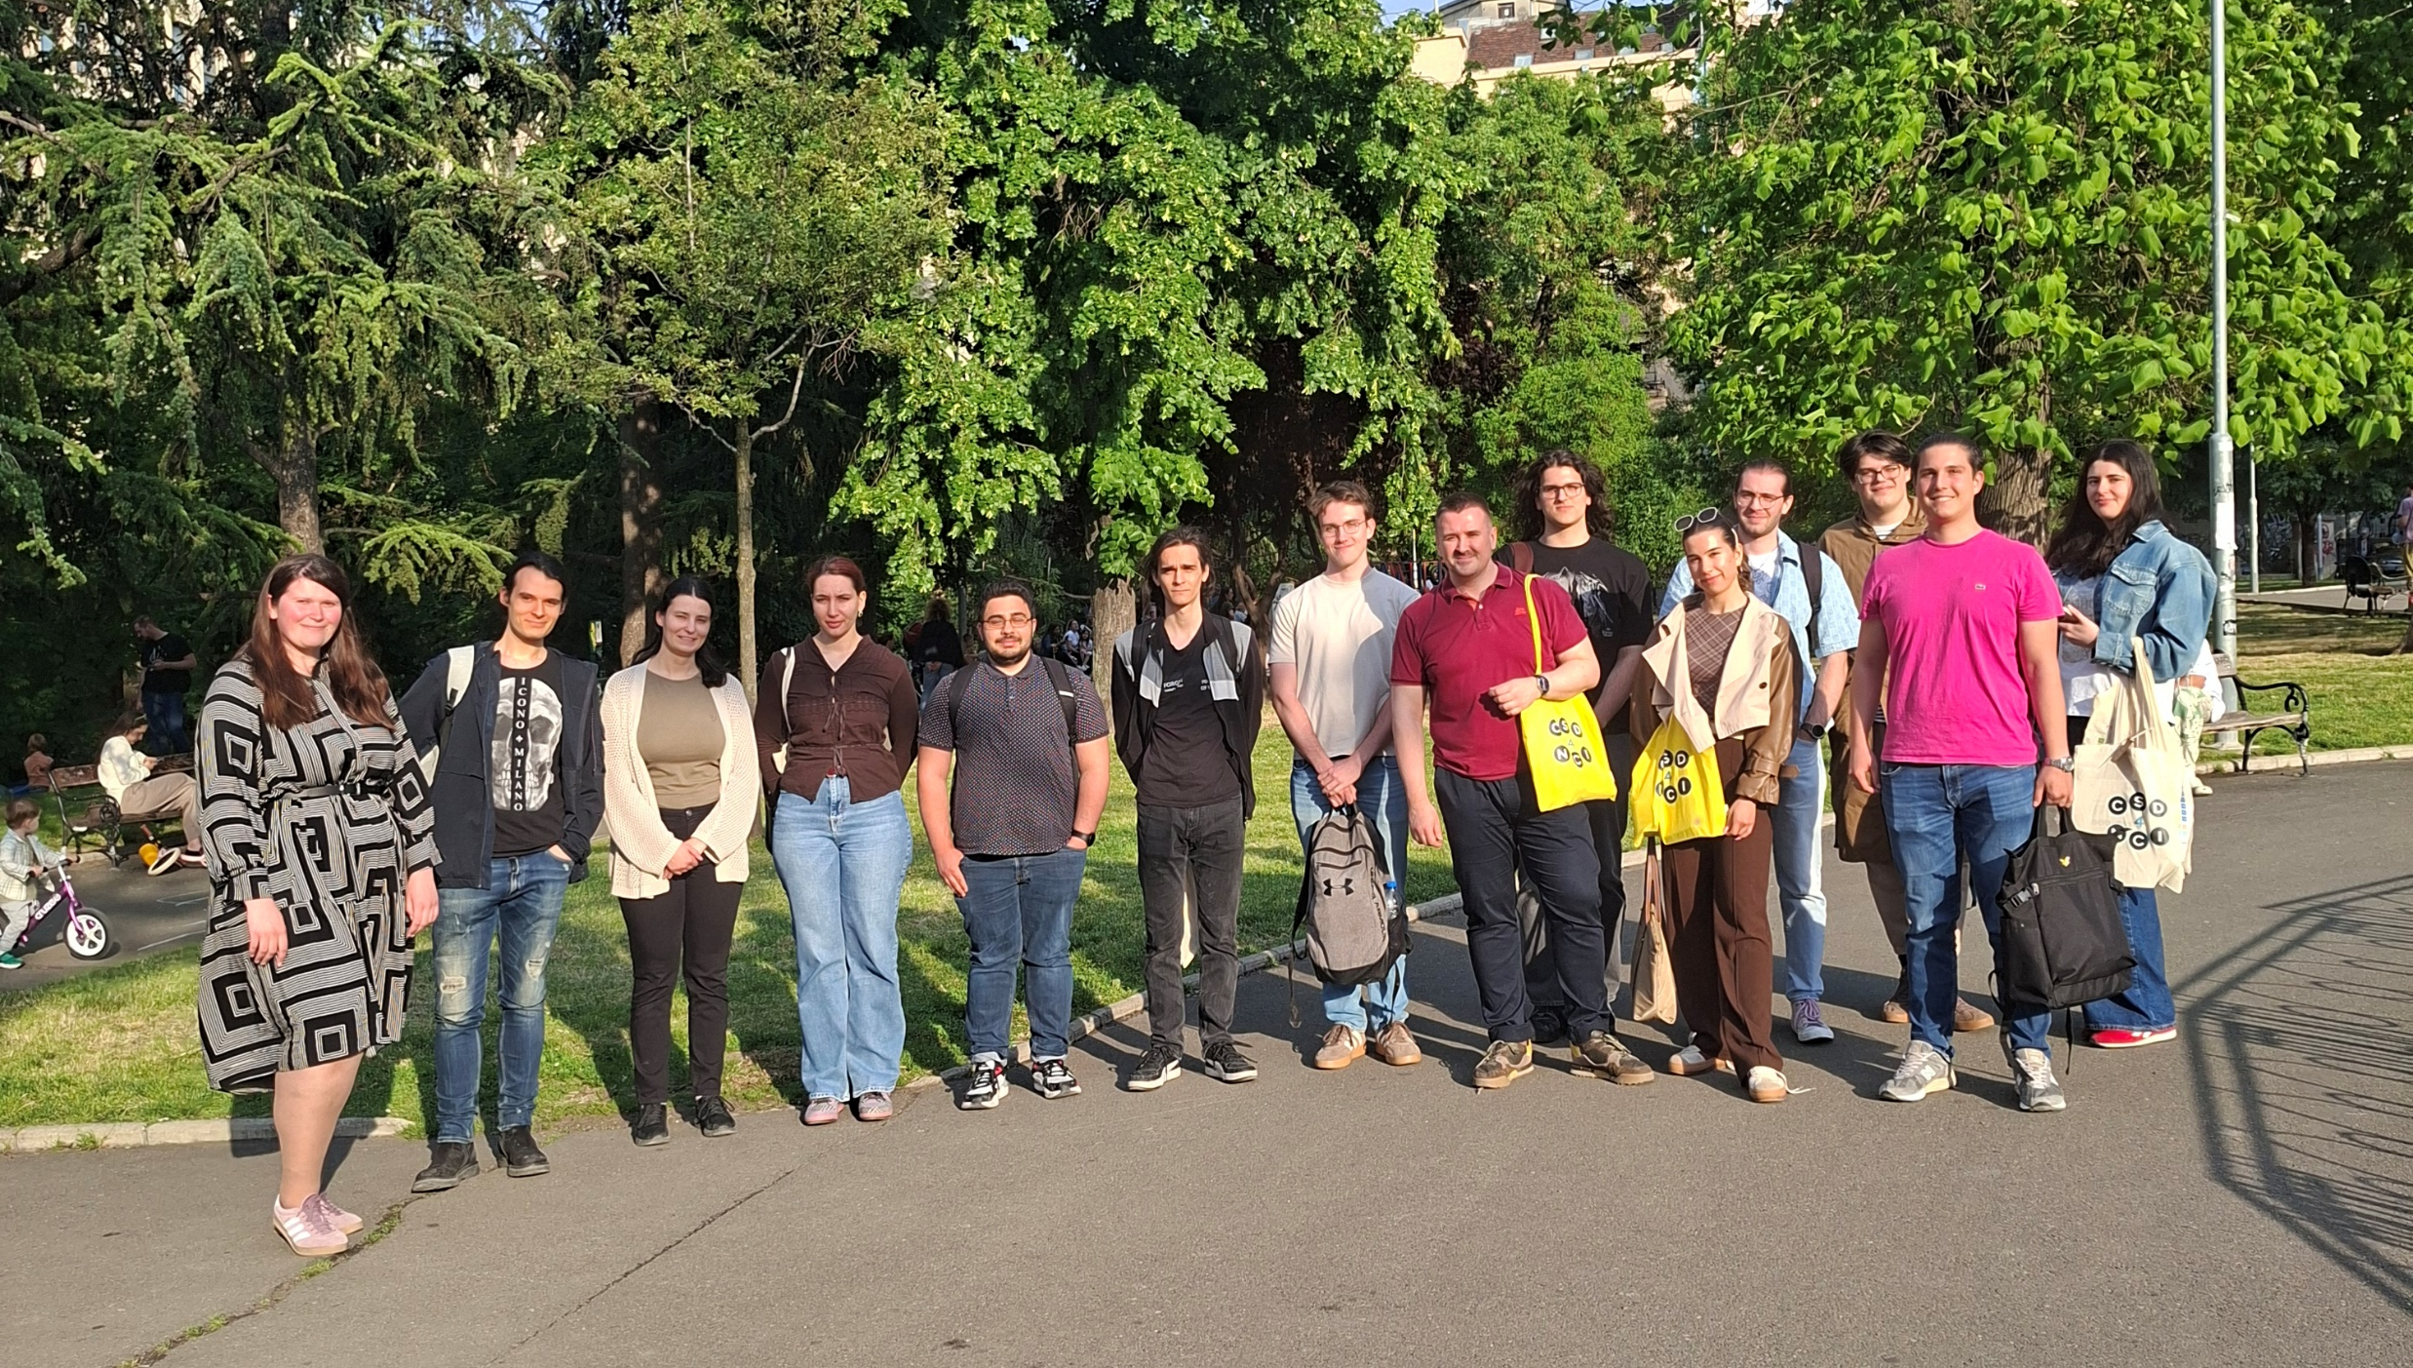
Kragujevac – 15 May 2026
university students (undergraduate)
CSD4NCI Workshops
Kragujevac – 14 May 2026
high school students
(to be continued...)
Belgrade – 21 May 2026
university students (undergraduate)

Slide 22
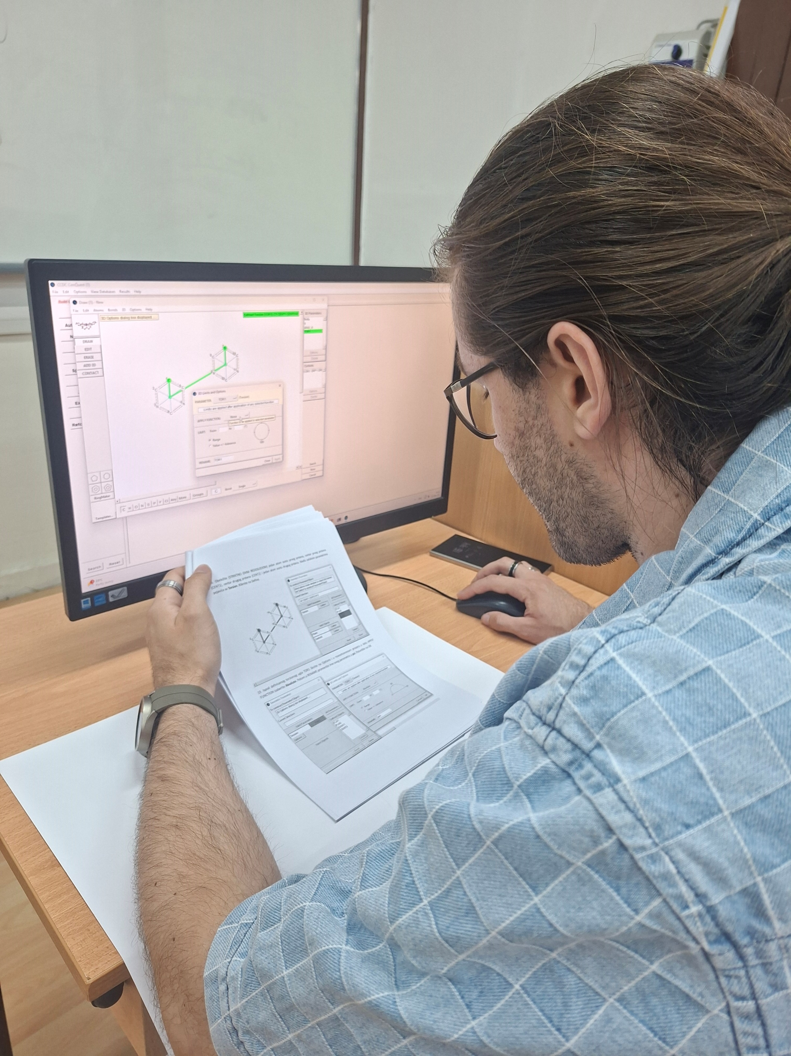
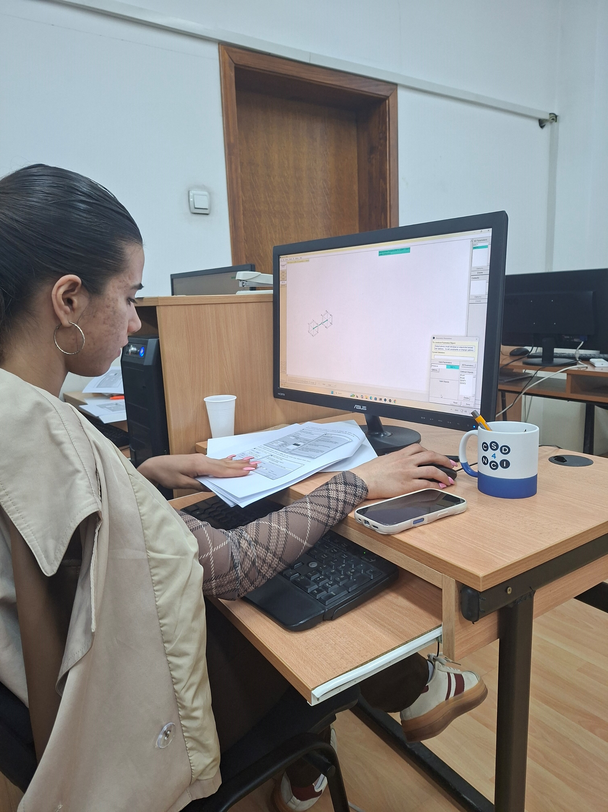
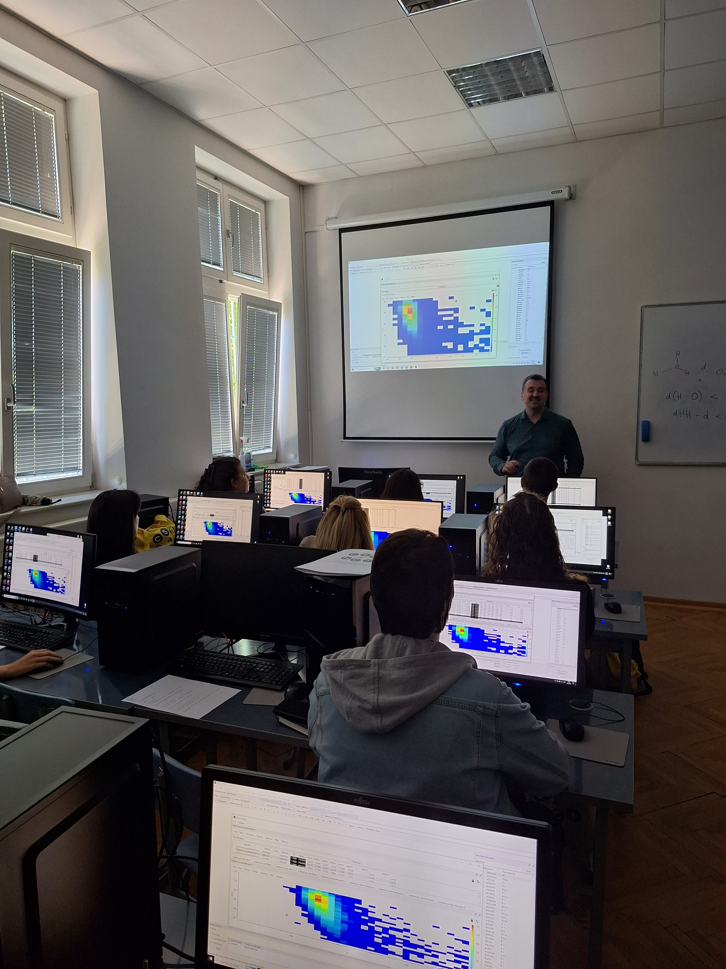
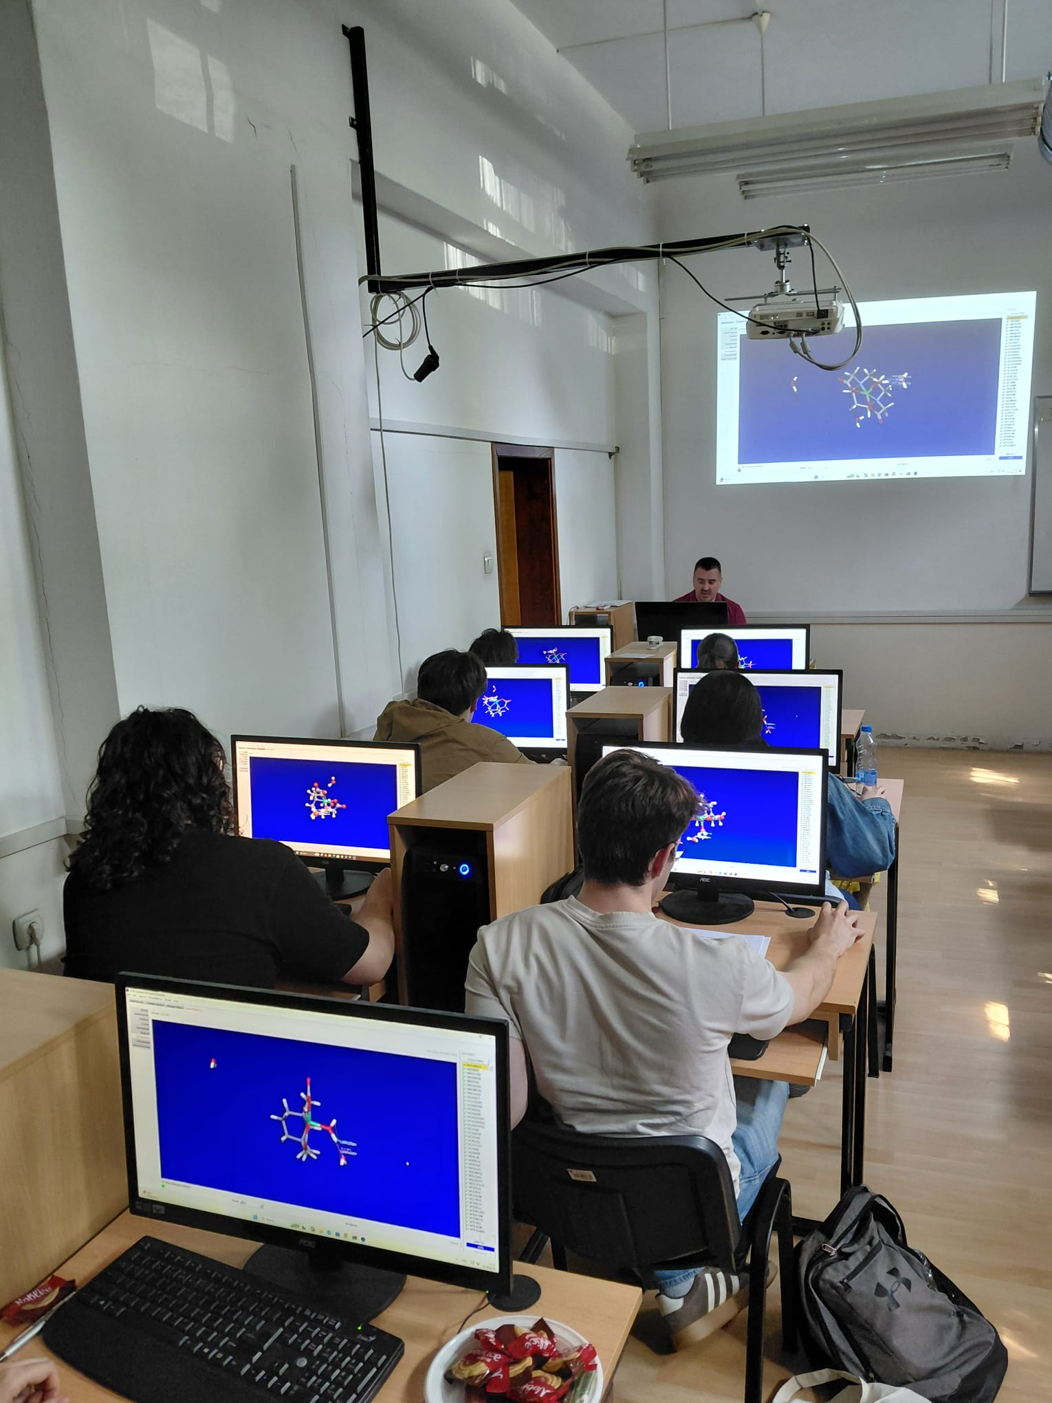
CSD4NCI Workshops
Kragujevac – 14 May 2026
Kragujevac – 15 May 2026
Belgrade – 21 May 2026
(to be continued...)

Slide 23

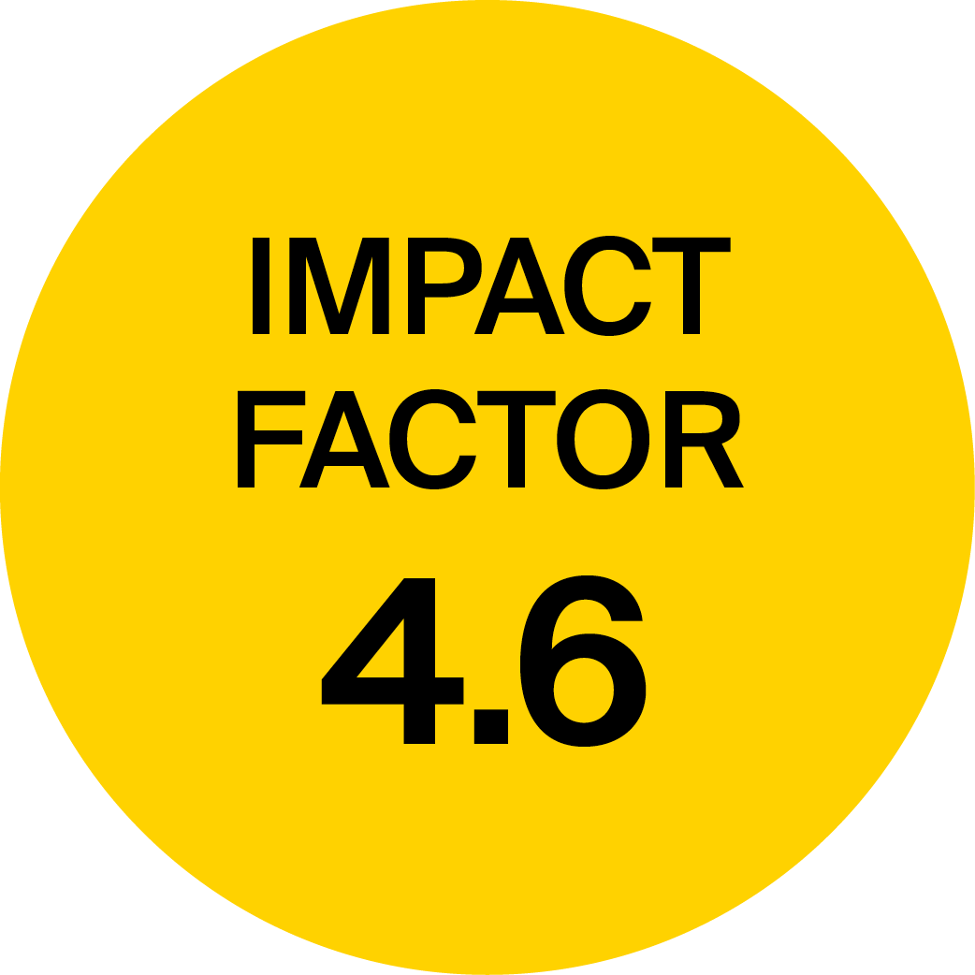



Computational Chemistry of Non-Covalent and Coordination Interactions
Special Issue Information
Guest Editors
Within this Special Issue, we would like to welcome contributions that apply state-of-the-art computational methods, including quantum chemistry, density functional theory, molecular dynamics, as well as the cheminformatics approach, to study various types of noncovalent interactions. We welcome contributions related to interactions of both organic and inorganic compounds, and we particularly encourage works on noncovalent and coordination interactions in transition metal complexes. This Special Issue will focus on novel computational insights into hydrogen and halogen bonds, stacking interactions, and cation-π and anion-π interactions. We would also like to welcome contributions related to other new and exciting types of noncovalent interactions recognized in recent years.
Dr. Dušan Malenov
Dr. Slađana Đorđević
Deadline for Manuscript
Submissions: 31 December 2026
Keywords
noncovalent interactions
coordination compounds
hydrogen bonds
metal complexes
stacking interactions
π-interactions
computational chemistry
density functional theory
mdpi.com/si/271129

Slide 24
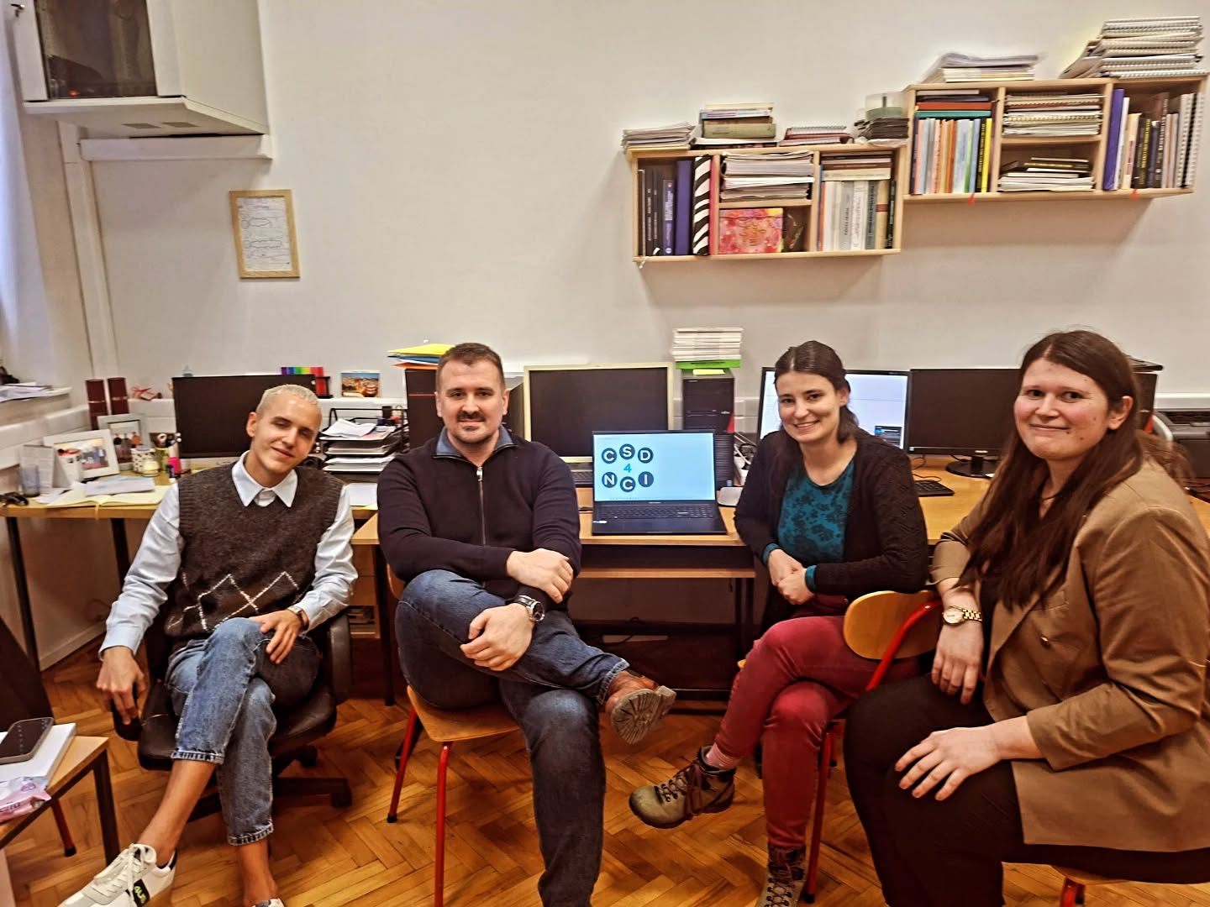

Acknowledgements
Dr. Slađana Đorđević
Katarina Ćeranić
Filip Stašević

